Slide 1
Session 1 Scarcity and Opportunity Costs
Disclaimer: The views expressed are those of the presenters and do not necessarily reflect those of the Federal Reserve Bank of Dallas or the Federal Reserve System.
.

Slide 2
TEKS
(1) Economics. The student understands the concepts of scarcity and opportunity costs. The student is expected to:
(A) explain why scarcity and choice are basic economic problems faced by every society;
(B) describe how societies answer the basic economic questions;
(C) describe the economic factors of production; and
(D) interpret a production-possibilities curve and explain the concepts of opportunity costs and scarcity.

Slide 3
Teaching the Terms
Scarcity
Opportunity costs
Marginal decisionmaking
Factors of production
Production possibilities curve

Slide 4
“Economics is a study of mankind in the ordinary business of life.”
-Alfred Marshall

Slide 5
Scarcity
Resources are scarce, so people face tradeoffs
Time, income, the number of miles of beachfront property, etc.
The real limit is the scarcity of productive resources (factors of production)
Society has unlimited wants in the face of limited resources

Slide 6
Scarcity
Tradeoffs
Opportunity Cost

Slide 7
Opportunity Costs
Tradeoffs imply costs – when a decision is made, something is forgone
The cost of getting something is what you give up to get it
Opportunity cost – the value of the next best alternative when a decision is made
Notes:
Examples
Beach or mountains for vacation
iPod or new clothes
Nap or clean house
Hamburger or salad
Economics major or history major

Slide 8
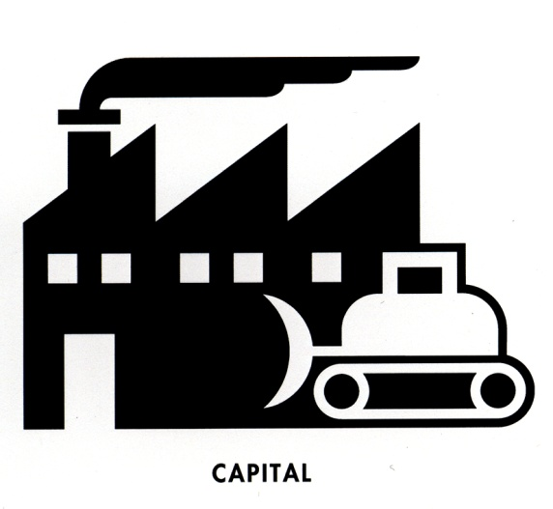
Factors of Production

Slide 9
Model: Production Possibility Curve
Economic Concepts
Trade-offs
Opportunity costs
Also
Economic growth
Efficiency
Tractors
A
C
B
D
Cars

Slide 10
Marginal Decisionmaking
Most decisions are made incrementally – costs and benefits are weighed at each step
Examples
How clean is clean enough?
How long should a student study?
How many tractors and cars should be produced?

Slide 11
Basic Economic Questions
What to produce?
How to produce?
Who will consume?
What should be made using available resources?
What combination of resources should be used?
How will production be allocated?

Slide 12
Questions?

