Slide 1
Session 3 Circular Flow
Disclaimer: The views expressed are those of the presenters and do not necessarily reflect those of the Federal Reserve Bank of Dallas or the Federal Reserve System.

Slide 2
TEKS
(8) Economics. The student understands the circular-flow model of the economy. The student is expected to:
(A) interpret the roles of resource owners and firms in a circular-flow model of the economy and provide real-world examples to illustrate elements of the model;
(B) explain how government actions affect the circular-flow model; and
(C) explain how the circular-flow model is affected by the rest of the world.

Slide 3
Teaching the Terms
Factors of production
Markets
Firms
Households
Entrepreneurs
Profit

Slide 4
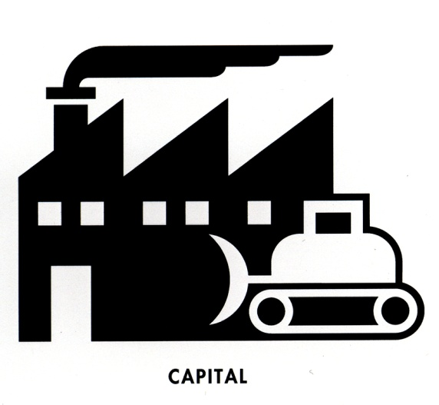
Factors of Production

Slide 5
Simulation
Half of the group will be entrepreneurs
Wear an “entrepreneur badge” that signifies your innate talent
Envelope contains money that may be used to buy resources
Sets of resources can be brought to the “factory” and traded for “econos,” which can be sold
The goal of the entrepreneur is to make a profit!

Slide 6
Simulation
Half of the group will be households
Each household possess a different combination of resources
Households sell resources and derive income
Income can be used to purchase goods and services, called “econos”
Households seek to increase their standard of living by acquiring “econos”

Slide 7
Simulation – Debrief
Were you a buyer or a seller?
What motivated you?
How many different types of markets did you observe?

Slide 8
Circular Flow
Resources
Land, Labor, Capital, Entrepreneurship
Resource Payments
Rent, Wages, Interest, Profit
Household Expenditures
Business Revenues
Goods and Services
Goods and Services

Slide 9
Circular Flow
Resources
Land, Labor, Capital, Entrepreneurship
Resource Market
Resource Payments
Rent, Wages, Interest, Profit
Households
Businesses
Household Expenditures
Business Revenues
Product Market
Goods and Services
Goods and Services

Slide 10
Resource Market
Businesses
Households
Government
Product Market

Slide 11
Resource Payments
Rent, Wages, Interest, Profit
Resources
Land, Labor, Capital, Entrepreneurship
Services
Resource Market
Households
Businesses
Government
Product Market
Expenditures
Goods and Services
Taxes

Slide 12
Questions?

