Slide 1
Session 7
International Trade:
Comparative Advantage and Trade Barriers
Disclaimer: The views expressed are those of the presenters and do not necessarily reflect those of the Federal Reserve Bank of Dallas or the Federal Reserve System.

Slide 2
TEKS
(3) Economics. The student understands the reasons for international trade and its importance to the United States and the global economy. The student is expected to:
  (A) explain the concepts of absolute and comparative advantages;
  (B) apply the concept of comparative advantage to explain why and how countries trade; and
  (C) analyze the impact of U.S. imports and exports on the United States and its trading partners.
(4) Economics. The student understands the issues of free trade and the effects of trade barriers. The student is expected to:
  (A) compare the effects of free trade and trade barriers on economic activities;
  evaluate the benefits and costs of participation in international free-trade agreements

Slide 3
Teaching the Terms
Absolute advantage
Comparative advantage
Opportunity cost
Factor endowments
Imports
Exports
Tariffs
Quotas
Subsidies

Slide 4
Pizza and Rugs Activity

Slide 5
Why trade?
All trade is voluntary
People trade because they believe that they will be better off by trading
Notes:
So why do people trade? People trade because they believe that they will be better off by trading than by not trading
Imagine what life would look like without trade. We would have to produce all the goods and services we use by ourselves. We would wind up spending all of our time just trying to produce the things necessary for survival. When we trade we don’t have to produce everything for ourselves. We can focus our efforts on producing those goods and services we are best suited for. We then trade with others for the goods and services we need.
International trade is very similar to trading domestically. We produce those goods and services we are best suited at and trade with other nations for the goods and services they are best suited at producing.
So again, we ask “Why Trade”

Slide 6
Absolute Advantage
“The natural advantages which one country has over another in producing particular commodities are sometimes so great that it is acknowledged by all the world to be in vain to struggle with them.”
Adam Smith in “Wealth of Nations” Book IV, Chapter 2

Slide 7
Comparative Advantage
David Ricardo extended the ideas of Adam Smith
Nations could benefit from trade based on comparative advantage, not just absolute advantage
Comparative advantage refers to a country’s ability to produce a good at a lower opportunity cost than another country

Slide 8
Sources of Comparative Advantage
Differences in technology
Differences in climate
Differences in factor endowments
  Factors of production – land, labor and capital
  Factor intensity – the factor that is used intensively in production
  Heckscher-Ohlin model
Notes:
Heckscher-Ohlin – countries will export goods that intensively use the resources that the country has in abundance
Leontief paradox – revealed that the U.S. exports skill-intensive production

Slide 9
Imagine an island with only two trees but lots of boats. The islanders produce two goods, coconuts and fish.
A nearby island has many trees, but it has very few boats.
Initially, there is no contact between the islands. However, a new navigational device will soon allow shipments between the islands. What will happen?
Notes:
Island has only two trees but lots of boats – leads to cheap fish and expensive coconuts in autarky.
Trade with a new island with lots of trees and few boats (expensive fish and cheap coconuts).
On our island results in cheap fish being exported. This is great for the boat owners, the boats are at sea 7 days a week etc. Good for sailors and fishers, lots of work. New markets cause the price of fish to rise.
On the other hand, the expensive coconuts no longer look very attractive. Faced with competition from producers from the other island, coconut production declines. Tree climbers might eventually learn to sail, but not right away. The value of owning coconut trees is diminished.

Slide 10
Only two trees → expensive domestic coconuts before trade
Imported foreign coconuts are cheap
Domestic price of coconuts ↓ with trade
Lots of boats → cheap domestic fish before trade
New export markets for fish increases demand
Domestic price of fish ↑ with trade
Notes:
Island has only two trees but lots of boats – leads to cheap fish and expensive coconuts in autarky.
Trade with a new island with lots of trees and few boats (expensive fish and cheap coconuts).
On our island results in cheap fish being exported. This is great for the boat owners, the boats are at sea 7 days a week etc. Good for sailors and fishers, lots of work. New markets cause the price of fish to rise.
On the other hand, the expensive coconuts no longer look very attractive. Faced with competition from producers from the other island, coconut production declines. Tree climbers might eventually learn to sail, but not right away. The value of owning coconut trees is diminished.

Slide 11
Who cares about the price of coconuts?
  People who own trees (land)
  People who climb trees (labor)
Who cares about the price of fish?
  People who own boats (capital)
  People who sail and fish (labor)
Notes:
Island has only two trees but lots of boats – leads to cheap fish and expensive coconuts in autarky.
Trade with a new island with lots of trees and few boats (expensive fish and cheap coconuts).
On our island results in cheap fish being exported. This is great for the boat owners, the boats are at sea 7 days a week etc. Good for sailors and fishers, lots of work. New markets cause the price of fish to rise.
On the other hand, the expensive coconuts no longer look very attractive. Faced with competition from producers from the other island, coconut production declines. Tree climbers might eventually learn to sail, but not right away. The value of owning coconut trees is diminished.

Slide 12
Who could object?
Domestic price is higher than world price.
Country begins to import and domestic price falls.
Domestic consumers benefit.
Domestic producers are harmed.

Slide 13
C

Slide 14
Who could object?
Domestic price is lower than world price.
Country begins to export and domestic price rises.
Domestic producers benefit.
Domestic consumers are harmed.

Slide 15
C

Slide 16
Who could object?
The total gains from specialization and trade are greater than the losses
But those gains do not necessarily go to the parties who lost welfare because of the trade
The challenge becomes the willingness of “winners” to compensate “losers”

Slide 17
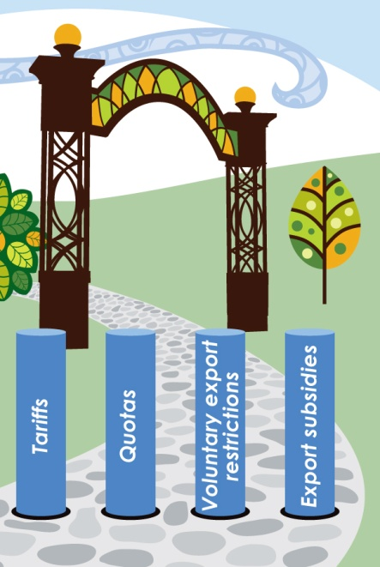
Barriers to Trade
Notes:
Tariffs – taxes on imports
Quotas – limits on the quantity of imports
Voluntary Export Restrictions – a self-imposed limit on the quantity of exports
Export Subsidies – government payments to producers of goods for export

Slide 18
Tariff
Tax on imported goods or services
Reasons for tariffs
  Raise tax revenues
  Reduce consumption of the imported good or service
Effect – Price of import rises, “cheaper” domestic goods become more attractive

Slide 19
Quota
Limits the amount of an imported good allowed into the country
Supply is decreased and price increases
Voluntary Export Restrictions (VER’s) are similar

Slide 20
Export Subsidy
Government financial assistance to a firm that allows a firm to sell its product at a reduced price
Benefits and harms
  Consumers (both at home and abroad) benefit from lower prices
  Foreign producers are harmed because of lower world prices
  Taxpayers in the producing country pay the subsidy

Slide 21
Product Standards
A type of “hidden” trade barrier
Types of standards
  Product safety
  Content
  Packaging

Slide 22
Trade Agreements
General Agreement on Trade and Tariffs (GATT) and World Trade Organization (WTO)
Regional trade agreements

Slide 23
GATT
“Provisional” agreement (1948 – 1994)
Dramatic tariff reductions were negotiated in a series of trade rounds
Grew from 23 to 123 countries

Slide 24
WTO
WTO created in the Uruguay trade round
Established in Geneva in 1995
153 member countries
GATT was updated and still forms the legal framework for WTO negotiations on the goods trade

Slide 25
What is the WTO?
A negotiating forum
A set of rules (international agreements)
  GATT
  GATS (General Agreement on Trade in Services)
  TRIPS (Agreement on Trade-Related Aspects of Intellectual Property Rights)
A place to settle trade disputes

Slide 26
Regional Trade Agreements
Examples include
  North American Free Trade Agreement
  Association of Southeast Asian Nations
  Common Market of the South (MERCOSUR)
  European Union
Regional agreements have been praised and criticized

Slide 27
Questions?

