Slide 1
Session 9 GDP and Growth
Disclaimer: The views expressed are those of the presenters and do not necessarily reflect those of the Federal Reserve Bank of Dallas or the Federal Reserve System.

Slide 2
TEKS
(10) Economics. The student understands key economic measurements. The student is expected to:
(A) interpret economic data, including unemployment rate, gross domestic product, gross domestic product per capita as a measure of national wealth, and rate of inflation; and
(B) analyze business cycles using key economic indicators.
(11) Economics. The student understands key components of economic growth. The student is expected to:
(A) analyze how productivity relates to growth;
(B) analyze how technology relates to growth; and
(C) analyze how trade relates to growth.

Slide 3
Teaching the Terms
Macroeconomics
Gross domestic product
Per capita GDP
Economic growth
Growth rate
Consumption
Investment
Gross national product
Aggregate

Slide 4
Macroeconomics
Big picture not individual decisions
Think about…
Consumer expenditures, not Coke vs. Pepsi
Prices of all goods, rather than a single item

Slide 5
Measuring the Economy
Measuring production using GDP
Economic growth
Business cycle

Slide 6
Why Worry about GDP?
Real GDP
Income
Employment

Slide 7
Gross Domestic Product
Gross domestic product (GDP) is the
total market (or dollar) value
of all final goods and services
produced in a country
during a given period of time
GDP does not include
Work in homes
Criminal activity
Underground economy

Slide 8
Is it part of GDP?
A parent that stays home to care for a baby
Dinner at a restaurant
Dinner at home
A social security check
A haircut
The construction of an office building
The sale of a ten-year-old house
An oil change
Interest on a CD at your bank
A new car
Tires purchased by Ford to put on a new car

Slide 9
Is it part of GDP?
A parent that stays home to care for a baby – No
Dinner at a restaurant – Yes
Dinner at home – No, but yes on the groceries
A social security check – No
A haircut – Yes, unless you did it yourself
The construction of an office building – Yes
The sale of a ten-year-old house – No
An oil change – Yes, unless you did it yourself
Interest on a CD at your bank – No
A new car – Yes
Tires purchased by Ford to put on a new car – No

Slide 10
GDP: Two Methods
Expenditure method (product market) – what is produced is also purchased
Income method (resource market) – the total value is the sum of all the parts

Slide 11
Circular Flow
Resources
Land, Labor, Capital, Entrepreneurship
Resource Market
Resource Payments
Rent, Wages, Interest, Profit
Households
Businesses
Household Expenditures
Business Revenues
Product Market
Goods and Services
Goods and Services

Slide 12
Expenditures → GDP = C + I + G + Xn
Consumption (C)
Government purchases (G)
Consumer durables
Consumer nondurables
Services
Investment (I)
Business investment
Residential investment
Inventory investment
Federal
State
Local
NOT transfer payments
Net exports (Xn)
Exports
MINUS Imports

Slide 13
Income → GDP ≈ W + R + I + P
Labor
Wages
Land
Rent
Capital
Interest
Entrepreneur
Profit

Slide 14
2008 Gross Domestic Product (in billions of current US$ from the World Bank)

Slide 15
2010 Gross Domestic Product (in billions of current US$ from the World Bank)

Slide 16
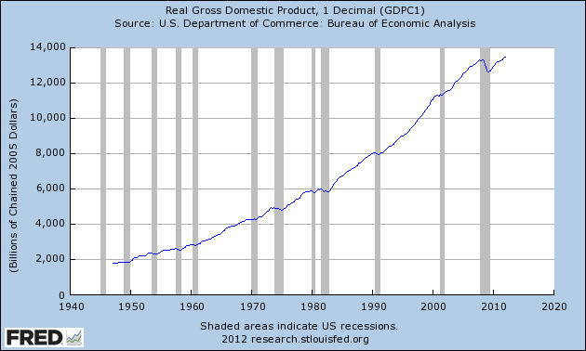
Real GDP in the U.S.

Slide 17
Three Variations on GDP
Per Capita GDP
Real GDP vs. nominal GDP
GDP vs. GNP

Slide 18
Per Capita GDP
Per capita GDP = GDP ÷ population
Average level of income in a nation
Not income distribution

Slide 19
2008 per capita GDP (in current US$ from the World Bank)

Slide 20
2010 per capita GDP (in current US$ from the World Bank)

Slide 21
Nominal GDP vs. Real GDP
Nominal GDP – current production at current prices
Real GDP – current production at base year prices
To convert, use the GDP deflator
GDP Deflator = (Nominal GDP / Real GDP) * 100

Slide 22
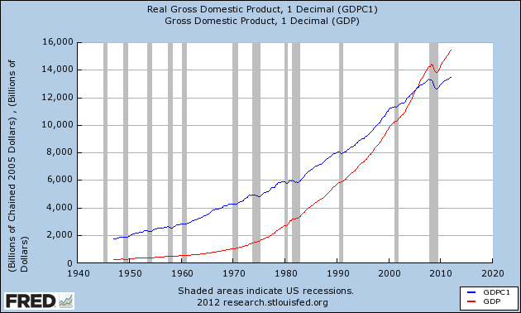
Graph of nominal vs. real

Slide 23
Gross National Product
GNP – total market value of all final goods and services produced in a year from factors of production (resources) owned by country’s residents
GNP is produced with the resources owned by the country (anywhere in the world).
GDP is produced inside the country’s borders.

Slide 24
GDP vs. GNP

Slide 25
Limits of GDP Measure
Leisure time
Nonmarket economic activities
Environmental quality and resource depletion
Quality of life
Poverty and economic inequality
International GDP comparisons based on exchange rates, which can introduce bias

Slide 26
Consider this…
“[GDP] does not allow for the health of our children, the quality of their education, or the joy of their play. It does not include the beauty of our poetry or the strength of our marriages, the intelligence of our public debate or the integrity of our public officials.”
Robert Kennedy

Slide 27
Concerns about GDP
The Rise and Fall of the GDP
New York Times Magazine (5/16/2010)

Slide 28
Economic Growth
What is it?
Steady (long-term) increase in the quantity and quality of goods and services an economy can produce
Why do we care?
It affects living standards
How do we measure it?
Percentage change in real GDP

Slide 29
Determinants
Growth
Technology
Productivity
Trade
Availability of resources

Slide 30
Rule of 72
72 ÷ annual % growth ≈ Years to double value
Shows the number of years required for a variable to double at a given annual rate of growth

Slide 31
Rule of 72
An economy that grows at 2% per year will double its GDP in about 36 years
(72 ÷ 2 = 36)
An economy that grows at 7% per year will double its GDP in just over 10 years
(72 ÷ 7 = 10.3)
An investment that earns a 4% annual return will double in value in about 18 years
(72 ÷ 4 = 18)

Slide 32
2010 Growth Rates and Doubling Time (World Bank)
Country | Annual Growth Rate | Years to Double
United States | 3.0% | 24
Mexico | 5.5% | 13.09
Greece | -3.5%
South Africa | 2.8% | 25.7
Australia | 2.2% | 32.7
Brazil | 7.5% | 9.6
Russian Federation | 4.0% | 18
India | 8.8% | 8.1
China | 10.4% | 7.0

Slide 33
Production Possibility Curve
Shows trade-offs, opportunity costs and efficiency
Model also shows economic growth as an outward shift as society can increase production
Capital Goods
A
C
B
D
Consumer Goods

Slide 34
Business Cycle
Real GDP
Long-Run Growth Trend
Peak
Expansion
Recession
Trough
Time

Slide 35
A New Model
Price
Price level
Quantity
Real GDP
Demand and supply
Aggregate demand and aggregate supply

Slide 36
Supply → Aggregate Supply
Price → Price Level
PL₁
Demand →
Aggregate Demand
Y_{F}
Full Employment Level of Output
Quantity →
Real GDP

Slide 37
AD/AS Model
AD/AS model is used to explain short-run fluctuations in economic activity around a long-run trend
Aggregate demand curve shows the quantity of goods and services that households, firms, government and customers abroad want to buy at each price level
Aggregate supply curve shows the quantity of goods and services that firms choose to produce and sell at each price level

Slide 38
Aggregate Demand
What causes the AD curve to shift?
Changes in consumption (C)
Changes in investment (I)
Changes in government purchases (G)
Changes in net exports (X_{n})
Remember,
GDP = C + I + G + X_{n} = AD

Slide 39
Aggregate Supply
What causes the SRAS to shift?
Changes in commodity (resource) prices
Changes in nominal wages
Changes in productivity (technology and otherwise)

Slide 40
Practice
Draw the graph.
Which curve is shifting because of the changing conditions? Aggregate Supply? Aggregate Demand? Both?
Which direction is the shift?
Draw the shift.
What is the impact on Price Level and Real GDP?

Slide 41
Price Level
Aggregate Supply
PL₁
Aggregate Demand
Y_{F}
Full Employment Level of Output
Real GDP

Slide 42
AD or AS
A $600 tax rebate check is sent to every taxpayer
Political instability in the Middle East leads to a rapid increase in the price of oil
New technology for drilling leads to a drop in the price of natural gas
A stronger dollar leads to a significant decline in tourist visits to the U.S.
New investment tax credits for green energy initiatives
Mandate for employer-provided health insurance

Slide 43
Questions?

