Slide 1
Banking in America Civil War to the Present
Disclaimer: The views expressed are those of the presenters and do not necessarily reflect those of the Federal Reserve Bank of Dallas or the Federal Reserve System.

Slide 2
The End of the State Banking Era
1861
$50M financed at different banks
Demand notes (greenbacks) are issued that are redeemable for specie “on demand”
1862
Legal Tender Act creates United States Notes
1863 – 64
Two National Bank Acts are passed

Slide 3
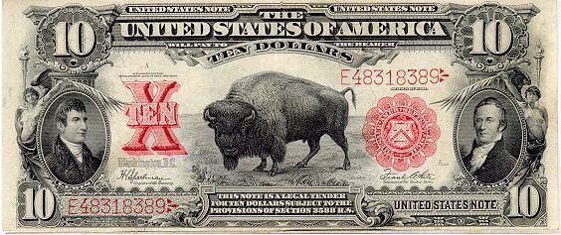
Legal Tender Note
Notes:
U.S. notes ended in 1971.
Treasury will also give face value.

Slide 4
National Bank Act
Created a uniform currency
Notes from different regions no longer discounted
Created federally chartered banks with uniform standards
Required to hold U.S. bonds as capital
Mandated supervision and examinations by Office of Comptroller of the Currency

Slide 5
National Currency

Slide 6
State Banks Attacked
Almost 1,600 in 1860, only 350 in 1865
10% tax placed on state bank notes – upheld by Supreme Court
Chief Justice Salmon P. Chase
State banks introduce demand deposits
Dual banking system still exists today!
Notes:
Congress placed 10% tax on state bank notes in March 1865 – to get uniform currency.
Supreme Court upheld challenge. Salmon P. Chase was Chief Justice. He was also Treasury Secretary in 1865 who proposed the tax!

Slide 7
Panic of 1873
Triggered by the collapse of Jay Cooke and Co.
largest bank in the U.S.
Agent for Northern Pacific Railroad bonds
Cooke’s bank could not sell enough railroad bonds to cover obligations
Led to a sell-off in the stock market
Runs on other large financial institutions led to their failure

Slide 8
Panic of 1893
Sparked by failure of Philadelphia and Reading Railroad
Withdrawal of European investment led to a crisis in railroad finance
Stock market crash and a banking panic followed
Created a run on the U.S. gold supply

Slide 9
Panic of 1907
Knickerbocker Trust Company failed leading to runs on other trust companies
Widespread panic
Bank failures
Shrinking money supply
Deep recession
J.P. Morgan, along with other bankers, served as lender of last resort and quelled the panic

Slide 10
The Role of a Central Bank
Issue and maintain the value of currency
Supervise banks
Serve as the fiscal agent for the government
Conduct monetary policy
Serve as a lender of last resort

Slide 11
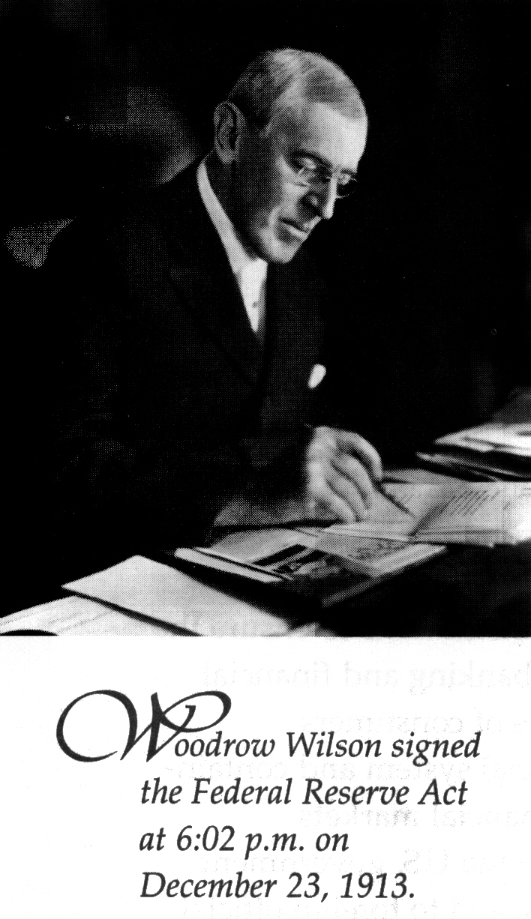
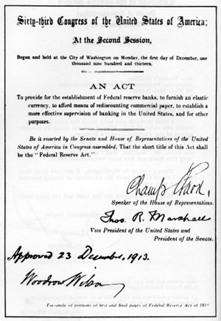
The Federal Reserve Act of 1913
“ to provide for the establishment of Federal reserve banks, to furnishing elastic currency, to afford means of rediscounting commercial paper, to establish a more effective supervision of banking in the United States, and for other purposes.”

Slide 12
The Federal Reserve Today

Slide 13
Structure of the Fed

Slide 14
Board of Governors
Daniel K. Tarullo
Ben Bernanke
Chairman

Slide 15
Federal Reserve Banks

Slide 16
Federal Open Market Committee FOMC

Slide 17
Three Responsibilities
Supervise and Regulate Banks
Provide Financial Services
Conduct Monetary Policy

Slide 18
Supervise and Regulate Banks
Board of Governors writes the rules that regulate financial institutions.
Reserve Banks supervise banks and enforce the rules during bank examinations.

Slide 19
Goals of Banking Supervision and Regulation
Safe and sound financial institutions
Financial Stability
Fair and equitable treatment of consumers

Slide 20
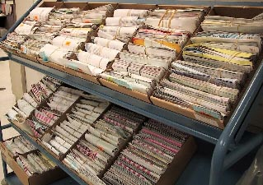
Financial Services
Cash services
Electronic payments
Check processing

Slide 21
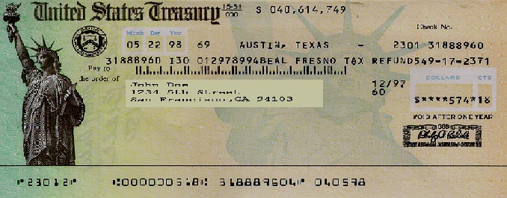
Financial Services for the U.S. Treasury
Banking services
Issuing, transferring and redeeming U.S. government securities

Slide 22
Economic Goals
Stable prices
Maximum employment

Slide 23
Achieving Economic Goals
Availability and cost of money and credit
Consumer and business spending
Employment and prices

Slide 24
Tools of Monetary Policy
Open Market Operations
Discount Rate
Reserve Requirements
Interest on Reserve Balances
Notes:
More tools than ever before

Slide 25
The Great Depression

Slide 26
Why is the “Great Depression” significant?
Worst economic crisis of the 20th century
Causes and cures still debated
Defining event in American history
Changed public’s expectations of the governments’ role in the economy

Slide 27
Stock Market Crash of 1929

Slide 28
Stock market crash of 1929
What was the role of the stock market crash?
Destroyed wealth
Reduced trust in the health of the financial system
Economic uncertainty (constrained spending)
Probably had some effect, but not big enough by itself to cause depression.

Slide 29
Three Schools of Thought
Keynesian explanation
Monetarist explanation
International explanation

Slide 30
John Maynard Keynes (1883—1946)
British economist
Principal representative for the British Treasury at Versailles – anticipated burden of reparation debt on Germany
Represented U.K. at Bretton Woods Conference after WWII

Slide 31
Keynesian Explanation
Prices fall
Consumer spending falls
Output falls
Revenue falls
Wages and employment down
Keynes advocated government spending to break this cycle.

Slide 32
Monetarist explanation
Shrinking supply of money and credit deepened and lengthened the Great Depression
Landmark book in 1963, A Monetary History of the United States, by Milton Friedman and Anna Schwartz

Slide 33
Monetarist Explanation
Withdrawn deposits
Bank reserves fall
Fewer loans
Spending falls
Prices and employment fall
Loan defaults
Bank failures

Slide 34
Where was the Fed?
Failed to serve as lender of last resort
Prevailing thought that failing banks should be allowed to fail
Many failed banks were small, nonmember banks
Few banks borrowed at the discount window
Raised interest rates in support of the gold standard

Slide 35
International explanation
Nations around the world experienced a downturn
Protectionist “beggar-thy-neighbor” tariffs
Smoot-Hawley tariff in the U.S.
International gold standard

Slide 36
The Collapse of World Trade
$ value imports of 75 countries

Slide 37
Smoot-Hawley Tariffs
Increased the cost of imported goods
Retaliatory measures from trading partners –which dried up foreign markets left products with nowhere to go.
Trade collapsed world wide – not just an American phenomena

Slide 38
Gold Standard
International system of fixed exchange rates
Domestic impact of global standard through gold as reserves in the bank system
Federal Reserve supported the gold standard

Slide 39
Supporting the Gold Standard
Allow gold to flow out of the country → bank lending is constrained
Raise interest rates → attract international investment and gold
How do these affect bank lending and consumer and business spending?

Slide 40
Since the Great Depression
Treasury-Fed Accords (1951)
Humphrey-Hawkins Act (1977)

Slide 41
Questions?

