Slide 1
American Banking Colonial Period to the Civil War

Slide 2
Money
“Among the conventions of almost every human society of historical record has been the use of money, that is, particular commodities or tokens as measures of value and media of exchange in economic transactions. Somehow the members of a society agree on what will be acceptable tender in making payments and settling debts among themselves. General agreement to the convention, not the particular media agreed upon, is the source of money's immense value to the society. In this respect money is similar to language, standard time, or the convention designating the side of the road for passing.”
James Tobin
From The New Palgrave Dictionary of Economics, Second Edition, 2008

Slide 3
Barter
Money facilitates trade.
Without it, we would barter.
Problems
Requires a double coincidence of wants
Inefficient
Time consuming
Difficult to satisfy wants and needs consistently

Slide 4
Functions of Money
Unit of account
Store of value
Medium of exchange

Slide 5
Characteristics of Money
Portable
Durable
Divisible
Uniform
Limited
Acceptable

Slide 6
Sources of Money’s Value
Commodity Money
Representative Money
Fiat Money
Medium of exchange has intrinsic value
Medium of exchange represents a claim on an item of value
Medium of exchange has value by government decree

Slide 7
Banks
Banks are institutions that bring together borrowers and savers.
Banks use short-term deposits to create longer-term loans.
Banks help savers avoid the cost of researching the risk of lending or investing.

Slide 8
Two Reasons Banks Fail
Borrowers fail to repay the loan
Depositors withdraw their assets (a bank run)

Slide 9
Colonial Period
Used a mix of currency and coins
British pounds
French francs
Spanish milled dollars
Shortage of money → barter
Paid for imports with gold or silver
Issuing paper currency was illegal, but colonists often ignored prohibition

Slide 10
Colonial Period
Notes:
Franklin is 23 years-old in 1729. He arrives in Philadelphia in 1723, goes to London from 1724 through 1725, then he returns to Philadelphia in 1726. Founds the Junto (APS) in 1727. Buys failing Pennsylvania Gazette press in 1729. This is the first pamphlet he publishes from his press.

Slide 11
Colonial Period
Notes:
B. Franklin printed Pennsylvania pound 20 shilling note, 1739. Note leaf-impression printing to minimize counterfeiting. Franklin first prints money for Pennsylvania in 1730/31 and continues through 1764, then sells out to partner Hall, as he returns to London for 1764-1774.

Slide 12
Domestic Exchange Rate?
Pennsylvania (1777)
Virginia (1776)

Slide 13
“Not worth a Continental”
Continental Congress issued currency in 1775
Excessive issuance of continentals led to inflation
Notes:
The phrase “Mind Your Business” is on the front.
Continental Congress chartered the Bank of North America (founded by Robert Morris) in 1781
Helped finance the war by buying and marketing bonds
Only a handful of banks existed before 1800.
Only 5 banks in 1792; 24 in 1800
Banks issued notes that circulated as currency.

Slide 14
Financial Challenges after Revolution
Shortage of money as economy expanded
No uniform currency that was accepted at par value
Government (federal and state) war debts
Federal government lacked a fiscal agent

Slide 15
Alexander Hamilton
First Secretary of Treasury
Advocated creation of a mint and a bank
Coinage Act of 1792
Created the U.S. Mint in Philadelphia
Set denominations for coins
Specified coins value in gold, silver and copper
Coin shortage remained
Notes:
George Washington reportedly contributed $75 worth of his personal tableware to provide the silver for the first coins.
Established U.S. mint

Slide 16
Debating a National Bank
Alexander Hamilton
Thomas Jefferson
Ideas of David Hume and Adam Smith
England’s use of public debt to build nation
Deliver capital to build the financial system
Financial monopoly would undermine state banks
National bank was unconstitutional
Vision of an agrarian (not commercial) society
Consolidate and finance federal and state debt

Slide 17
James Madison Objects
“…was condemned by the silence of the Constitution;
was condemned by the rule of interpretation arising out of the Constitution;
was condemned by its tendency to destroy the main characteristic of the Constitution;
was condemned by the expositions of the friends of the Constitution whilst depending before the public;
was condemned by the apparent intentions of the parties which ratified the Constitution;
was condemned by the explanatory amendments proposed by Congress themselves to the Constitution.”
Source: Banks and Politics in America, Bray Hammond, 1957, pp. 115-116.
Notes:
The proposal for a national bank was…

Slide 18
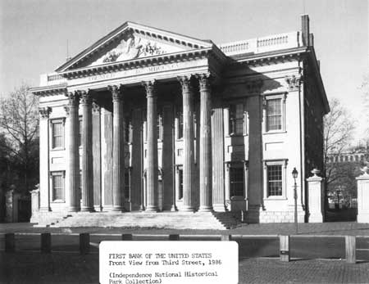
First Bank of the United States
Ownership
20% government owned
70% foreign owned
Only national bank
Located in Philadelphia
8 branches
20-year charter
1791 to 1811

Slide 19
Branches of the First Bank of the U.S.

Slide 20
First Bank of the United States
Government’s fiscal agent
Valid for payment of federal taxes
Private bank
Accepted deposits
Made loans (interest capped at 6%)
Circulated as currency
Convertible into gold or silver
Issued notes
Collected taxes (mainly customs duties)
Transferred funds through branches
Paid bills

Slide 21
First Bank of the United States
Not a central bank in the modern sense
Rudimentary monetary policy through holdings of notes from state banks
To constrain money growth → redeem notes and reduce reserves of specie
To speed money growth → hold notes and allow reserves of specie to grow

Slide 22
First Bank of the United States
Charter renewal rejected by a single vote in both the House and the Senate in 1811
Federalists were out of power
Opposition of state banks

Slide 23
State Banking from 1811 – 1816
War of 1812 reduced trade impacted custom duties
Federal government forced to rely on state banks to finance war
Inflation as state bank notes grew 150%
 | Exports | Imports
1811 | $61 M | $53 M
1816 | $7 M | $13 M
Notes:
From Ken:
No central institution for Treasury to deal with.
Sec. of State James Monroe pledged his personal fortune to secure funds for Andrew Jackson to move troops for Battle of N.O.

Slide 24
Madison’s Shift
“…as being precluded…by repeated recognitions, under varied circumstances, of the validity of such an institution, in acts of the legislative, executive, and judicial branches of the government, accompanied by indications in different modes of a concurrence of the general will of the nation…”
Source: Banks and Politics in America, Bray Hammond, 1957, pp. 233-234
Notes:
Constitutional issues were precluded…

Slide 25
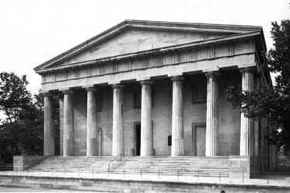
Second Bank of the United States
Ownership
80% privately held
20% government
Located in Philadelphia
Grew to 25 branches
25 directors (5 appointed by President)
20-year charter

Slide 26
Second Bank of the United States
Notes:
Chillicothe???

Slide 27
Second Bank of the United States
Supported growing international trade
Even larger relative to other banks and businesses than the First Bank
Branches helped support westward expansion and the federal government’s land sales
Exercised some control over money and credit through lending policies and state note holdings

Slide 28
First Second Bank of the United States
Government’s fiscal agent
Valid for payment of federal taxes
Private bank
Accepted deposits
Made loans (interest capped at 6%)
Circulated as currency
Convertible into gold or silver
Issued notes
Collected taxes (mainly customs duties)
Transferred funds through branches
Paid bills

Slide 29
State-Chartered Banks in the U.S.

Slide 30
Panics under the Second Bank
Panic of 1819
Panic of 1825
Panic of 1833—34

Slide 31
Opposition from Andrew Jackson
Distrust of Paper Money
Felt that specie was the only medium of exchange
Distrusted banks (issuers of paper notes) and credit
Land deal gone bad where Jackson accepted paper notes that became worthless
Other Concerns
States’ rights
Unchecked power in the hands of private citizens
Bank lacked an effective form of regulation
Notes:
Second Bank not a significant issue in 1828, but rumors circulated that Henry Clay manipulated the Bank to help John Quincy Adams

Slide 32
State Banking Era: 1836-1863
Banks were chartered and regulated by states
Several states banned banking
Variety of notes exploded
Notes were often not exchanged at face value
In Philadelphia in 1842
A $1 note from a Tennessee bank is worth 80₵
A $1 note from an Illinois bank is worth 50₵

Slide 33
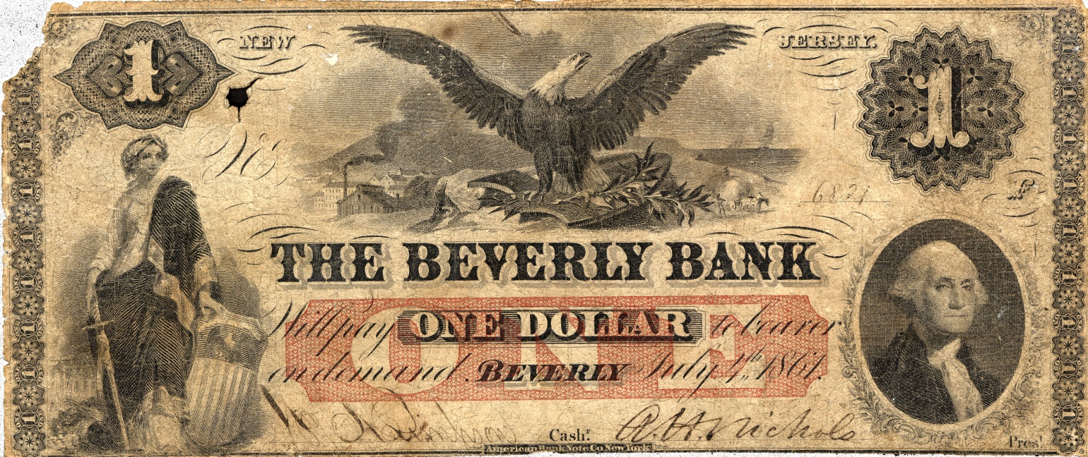
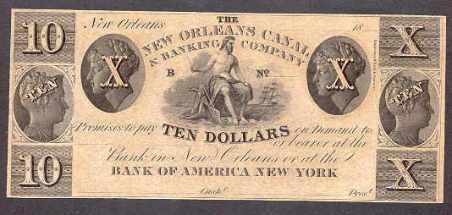
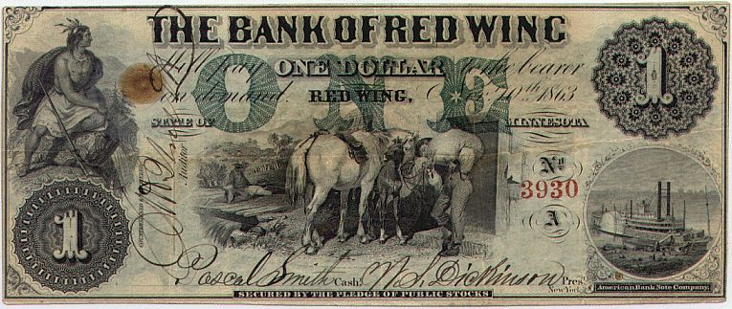
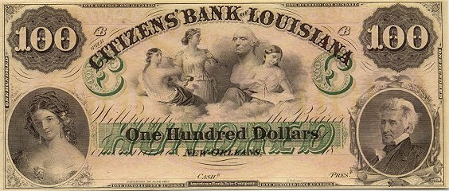
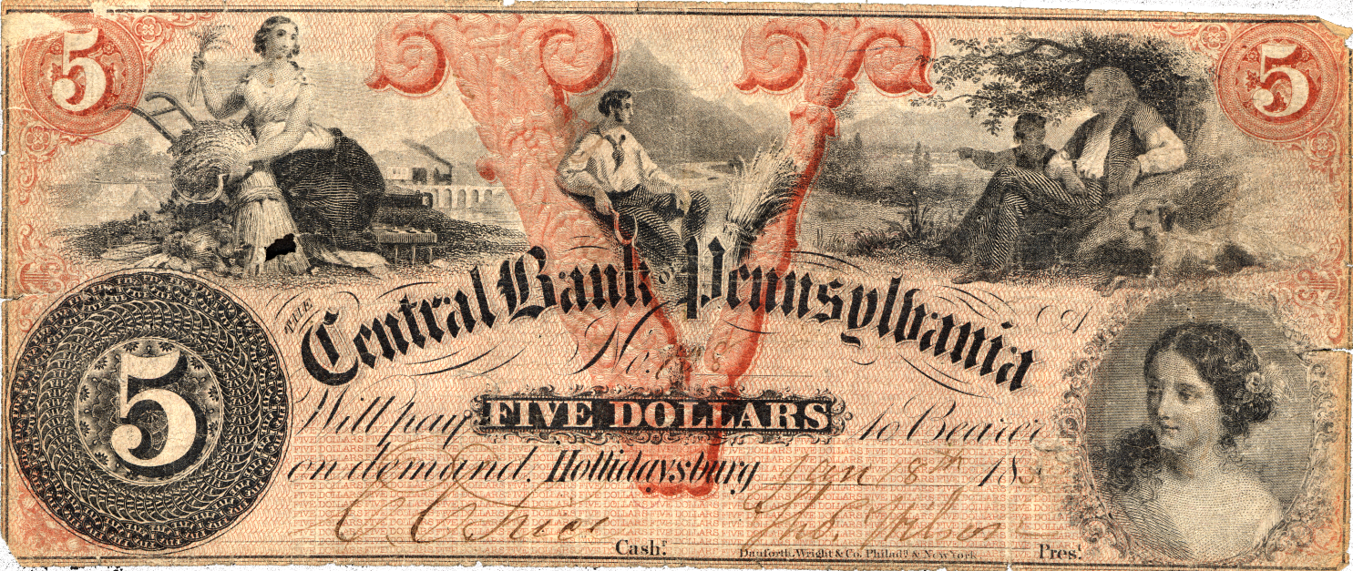
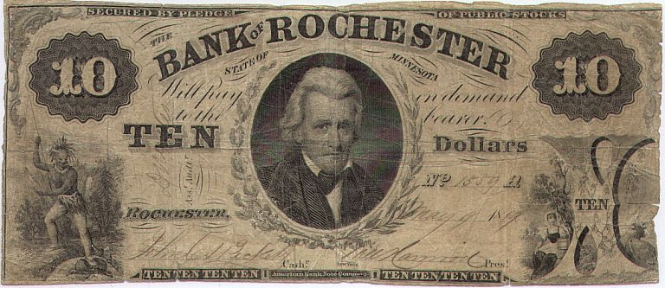
State Bank Notes
Notes:
State banks also issued notes.
Circulated as money.
Notes are responsibility of bank. You are responsible for deposit.

Slide 34
Free Banking
First adopted in Michigan (1837)
Charter by state legislature no longer necessary
Anyone is free to engage in banking
Intended as a reform to political nature of bank chartering
States established their own regulations
Notes:
Charter granted without discretion – as long as requirements were met.

Slide 35
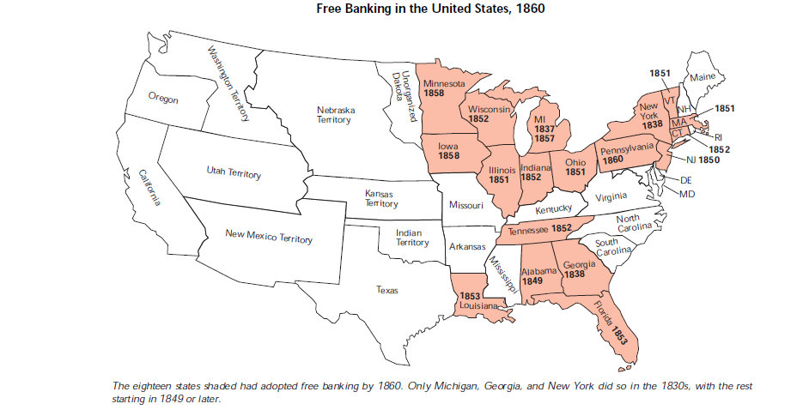
Free Banking States
Source: “Wildcat Banking, Banking Panics, and Free Banking in the United States, Gerald P. Dwyer Jr., FRB Atlanta Economic Review, December 1996.

Slide 36
Ratio of Specie to Deposits and Notes in 1859
Source: Banks and Politics in America, Bray Hammond, 1957, p. 716.
Notes:
Louisiana’s experience with free banking good.

Slide 37
Banking in Texas
No corporate body shall hereafter be created, renewed, or extended, with banking or discounting privileges.
Constitution of the State of Texas
Article VII, Sec. 30
1845

Slide 38
Why Are Banks Important?
Critical to the ability of a region to realize its economic potential
Two main functions
Monetize the economy by providing a medium of exchange and a store of value
Provide credit that supports entrepreneurs
Provided social benefit (positive externalities)

Slide 39
An American Approach to Banks
Federalist U.S. political system
States established banking systems reflecting local needs and preferences
Many regional differences were reflected in different state banking systems
Geography
Climate
Crop mix
Manufacturing activity
Population density
Other variables?

Slide 40
Three Regions
New England
Mid-Atlantic
South and West

Slide 41
State Banks in New England
Relatively small, unit banks
Closely-held stock
Granted loans to local farmers, merchants and artisans with whom the bank's managers had close relationships
Minimal involvement of the state in operations or supervision

Slide 42
Average Bank Size (in $ thousands)

Slide 43
New England Banks in 1860

Slide 44
Banknote Redemption and Clearing
Rural banknotes tended to flow toward cities (especially ports)
Every bank issued its own notes
Significant costs to redeem notes from distant banks
The Suffolk System

Slide 45
Two Very Different Systems
New England
Many small banks
Private and closely held
Middle Atlantic
Larger banks
Significant role for the state
No financial stake by the states

Slide 46
Pennsylvania Banks
Bank of North America (1781)
Supported revolution
Bank of Pennsylvania (1793)
State’s fiscal agent
State subscribed $1 million in capital to gain line of credit and right to appoint directors
Philadelphia Bank (1803)
$135,000 bribe to legislature for a charter
Line of credit and appointments given to state

Slide 47
Real Bills
Most banks followed a “real-bills” lending policy
30 to 90 day credit to merchants
Credit extended for already existing goods
Excluded many types of lending secured by
Property (mortgages)
Goods in process (trade credit)
Start-up loans (venture capital)

Slide 48
New Type of Banks
Farmers and Mechanics Bank of Philadelphia (1809)
Served artisans, manufacturers and farmers excluded by real-bills doctrine
Seven of 13 directors from these groups
Required to lend 10% of capital to farmers for mortgages of at least one year
Other similar institutions followed
Merchants Bank, Planters Bank, Farmers Bank, Mechanics Bank, Grocers Bank, Importers Bank, etc.

Slide 49
Bank of New York
Founded by Alexander Hamilton
Opened in 1784 and operated without a charter until 1791
Federalist legislature prevented Aaron Burr from chartering a competing bank
Manhattan Company chartered in 1799 to supply fresh water to lower Manhattan, but Burr inserted language that allowed the company to use excess capital in any activity
$500,000 of capital immediately invested in banking

Slide 50
Deposit Insurance
New York passed the Safety Fund Act in 1829
Authorized bank regulators
Established an insurance fund
Lasted until 1860s, but nearly bankrupted during the panic of 1837
Model for later deposit insurance programs
Midwestern states in the early twentieth century
FDIC created in the 1930s

Slide 51
South and West
Branch banking model
Extending banking into areas that did not have enough capital to charter a bank
Extensive state involvement
Branches were required by some states as a condition of charter

Slide 52
Banks and Branches
 | 1848 |  | 1856 |  | 1860
 | Banks | Branches | Banks | Branches | Banks | Branches
Georgia | 3 | 7 | 6 | 20 | 2 | 5
Indiana | 1 | 13 | 1 |  | 1 | 20
Kentucky | 3 | 13 | 6 | 26 | 7 | 31
Missouri | 1 | 5 | 1 | 5 | 9 | 33
North Carolina | 2 | 14 | 3 | 17 | 3 | 19
Ohio | 1 | 29 | 1 | 36 | 1 | 36
South Carolina | 1 | 2 | 1 | 2 | 1 | 1
Tennessee | 3 | 17 | 3 | 15 | 3 | 17
Virginia | 6 | 30 | 7 | 39 | 7 | 39

Slide 53
State Involvement in Banking
Virginia held a significant stake in earliest chartered banks and required that banks subsidize state projects
Bank of Virginia
Farmers Bank of Virginia
South Carolina chartered several banks in which it took no financial interest, but also wholly owned the Bank of the State of South Carolina
Designed to lend to planters and farmers
Dominated South Carolina's financial sector.
Notes:
Indiana, Kentucky, Louisiana, Mississippi, Illinois, Kentucky, Tennessee and Georgia all were similar to Virginia

Slide 54
Three Types of Louisiana Banks (1830’s)
Commercial banks
Merchants and manufacturers
Property banks
Long-term mortgage credit to planters and other property holders
Improvement banks
Financed various projects including canals, hotels, streetlights and railroads
Notes:
New Orleans Canal and Banking Company built a canal connecting Lake Ponchartrain to the Mississippi River
The Exchange and Banking Company and the New Orleans Improvement and Banking Company built and operated hotels
New Orleans Gas Light and Banking Company constructed and operated gas streetlights in New Orleans and five other cities
Carrollton Railroad and Banking Company and the Atchafalaya Railroad and Banking Company were rail construction companies

Slide 55
“Commonwealth” Ideal
Banks should promote general welfare and economic growth
Bank of the Commonwealth of Kentucky (1821)
Longer mortgage loans
Landowners eligible for $1,000 loans
Notes not redeemable into specie but were accepted at the state treasury
Law forced creditors to accept notes in payment (legal tender)
Similar banks chartered in Tennessee, Illinois and Louisiana

Slide 56
Questions?
Disclaimer: The views expressed are those of the presenters and do not necessarily reflect those of the Federal Reserve Bank of Dallas or the Federal Reserve System.

