Slide 1
Wars, Panics and Politics: The American Debate on a National Bank
Disclaimer: The views expressed are those of the presenters and do not necessarily reflect those of the Federal Reserve Bank of Dallas or the Federal Reserve System.

Slide 2
Wars
American Revolution
War of 1812
Panics
Colonial shortages
“Not worth a Continental”
Politics
Hamilton vs. Jefferson
Jackson vs. Clay (and Biddle)
Civil War
Post war inflation and debt
19th Century Banking Crises
Panic of 1907

Slide 3
Central Banking in the U.S.
1816-1836
1836-1863
1863-1913
1791-1811
Second Bank of the U.S.
State Banking Era
National Banking Era
1913
Federal Reserve Act
First Bank of the U.S.

Slide 4
Some Definitions
Specie – gold and silver
Redemption – banks exchange (or redeem) paper money for specie
Suspension – banks refuse to redeem their paper money for specie
Bank notes – issued by banks (in lieu of deposits) and circulated as money

Slide 5
Colonial Period
Used a mix of currency and coins
British pounds
French francs
Spanish milled dollars
Shortage of money → barter
Paid for imports with gold or silver
Generally prohibited from issuing paper currency, but often ignored prohibition

Slide 6
Colonial Period
Notes:
Franklin is 23 years-old in 1729. He arrives in Philadelphia in 1723, goes to London from 1724 through 1725, then he returns to Philadelphia in 1726. Founds the Junto (APS) in 1727. Buys failing Pennsylvania Gazette press in 1729. This is the first pamphlet he publishes from his press.

Slide 7
Colonial Period
Notes:
B. Franklin printed Pennsylvania pound 20 shilling note, 1739. Note leaf-impression printing to minimize counterfeiting. Franklin first prints money for Pennsylvania in 1730/31 and continues through 1764, then sells out to partner Hall, as he returns to London for 1764-1774.

Slide 8
Colonial Period
Notes:
A 50 Shilling paper note issued by Pennsylvania in 1775.
Note the reference to “his Majesty George the Third” – a phrase that soon disappeared.

Slide 9
Colonial Period
Notes:
“To Counterfeit is Death” on this Pennsylvania currency indicates how seriously counterfeiting was treated.

Slide 10
Revolutionary War & Early National Period
Pennsylvania (1777)
Virginia (1776)

Slide 11
Revolutionary War & Early National Period
Continental Congress issued currency in 1775
Excessive issuance of continentals led to inflation
“Not worth a Continental”
Notes:
The phrase “Mind Your Business” is on the front.
Continental Congress chartered the Bank of North America (founded by Robert Morris) in 1781
Helped finance the war by buying and marketing bonds
Only a handful of banks existed before 1800.
Only 5 banks in 1792; 24 in 1800
Banks issued notes that circulated as currency.

Slide 12
Financial Challenges after Revolution
Shortage of money as economy expanded
No uniform currency that was accepted at par value
Government (federal and state) war debts
Federal government lacked a fiscal agent

Slide 13
Fugio cent (1787) – 1st coin issued by the U.S.
Notes:
Other than foreign coins, domestic coins of the Colonies (or States) and private tokens circulated.

Slide 14
U.S. Constitution
Congress shall have the power…
“…to coin money, regulate the Value thereof, and of foreign Coin…”
- Article I, Section 8
No state shall…
“…coin Money; emit Bills of Credit; make any Thing but gold and silver Coin a Tender in Payment of Debts…”
- Article I, Section 10
Notes:
Bank not in constitution
Can federal gov. print money? Charter banks?

Slide 15
Alexander Hamilton
As the first Secretary of Treasury, Hamilton advocated,
National Mint
National bank
Notes:
1st Treasury Secretary
Established U.S. mint

Slide 16
Revolutionary War & Early National Period
Coinage Act of 1792
Created the U.S. Mint in Philadelphia
Set denominations for coins
Specified coins value in gold, silver and copper
Coin shortage remained – private tokens and foreign coins still circulated
Notes:
George Washington reportedly contributed $75 worth of his personal tableware to provide the silver for the first coins.

Slide 17
Hamilton’s Proposal – December 1790
A national bank that would
Issue paper currency
Act as the government’s fiscal agent
Offer banking facilities for commercial transactions
Structure
Shareholders vote based on ownership
Maximum ratio of loans to specie
Government would own 20%

Slide 18
Alexander Hamilton

Slide 19
Debating a National Bank
Alexander Hamilton
Thomas Jefferson (also James Madison)
Ideas of David Hume and Adam Smith
England’s use of public debt to build nation
Deliver capital to build the financial system
Financial monopoly would undermine state banks
National bank was unconstitutional
Vision of an agrarian (not commercial) society
Consolidate and finance federal and state debt

Slide 20
James Madison Objects
“…was condemned by the silence of the Constitution; was condemned by the rule of interpretation arising out of the Constitution; was condemned by its tendency to destroy the main characteristic of the Constitution; was condemned by the expositions of the friends of the Constitution whilst depending before the public; was condemned by the apparent intentions of the parties which ratified the Constitution; was condemned by the explanatory amendments proposed by Congress themselves to the Constitution.”
Source: Banks and Politics in America, Bray Hammond, 1957, pp. 115-116.
Notes:
The proposal for a national bank was…

Slide 21
First Bank of the United States
Notes:
Alexander Hamilton (Treasury Secretary) proposed a national bank
Bank met with opposition from Jefferson and others
Washington unsure and asks Hamilton for arguments in favor of bank
Hamilton wins the argument and Washington signs the bill that creates the (first) Bank of the United States
Not referred to as the “First Bank” it was the only bank.

Slide 22
First Bank of the United States
Privately held
20% government owned
70% foreign owned
Only national bank
Located in Philadelphia
8 branches
20-year charter lasted from 1791 to 1811

Slide 23
Branches of the First Bank of the U.S.

Slide 24
First Bank of the United States
Government’s fiscal agent
Valid for payment of federal taxes
Private bank
Accepted deposits
Made loans (interest capped at 6%)
Circulated as currency
Convertible into gold or silver
Issued notes
Collected taxes (mainly customs duties)
Transferred funds through branches
Paying bills

Slide 25
Note from the First Bank of the U.S.

Slide 26
First Bank of the United States
Not a central bank in the modern sense, but some influence over the economy
Rudimentary monetary policy through holdings of notes from state banks
To constrain money growth → redeem notes and reduce reserves of specie
To speed money growth → hold notes and allow reserves of specie to grow

Slide 27
State-Chartered Banks in the U.S.

Slide 28
First Bank of the United States
Charter renewal rejected by a single vote in House and Senate in 1811
Federalists were out of power
Opposition of state banks

Slide 29
State Banking from 1811 – 1816
War of 1812 reduced trade impacted custom duties
Federal government forced to rely on state banks to finance war
Inflation as state bank notes grew 150%
 | Exports | Imports
1811 | $61 M | $53 M
1816 | $7 M | $13 M
Notes:
From Ken:
No central institution for Treasury to deal with.
Sec. of State James Monroe pledged his personal fortune to secure funds for Andrew Jackson to move troops for Battle of N.O.

Slide 30
Proposing a Second Bank
John Jacob Astor
David Parish
Stephen Girard
Jacob Barker
Alexander Dallas
John C. Calhoun

Slide 31
Madison Concurs
“…as being precluded…by repeated recognitions, under varied circumstances, of the validity of such an institution, in acts of the legislative, executive, and judicial branches of the government, accompanied by indications in different modes of a concurrence of the general will of the nation…”
Source: Banks and Politics in America, Bray Hammond, 1957, pp. 233-234
Notes:
Constitutional issues were precluded…

Slide 32
Second Bank of the United States
Notes:
Again, create another national bank
Astor, Barker, Calhoun, Dallas, Girard, Parish support creation of second national bank
Debate goes on for a couple of years
War ends so Madison thinks there’s no need for a second bank
But government has debt from war; Madison rejects several bank bills
Finally, in 1816, Madison signs bill to create the (second) Bank of the United States

Slide 33
Second Bank of the United States
Ownership
80% privately held
20% government
25 directors (5 appointed by President)
Located in Philadelphia
Grew to 25 branches
20-year charter

Slide 34
Second Bank of the United States
Notes:
Chillicothe???

Slide 35
Second Bank of the United States
Supported growing international trade
Even larger relative to other banks and businesses than the First Bank
Branches helped support westward expansion and the federal government’s land sales
Exercised some control over money and credit through lending policies and state note holdings

Slide 36
First Second Bank of the United States
Government’s fiscal agent
Valid for payment of federal taxes
Private bank
Accepted deposits
Made loans (interest capped at 6%)
Circulated as currency
Convertible into gold or silver
Issued notes
Collected taxes (mainly customs duties)
Transferred funds through branches
Paying bills

Slide 37
Second Bank of the United States
Notes:
An 1835 Second Bank note

Slide 38
Second Bank of the United States

Slide 39
State-Chartered Banks in the U.S.

Slide 40
Panics
1819
Second Bank extended a large number of loans
Increasing trade deficit → outflow of specie
Bank contracted lending
1825
Stock market crash due to speculative investments in Latin America
Worse in England, but led to a decline in economic activity in the U.S.
1833-34
Brief recession followed by an expansion fueled by land speculation
Bankruptcies, foreclosures, bank failures, falling real estate prices and a slump in agriculture and manufacturing

Slide 41
Opposition from Andrew Jackson
Distrust of Paper Money
Felt that specie was the only medium of exchange
Distrusted banks (issuers of paper notes) and credit
Land deal gone bad where Jackson accepted paper notes that became worthless
Other Concerns
States’ rights
Unchecked power in the hands of private citizens
Bank lacked an effective form of regulation
Notes:
Second Bank not a significant issue in 1828, but rumors circulated that Henry Clay manipulated the Bank to help John Quincy Adams

Slide 42
Opposition from Andrew Jackson
Bank was not a major factor in election of 1828
Nicholas Biddle, president of Second Bank (1823—1836)
Election of 1832
Jackson vetoes re-charter of the Bank that is supported by Henry Clay
After election, federal government’s deposits removed to state banks
Bank’s charter expires in 1836
Notes:
Second Bank not a significant issue in 1828, but rumors circulated that Henry Clay manipulated the Bank to help John Quincy Adams

Slide 43
State Banking Era: 1836-1863
Banks were chartered and regulated by states
Several states (including Texas) banned banking
Variety of notes exploded

Slide 44
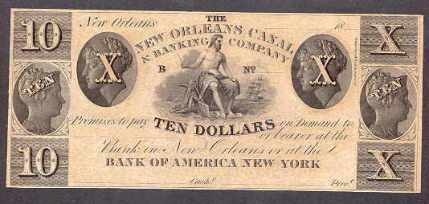
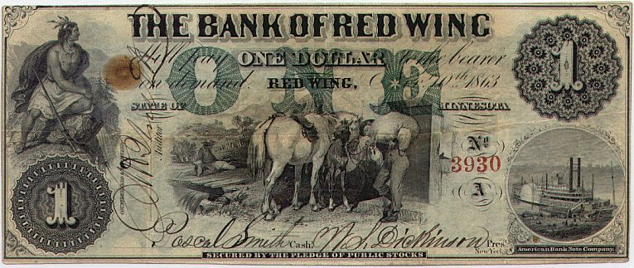
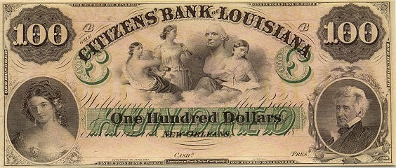
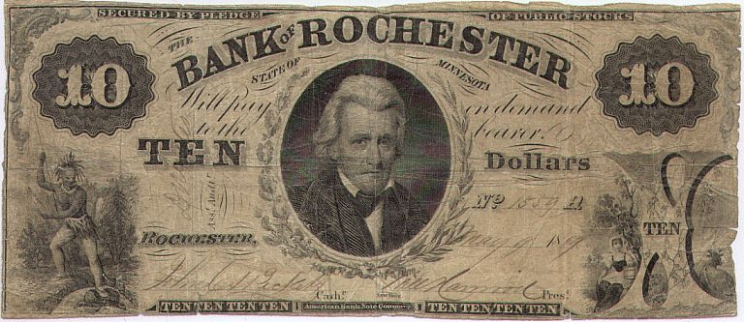
Notes:
State banks also issued notes.
Circulated as money.
Notes are responsibility of bank. You are responsible for deposit.

Slide 45
State Banking Era
Notes:
State bank notes circulated as currency but were often not accepted at face value.

Slide 46
State Banking Era: 1836-1863
Notes were often not exchanged at face value
Lists published of discounts used.
State bank notes not a uniform currency.
In 1842, a $1 note from a Tennessee bank is exchanged for 80 cents in Philadelphia, while a $1 note from an Illinois bank is exchanged for only 50 cents.
Increased number of state bank notes issued
By 1860, more than 1,300 banks issue 7,000 different types of notes used as currency.

Slide 47
State Banks

Slide 48
State Bank Notes and Deposits
$ Millions
Source: The Economics of Money and Banking, Lester V. Chandler, 4th ed., 1964, p. 140.
Notes:
Deposits become more important than notes.

Slide 49
Free Banking Era: 1837 – 1863
First adopted in Michigan
Charter by state legislature no longer necessary
Anyone is free to engage in banking, but banking is not free
States established their own regulations
Notes:
Charter granted without discretion – as long as requirements were met.

Slide 50
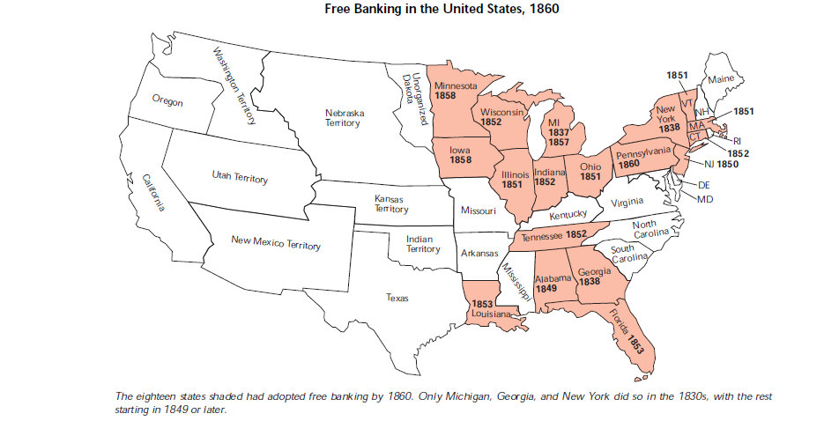
Free Banking States
Source: “Wildcat Banking, Banking Panics, and Free Banking in the United States, Gerald P. Dwyer Jr., FRB Atlanta Economic Review, December 1996.

Slide 51
Ratio of Specie to Deposits and Notes in 1859
Source: Banks and Politics in America, Bray Hammond, 1957, p. 716.
Notes:
Louisiana’s experience with free banking good.

Slide 52
Free Banking Era
Notes:
In addition to state-chartered banks, some companies issued notes that circulated as currency, such as this one from the Delaware Bridge Company in Lambertville, NJ:

Slide 53
Banking in Texas
No corporate body shall hereafter be created, renewed, or extended, with banking or discounting privileges.
Constitution of the State of Texas
Article VII, Sec. 30
1845

Slide 54
Wildcat Banking?
Notes:
Locate banks in difficult-to-access locations
Makes it difficult to redeem notes.

Slide 55
Panics
1837
Lack of specie led to suspension of note redemption
Lack of liquidity led to bank failures
1857
Collapse of the Ohio Life Insurance and Trust Company
Led to banking panic
More than 5,000 businesses failed in the first year of the panic

Slide 56
Independent Treasury System
Federal government deposits in state banks
Bank failures led to congressional action
1836: financial reports to be filed with Treasury
1846: established the Independent Treasury System to hold federal deposits
Sub-treasury offices located throughout the country.
Not all offices were very secure
One Indiana sub-treasury office in tavern

Slide 57
The End of the State Banking Era
1861
$50M financed at different banks
Demand notes (greenbacks) are issued that are redeemable for specie “on demand”
1862
Legal Tender Act creates United States Notes
1863 – 64
Two National Bank Acts are passed

Slide 58
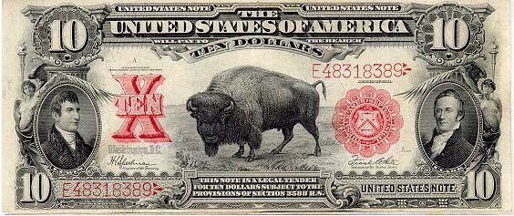
Legal Tender Note
Notes:
U.S. notes ended in 1971.
Treasury will also give face value.

Slide 59
National Bank Act of 1864
“An act to provide a national currency, secured by a pledge of United States bonds, and to provide for the circulation and redemption thereof.”

Slide 60
National Bank Act
Created federally chartered banks under the Comptroller of the Currency
Established capital and reserve requirements
Provided for supervision and examinations
Created a uniform currency

Slide 61
State Banks Attacked
Almost 1,600 in 1860, only 350 in 1865
10% tax placed on state bank notes – upheld by Supreme Court
Chief Justice Salmon P. Chase
State banks introduce demand deposits
Dual banking system still exists today
Notes:
Congress placed 10% tax on state bank notes in March 1865 – to get uniform currency.
Supreme Court upheld challenge. Salmon P. Chase was Chief Justice. He was also Treasury Secretary in 1865 who proposed the tax!

Slide 62
State and National Banks
Source: Banking and Monetary Statistics, Federal Reserve System, 1914-1941, p. 6
Notes:
State banks almost disappear.
Were about 1600 in 1861, only 350 in 1865.

Slide 63
State and National Banks
Source: Banking and Monetary Statistics 1914-1941, Federal Reserve System, p. 6.
Notes:
State banks survived by introducing something called a demand deposit.

Slide 64
New Forms of Paper Currency
Fractional currency
Greenbacks
Demand Notes (not backed by gold or silver)
Legal Tender Notes or U.S. Notes
Gold certificates
Confederate currency
National bank notes

Slide 65
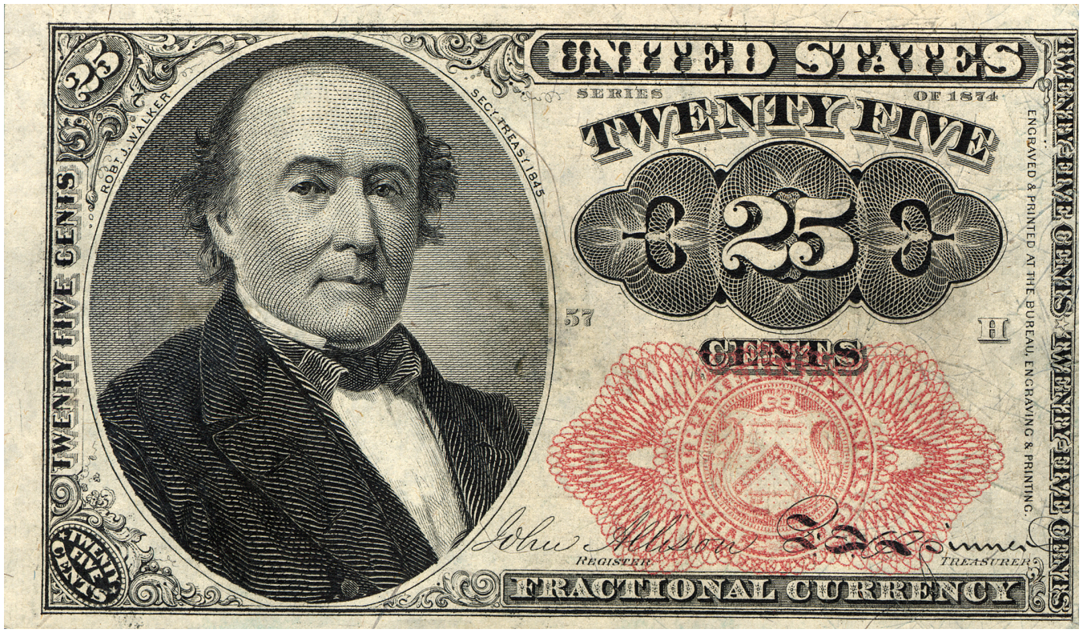
Fractional Currency
Notes:
Fractional
currency notes
and postage stamps
replaced coins, which
were being hoarded
during the Civil War.

Slide 66
Notes:
United States Notes issued by Congress to finance the Civil War were called Greenbacks.
Confederate Currency Issued to Finance the Civil War

Slide 67
National Bank Notes
Uniform currency that exchanged at face value
Only issued against U.S. government bonds
Issuing bank maintained a redemption fund with Comptroller
Note holders had first lien on bank assets
Note issue could not exceed bank’s capital

Slide 68
National Bank Notes
Notes:
Beginning in 1877, all national banks’ notes are printed by Treasury’s Bureau of Engraving and Printing, which still prints our currency today.

Slide 70
Panic of 1873
Triggered by the collapse of Jay Cooke and Co.
largest bank in the U.S.
Agent for Northern Pacific Railroad bonds
Cooke’s bank could not sell enough railroad bonds to cover obligations
Led to a sell-off in the stock market
Runs on other large financial institutions led to their failure

Slide 71
Gold Standard
Debate about paying off greenbacks in specie
Coinage Act of 1873
Mint gold dollars
Mint small-denomination silver coins – not silver dollars
Depressed the price of silver and established a gold standard, leading to a period of deflation and depression
“Long depression” lasted until 1879

Slide 72
Notes:
During and after the Civil War, Congress authorized the Treasury to issue gold certificates.

Slide 73
Notes:
Silver certificates were authorized by Congress in response to the “Free Silver” movement.

Slide 74
Panics
1882 – 1885
Recession due to the end of the railroad construction boom
1884 (during the 1882-85 recession)
Impacted other industries, particularly iron and steel
European gold reserves were depleted
Banks called in loans

Slide 75
Panic of 1893
Sherman Silver Purchase Act (1890) had increased federal purchases of silver
Indebted farmers harmed by deflation
Silver mining companies with Western silver
Panic of 1893
Sparked by failure of Philadelphia and Reading Railroad
Withdrawal of European investment led to a crisis in railroad finance
Stock market crash and a banking panic followed
Created a run on the U.S. gold supply

Slide 76
Bank Suspensions
Source: Banking and Monetary Statistics 1914-1941, Federal Reserve System, Table 66.
Notes:
Note issue depended on volume of gov. debt – no elastic currency or lender of last resort.
Suspensions common. 1893. 1907 – New York banks.

Slide 77
Gold Standard vs. Bimetallic Standard
Key element of presidential politics and the Populist movement
Election of 1896
William Jennings Bryan (pro-silver and pro-paper currency)
William McKinley (pro-gold standard)
Cross of Gold speech
“…You shall not crucify mankind on a cross of gold.”

Slide 78
Panic of 1907
Knickerbocker Trust Company failed leading to runs on other trust companies
Widespread panic
Bank failures
Shrinking money supply
Deep recession
J.P. Morgan, along with other bankers, served as lender of last resort and quelled the panic

Slide 79
Federal Reserve Act of 1913
“To furnish an elastic currency”
“To establish a more effective supervision of banking in the U.S.”
To engage in other payment activities (such as check-clearing)

Slide 80
Questions?

Slide 81
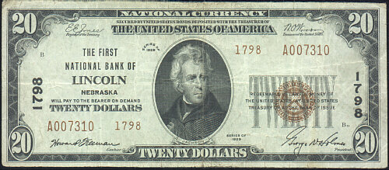
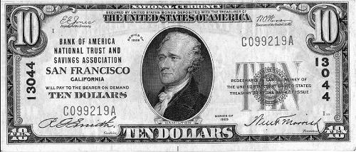
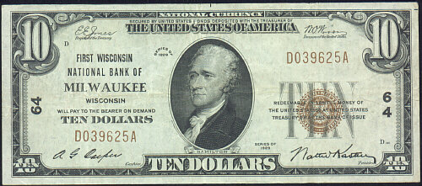
National Bank Notes
Notes:
National bank notes not issued since 1935.
Treasury will redeem them for face value.

