Slide 1
Business, Banks and Bragging How Dallas Became a Federal Reserve City
Princeton Williams
Economic Education Program Coordinator
Federal Reserve Bank of Dallas
The views expressed are those of the presenter and do not reflect those of the Federal Reserve Bank of Dallas or the Federal Reserve System.

Slide 2
Setting the Stage for the Federal Reserve

Slide 3
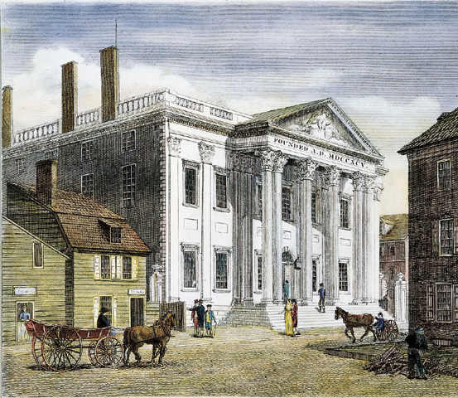
Notes:
First and Second Banks of the United States

Slide 4
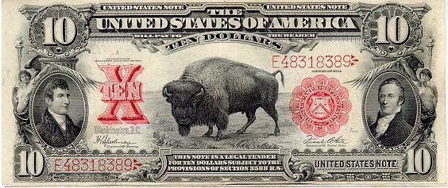
Notes:
Free Banking Era (1837-1863)
Over 30,000 different types of currency
Civil War leads to national currency issued by the Treasury
Demand Notes (1861)
United States Notes or Greenbacks (1862)
U.S. notes ended in 1971.
Treasury will also give face value.

Slide 5
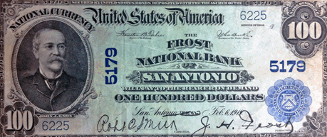
Notes:
National Bank note from Frost Bank from Feb of 1913, before the Federal Reserve Act.
National Bank Act of 1863
Nationally chartered banks
National Bank Notes were issued and backed by U.S. securities
State notes were taxed out of existence

Slide 6
Panic of 1907
Notes:
Walter Bagehot (editor of London Economist)
A panic is a species of neuralgia and you must not starve it. The holders of the cash reserve must advance it most freely. In wild periods of alarm, one failure makes many, and the best way to prevent derivative failures is to arrest the primary.
With the nation confronting another financial crisis in 1907, and the United States the only one of the world’s major financial powers without a central bank, the nation was forced to turn to Wall Street. Finance mogul J.P. Morgan, who had bailed the government out of a financial crisis in 1895, organized private sector investments and lines of credit to stabilize the banking system amid its latest panic.

Slide 7
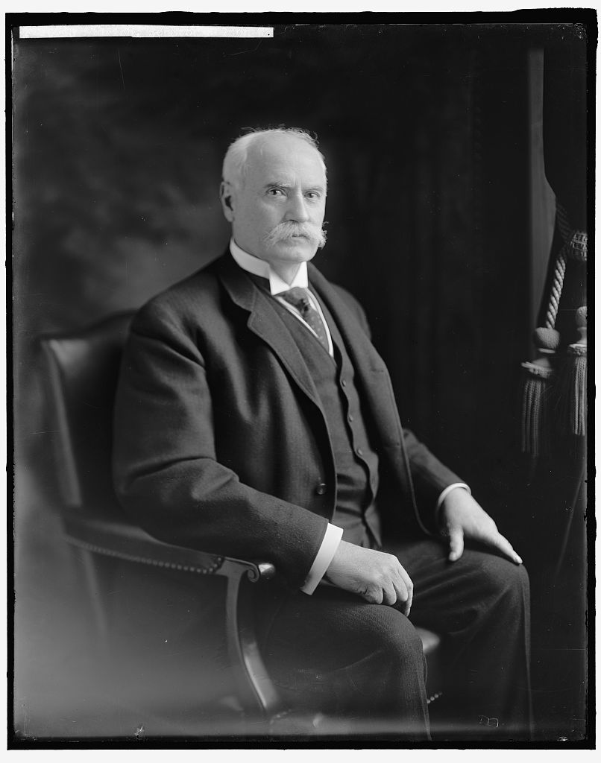
Notes:
http://lcweb2.loc.gov/service/pnp/hec/16600/16628v.jpg
Senator Nelson Aldrich of Rhode Island
Panic of 1907 led Congress to pass the Aldrich-Vreeland Act on May 30, 1908.
Provided for the issuance of emergency currency
Created the eighteen-member National Monetary Commission, chaired by Sen. Nelson Aldrich, to determine what changes were necessary to the nation’s monetary system and laws related to banking and currency.
Commission visited major capitals of Europe and hosted a hearings in the United States.
1912 – Aldrich plan proposed a $100 million multi-branched corporation called the National Reserve Association.
Roots in Jekyll Island meeting (favored by bankers)
Aldrich’s proposal attacked by committees in both chambers
Gave too little control to the government and too much power to bankers, especially those who ran the largest institutions
46 member Board with only 6 appointed by the government and one of those – the head of the organization – selected from a list of three names supplied by the association
Government would have no financial stake in the National Reserve Association (different from 1st and 2nd Bank)

Slide 8
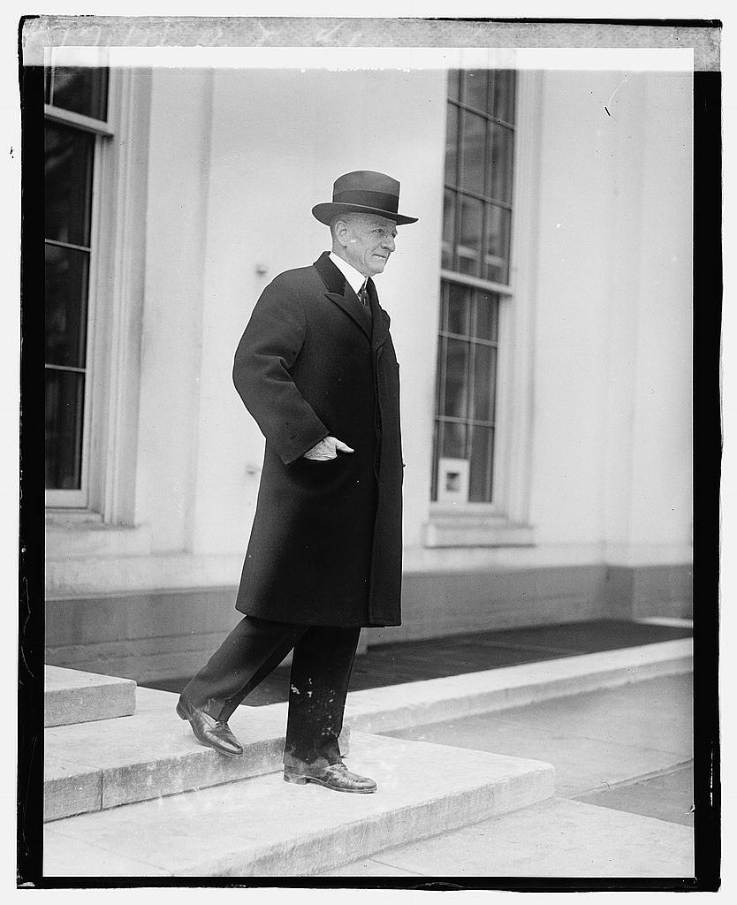
Notes:
http://lcweb2.loc.gov/service/pnp/npcc/01500/01520v.jpg
Carter Glass – chair of the House Banking Committee
Wilson’s election in 1912 doomed Aldrich plan (opposition to the proposal was a plank in the Democratic platform)
House Banking and Currency Committee assigned a subcommittee under the leadership of Rep. Carter Glass to explore reform proposals.
Glass enlisted the help of Henry Parker Willis, a professor at Washington and Lee University. Willis, who also wrote for the New York Journal of Commerce, would come to wield enormous influence over a subcommittee whose members had little knowledge of banking and finance.
Glass proposed legislation that:
Created a system of up to 20 autonomous regional banks (as opposed to National Reserve Association)
“In the United States, with its immense area, numerous natural divisions, still more numerous competing divisions, and abundant outlets to foreign countries, there is no argument, either of banking theory or of expediency, which dictates the creation of a single central banking institution, no matter how skillfully managed, how carefully controlled, or how patriotically conducted.”
Did not have a central coordinating board therefore giving significant control to bankers
Comptroller of the Currency coordinating function
Wilson felt the plan needed an oversight agency, a central board. He also believed strongly that neither Congress nor the public would support a proposal that gave the government little control. A provision was added that
Creating the Federal Reserve Board made up entirely of presidential appointees: either ex officio members because of their cabinet positions or appointees to the Board for specific terms
Federal Advisory Council, a group of twelve bankers elected by the regional banks that would occasionally meet with the Board (give bankers a voice)
Also currency question – bank notes or government notes? William McAdoo proposed blend of Federal Reserve Notes

Slide 9
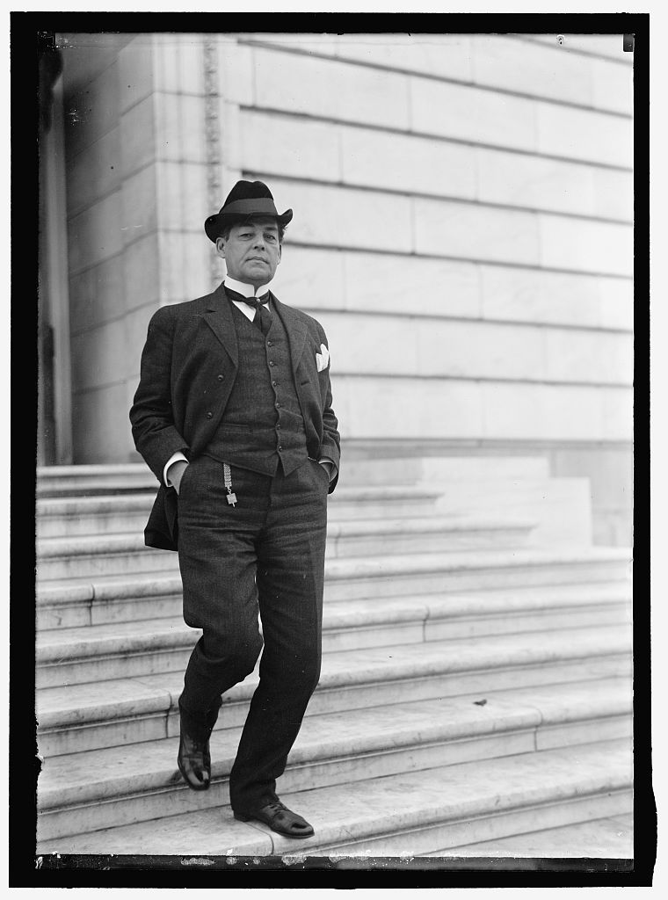
Notes:
http://lcweb2.loc.gov/service/pnp/hec/03700/03775v.jpg
Senators generally favored more centralization
New bill from Oklahoma Democratic Sen. Robert L. Owen – similar to the House bill but with a few changes
Limit Reserve Banks to no more than twelve
Remove the secretary of agriculture and the comptroller of currency from the Federal Reserve Board
Changed the capital of the system to 6 percent of member banks’ capital and the surplus (20% in Glass bill) – favorable to smaller banks
Worked out in Committee
Number of Reserve Banks, specifying between eight and twelve
Makeup of the Federal Reserve Board, returned of the comptroller of the currency to the Board
Extended the terms of the Federal Reserve governors, they agreed on staggered terms and extended them from the six or eight years in the approved bills to ten to ensure no president could appoint all governors during a two-term presidency.

Slide 10
Notes:
The Federal Reserve Act was signed by Wilson on Dec. 23, 1913.

Slide 11
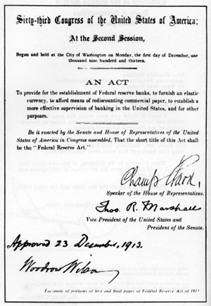
Notes:
“ to provide for the establishment of Federal reserve banks,
to furnishing elastic currency,
to afford means of rediscounting commercial paper,
to establish a more effective supervision of banking in the United States,
and for other purposes.”

Slide 12
Creating the Federal Reserve System

Slide 13
Reserve Bank Organizing Committee
Members
Secretary of the Treasury William G. McAdoo
Secretary of Agriculture David F. Houston
Comptroller of the Currency John Skelton Williams
Charge
Designate between eight and twelve cities as Federal Reserve cities
Create districts with boundaries that took into account that region’s “convenience and customary course of business”

Slide 14
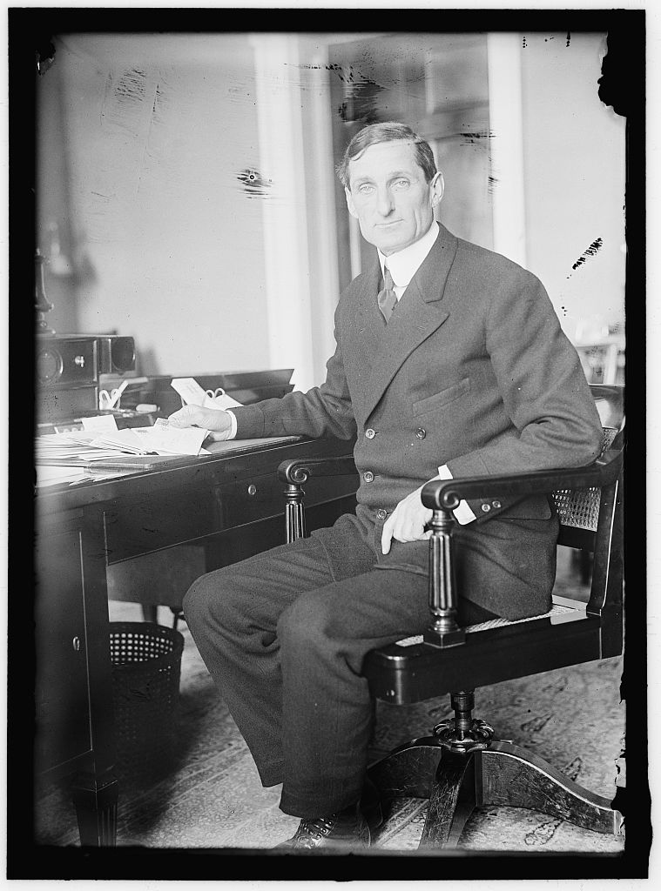
Notes:
http://lcweb2.loc.gov/service/pnp/hec/02100/02197v.jpg
Treasury Secretary William G. McAdoo
Lawyer from Tennessee, lead the project to build a railway tunnel under Hudson River
Married to Woodrow Wilson’s daughter, Eleanor.

Slide 15
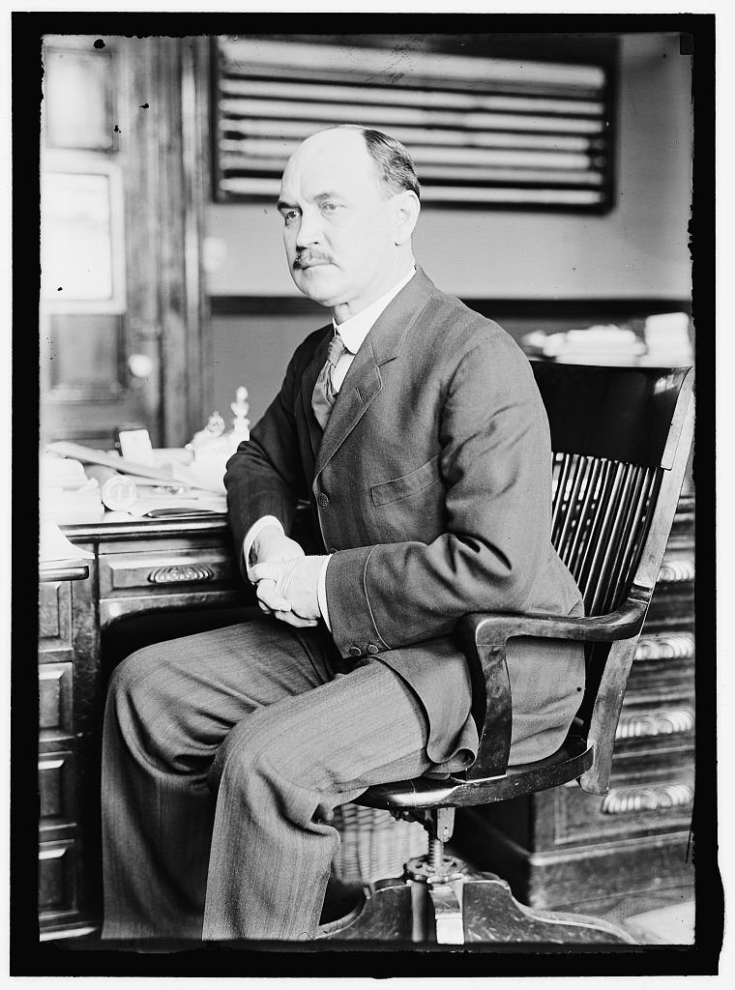
Notes:
http://lcweb2.loc.gov/service/pnp/hec/02100/02180v.jpg
David F. Houston
11th President of Texas A&M University
1902–1905
4th President of the University of Texas at Austin
1905–1908
8th Chancellor of Washington University in St. Louis
1908–1913
5th United States Secretary of Agriculture
March 6, 1913 – February 2, 1920
48th United States Secretary of the Treasury
February 2, 1920 – March 3, 1921

Slide 16
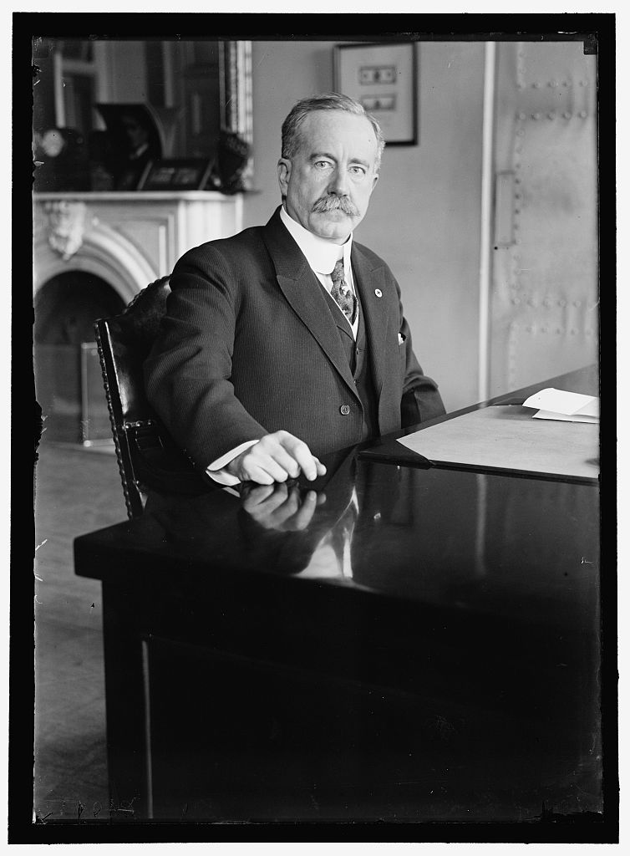
Notes:
http://lcweb2.loc.gov/service/pnp/hec/10200/10266v.jpg
John Skelton Williams
Had not been confirmed when the committee began its work.

Slide 17
Six weeks and 10,000 miles
Public hearings in 18 cities, including Austin
37 cities made presentations
5,000 pages of testimony
“There was a vast amount of state and city pride revealed to us in the hearing; and to hear some of the speeches one would have thought that not to select a city…would mean its ruin.”
David Houston
Notes:
Hearings allowed business leaders, bankers, chambers of commerce, clearing house associations, and other representatives to make a case for why a Federal Reserve Bank should be located in their city.
Public hearings were held in eighteen cities: Atlanta, Austin, Boston, Chicago, Cincinnati, Cleveland, Denver, El Paso, Kansas City, Lincoln, Los Angeles, New Orleans, New York, Portland, St. Louis, San Francisco, Seattle, and Washington, DC.
Presentations included a wide range of topics, including testimony on banking conditions and commercial, industrial, and agricultural statistics. Representatives also discussed location, trade, transportation and communication links, and population growth.

Slide 18
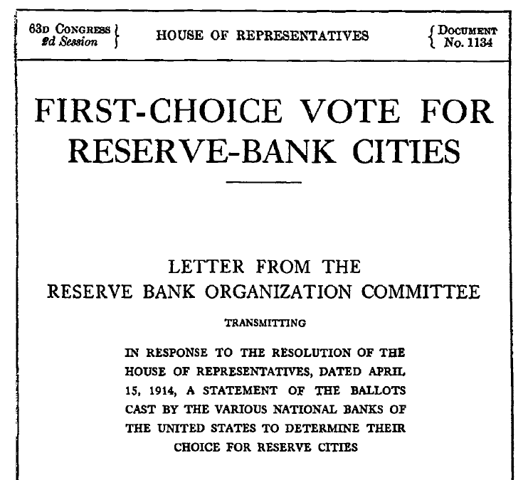
Notes:
In addition to holding hearings and accepting petitions from bankers and other parties, the RBOC polled 7,471 national banks on their first, second, and third choices for Reserve Bank cities.
Some cities were obvious choices, such as New York, Chicago, and St. Louis, which were designated central reserve cities under the National Banking Act of 1863 and subsequent legislation.

Slide 19
The Case for Dallas: Business, Banks and Bragging (with a little bit of politics)
Notes:
Dallas, Fort Worth and Houston all expressed interest in a Reserve Bank, as did New Orleans.
Among Texas cities, Dallas was the odds-on favorite. Fort Worth made a pretty good effort, despite having only 73,312 residents—some 5,000 less than Houston and well short of the 131,278 of the population of Dallas. However, Fort Worth’s representative may have been tripped up by being a tad parochial: He noted that they had 13 rail connections. Asked by a member of the Reserve Bank Organization Committee if one of those connections was to Dallas, the spokesman replied, “Yes, but we seldom use it.”
But no Texas city had the inside lead held by New Orleans: At the time, it was the 15th-largest city in America, had a population over three times larger than Dallas and had an active financial community centered on Mississippi River commerce.
Dallas, however, had something that New Orleans did not have—a force of nature named George Dealey. Mr. Dealey was the publisher of the Dallas Morning News. In manner and character, he was quite the polar opposite of New Orleans’ “laissez les bon temps rouler” ethic. Dealey lived by the dictum that “men who exist get overrun by men who act.”[1] When he learned of the potential of hosting a Federal Reserve Bank, he enacted a no-holds-barred action plan to secure the franchise for Dallas.
Dealey organized a pro-Dallas rally in Washington. He encouraged studies to make the case for our city. He lobbied the Reserve Bank Organization Committee. These were the visible parts of his campaign. He applied his most effective techniques sub-rosa: He adroitly harvested his friendship with an influential member of the Wilson administration—Postmaster General Albert Burleson—with an eye to ultimately convince the secretary of the treasury, William McAdoo.
Burleson was a native Texan, with whom Dealey often corresponded through coded telegrams, using names like “Mercury” and “Tacitus

Slide 20
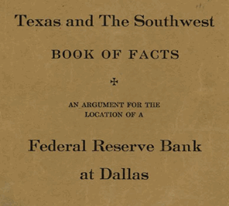
Notes:
Book of Facts for the Austin hearing
Prepared by Dallas Chamber of Commerce, Dallas Clearinghouse Association and the Dallas Cotton Exchange
“Our argument is particularly developed for the City of Dallas; the largest city west of the Mississippi River, and south of the Missouri, with unexcelled railroad facilities and mail service; the telegraph, telephone and express development ranking with the seven largest cities in the United States. We present for your distinguished consideration a city now the acknowledged market of the Southwest, the distributing and financial center of the most progressive and rapidly developing section of the United States.”
“Texas and the Southwest Book of Facts: An Argument for the Location of a Federal Reserve Bank of Dallas,” by C.W. Hobson (Dallas Chamber of Commerce), R.H. Stewart (Dallas Clearing House Association) and S.W. King Jr. (Dallas Cotton Exchange), 1914.

Slide 21
The Case for Dallas Diverse Economy
Annual Production |  | Demand for Money
Factory | $685,506,000 | Uniform
Cotton | 381,132,000 | Four months
Live Stock | 205,244,132 | Uniform
Corn | 175,899,000 | Consumed on farm
Minerals | 73,501,000 | Uniform
Miscellaneous Crops (Wheat, Oats, Hay, Vegetables, Fruit, etc.) | 237,866,017 | Each balancing the other, making uniform demand.

Slide 22
The Case for Dallas Transportation and Communication
Nine trunk line railroads
Five interurban railroads
Sixth in total volume of telegraphs
Headquarters of Bell Telephone for the Southwest
Largest telephone development per capita of any city in the U.S.

Slide 23
The Case for Dallas Commerce
“Leads the world in the manufacture of cotton gin machinery and in the manufacture of harness and saddlery.”
“Sells more goods … than either St. Louis or Kansas City, and particularly surpasses them … in automobiles, cement, drugs and groceries … hats and caps, machinery, paper, petroleum products [and] paints and oils.”
Largest cotton market in the U.S.

Slide 24
The Case for Dallas Growth
City | Growth in Population | Increase in Factory Employees |  | Increase in Value of Factory Products
 | 1900 to 1910 | 1899 to 1904 | 1904 to 1909 | 1899 to 1904 | 1904 to 1909
Dallas | 116% | 21.2% | 41.7% | 64.7% | 72.5%
New Orleans | 18% | 7.9% | –3.6% | 41.7 | –1.2%
St. Louis | 19% | 13.8% | 32.6% | 50.8% | 53.8%
Kansas City | 51.7% | 13.8% | 32.6% | 50.8% | 53.8%
Memphis | 28.1% | 11.3% | 7.5% | 40.8% | 50.9%
Denver | 59.4% | 13.8% | 24.7% | –3.3% | 40.6%
Notes:
Dallas grew 116% between 1900 and 1910 and by 41.7% from 1904 to 1909
Compared to 18% growth for New Orleans in the decade and a decline of 3.6% during the same four-year period
“There are 1,486,041 people which is 24,582 more than there are within 100 miles of Kansas City.”

Slide 25
Notes:
In addition to holding hearings and accepting petitions from bankers and other parties, the RBOC polled 7,471 national banks on their first, second, and third choices for Reserve Bank cities.
Some cities were obvious choices, such as New York, Chicago, and St. Louis, which were designated central reserve cities under the National Banking Act of 1863 and subsequent legislation.

Slide 26
The Bankers’ Vote
City | First-Choice Votes
Dallas | 232
Kansas City | 105
Houston | 97
Fort Worth | 87
St. Louis | 46
New Orleans | 21
Dallas or Houston | 7
Dallas or Fort Worth | 4

Slide 27
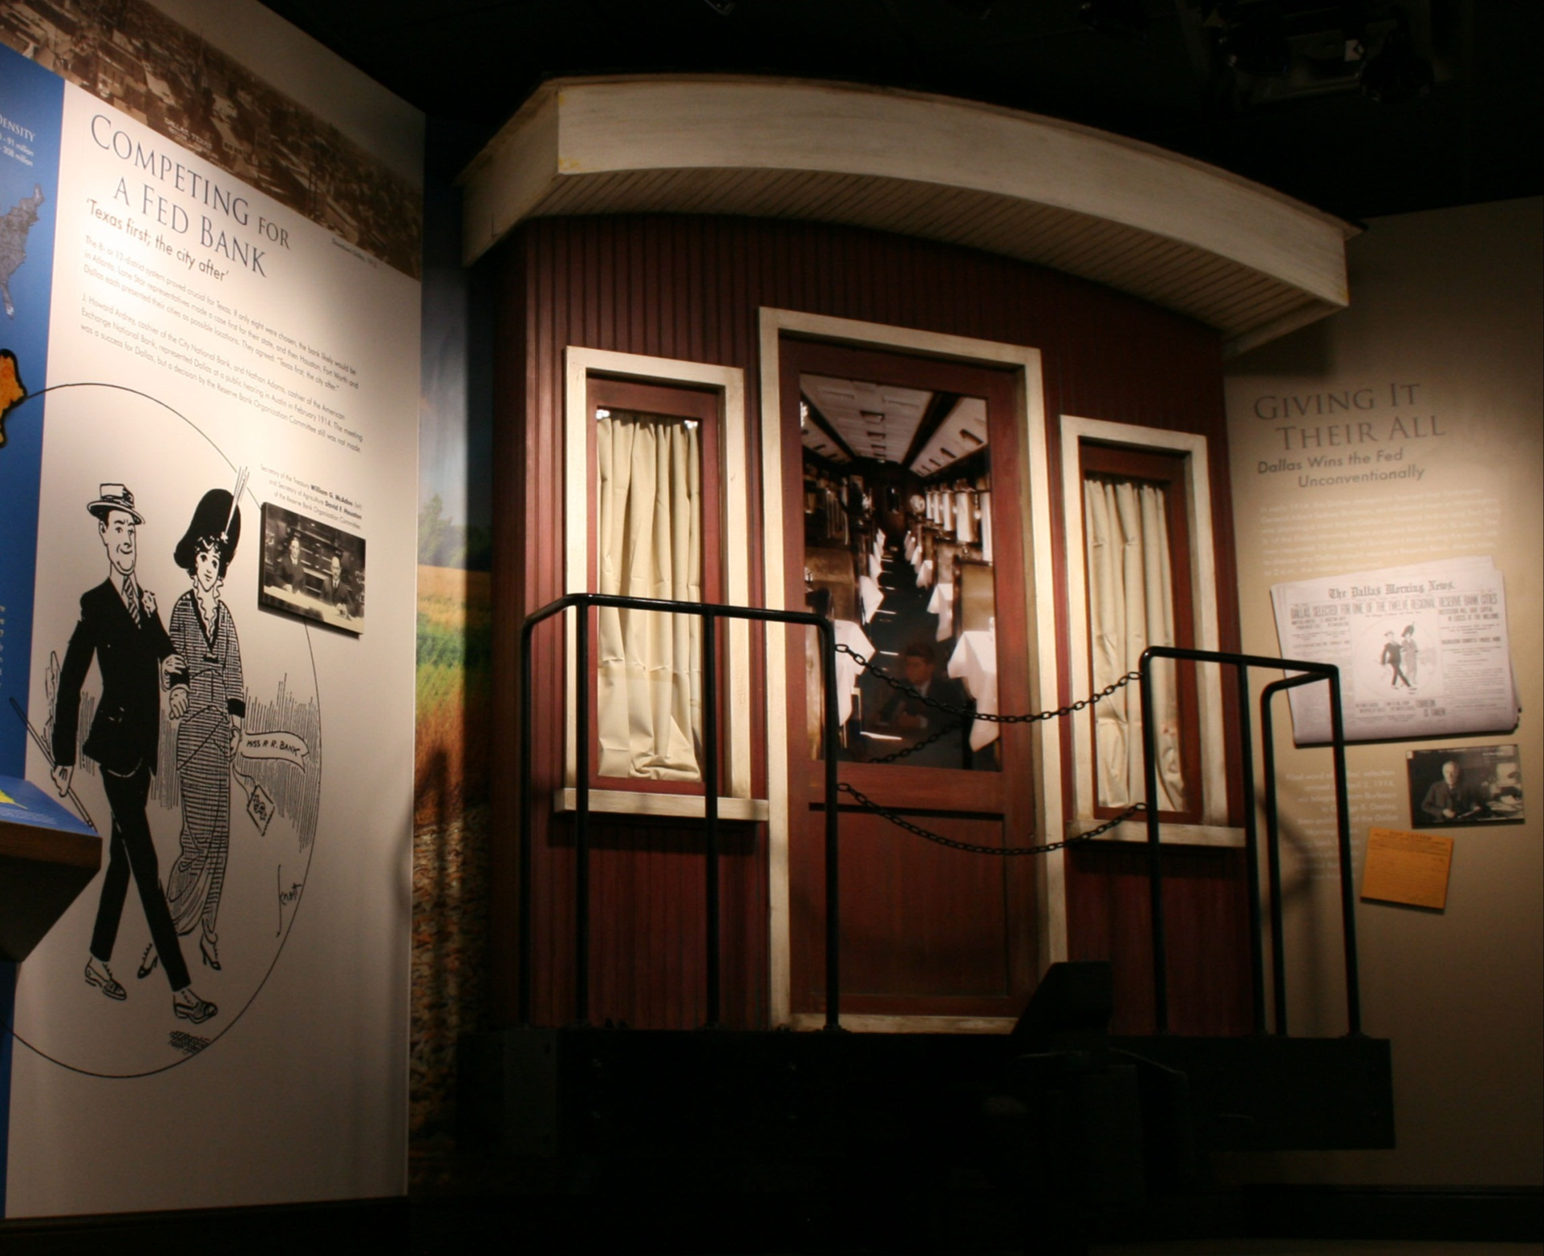
Notes:
Thanks to a man named Otto Prager—the postmaster of Washington and a loyal former Dealey employee—Mr. Dealey heard that Burleson would be traveling by train from St. Louis to Dallas. So he dispatched Dallas Morning News reporter Tom Finty and Dallas Clearing House executive Howard Ardrey to St. Louis. There, they boarded the train and “accidentally” ran into Postmaster General Burleson. By the time the train arrived in Dallas, Burleson was convinced that our city deserved a Federal Reserve Bank.
At Dealey’s urging, Burleson contacted Treasury Secretary McAdoo and argued the merits of selecting Dallas, backed up by this document here, pulled together by the Dallas Chamber, the Dallas Clearing House and the Dallas Cotton Exchange.

Slide 28
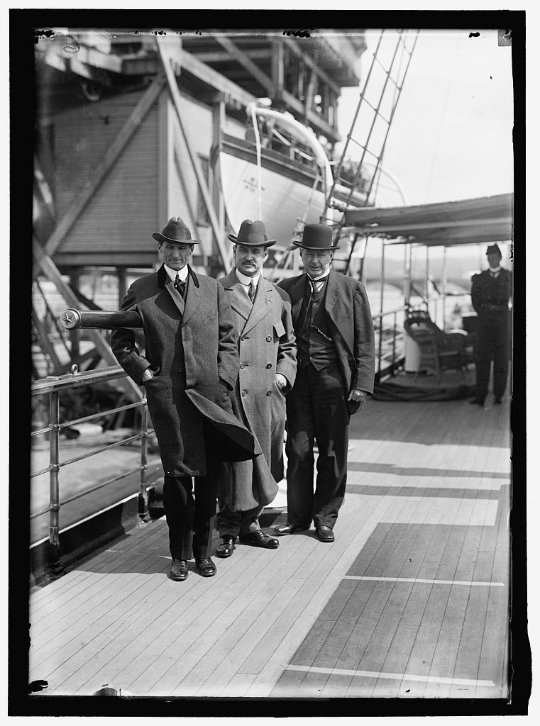
Notes:
http://lcweb2.loc.gov/service/pnp/hec/02300/02301v.jpg
McAdoo, Houston and Burleson

Slide 29
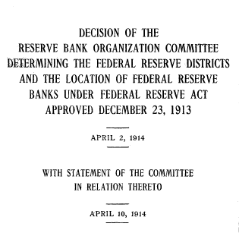
Notes:
Debate about the appropriate structure and governance of the System and the number of Reserve Banks
Those favoring a concentrated system felt that the number of Reserve Banks should be kept at a minimum and some, including financier J.P Morgan, thought that New York should have the largest Reserve Bank in terms of capital and should serve most of the northeastern United States
Bankers in other parts of the country thought otherwise, advocating for the maximum number of Reserve Banks with roughly equal capital to regionalize the system.
On April 2, 1914, the RBOC announced its decision and published a report describing the selection process. In drawing the districts and selecting Reserve Bank cities, the committee considered the following criteria:
The ability of the member banks within the district to provide the minimum capital of $4,000,000 required for the Federal Reserve Bank, on the basis of six per cent of the capital stock and surplus of member banks within the district. (required by Federal Reserve Act)
The mercantile, industrial, and financial connections existing in each district and the relations between the various portions of the district and the city selected for the location of the Federal Reserve Bank.
The probable ability of the Federal Reserve Bank in each district, after organization and after the provisions of the Federal Reserve Act shall have gone into effect, to meet the legitimate demands of business, whether normal or abnormal, in accordance with the spirit and provisions of the Federal Reserve Act.
The fair and equitable division of the available capital for the Federal Reserve banks among the districts created.
The general geographical situation of the district, transportation lines, and the facilities for speedy communication between the Federal Reserve Bank and all portions of the district.
The population, area, and prevalent business activities of the district, whether agricultural, manufacturing, mining, or commercial, its record of growth and development in the past and its prospects for the future.
Of the thirty-seven cities that applied to have Reserve Banks, twelve were selected.
Criticism of decision:
Denver and New Orleans both wanted to be headquarter cities with Texas as part of their territory.
New Orleans and Baltimore were in an uproar, both cities were larger than some selected.
Richmond’s selection as a Reserve Bank location also engendered criticism, because Atlanta—another southeastern city—was also designated a Reserve Bank city.
Willis argued that political pressure played a role in Richmond’s selection
Cleveland’s selection over Cincinnati or Pittsburgh
Two Reserve Banks in Missouri—Kansas City and St. Louis—and linked the decision to the numerous Missouri politicians then in office.
RBOC published a statement defending its decision on April 10, 1914, and the results of the poll conducted among national banks
RBOC explained that New Orleans didn’t receive Reserve Bank designation because although the size of the banks in New Orleans, Atlanta, and Dallas were similar at the time, the previous decade had seen the Atlanta and Dallas banking markets double, while the size of the New Orleans market had changed little. As for Richmond, the RBOC referred to the bankers’ poll that showed Richmond receiving more votes than Baltimore.
In ninety-eight days, the RBOC completed its task of organizing the system of Reserve Banks, and the twelve Federal Reserve District Banks opened for business less than one year after the committee was formed.

Slide 30
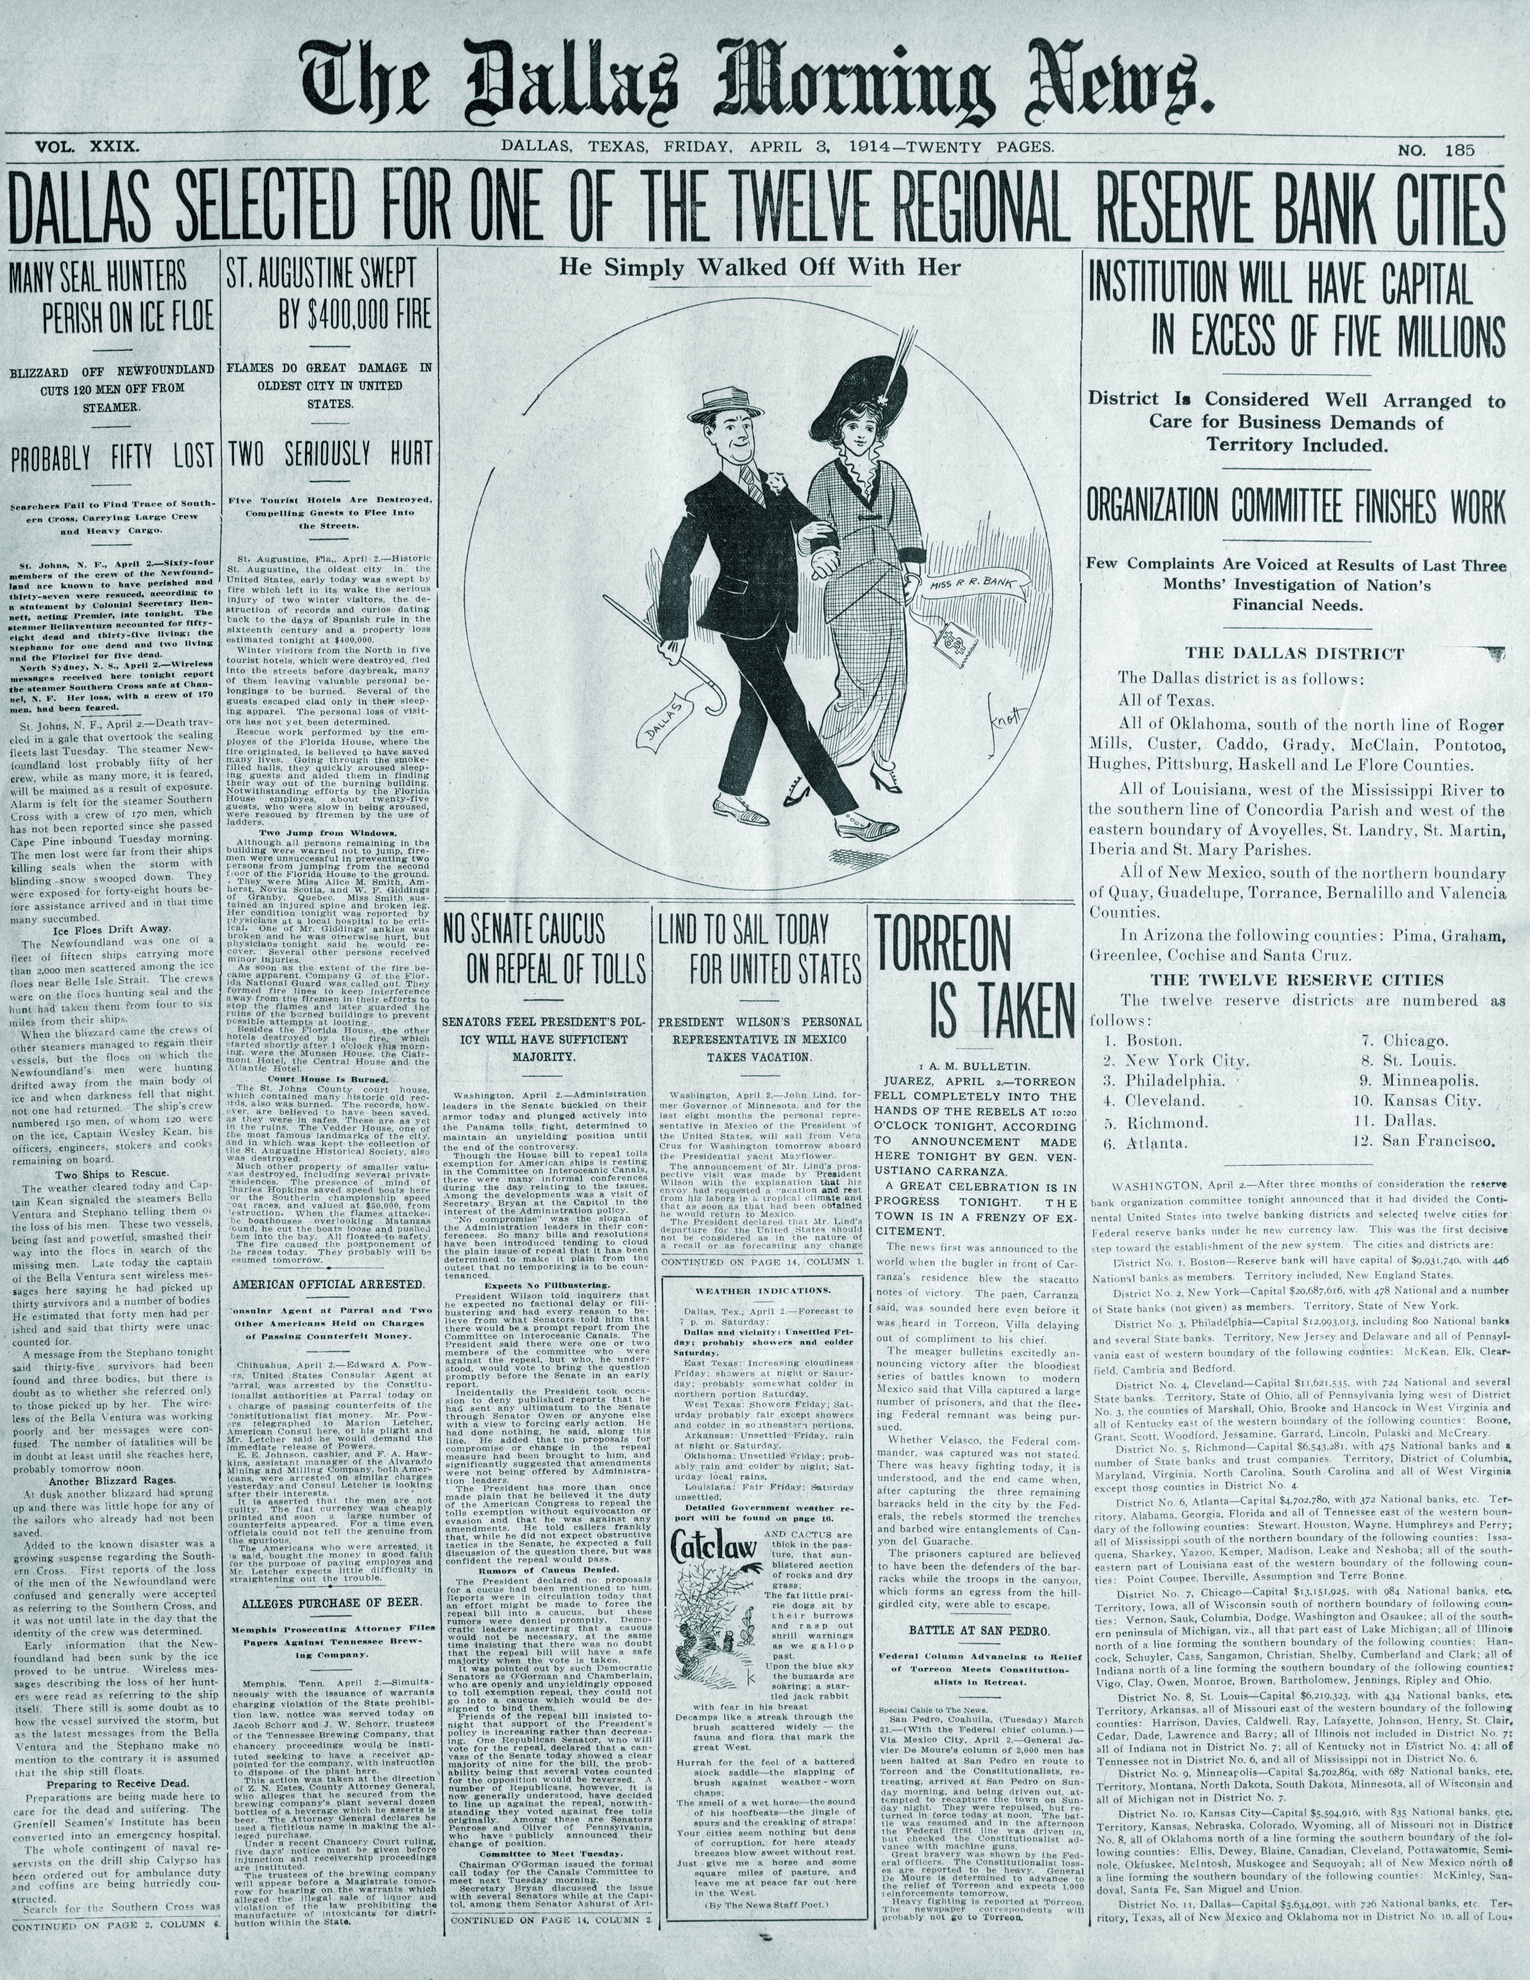
Notes:
The Dallas Morning News, Dealy’s paper, proudly announced the news on April 3, 1914

Slide 31
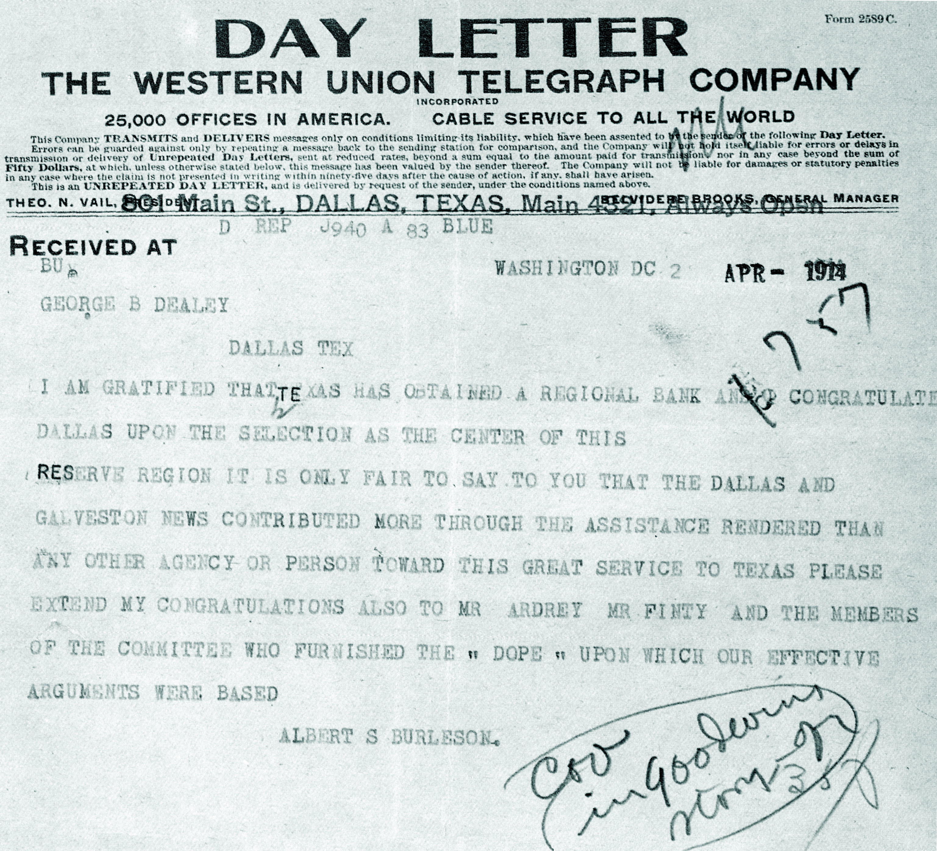
Notes:
Congratulations from Burleson to George Dealy

Slide 32
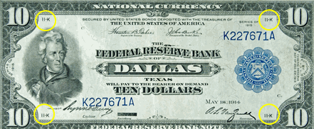

Slide 33
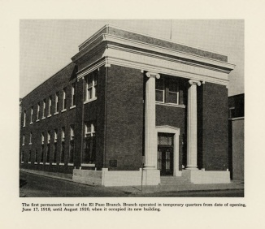
Notes:
Opened June 17, 1918
Moved to Myrtle Ave in 1919

Slide 34
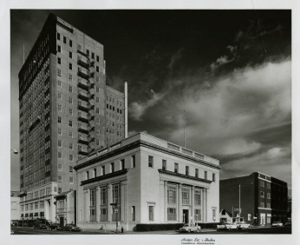
Notes:
August 4, 1919
Moved to Texas Ave in 1922

Slide 35
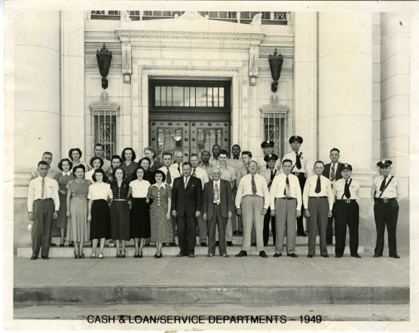
Notes:
July 5, 1927
Opened new building in 1928

Slide 36
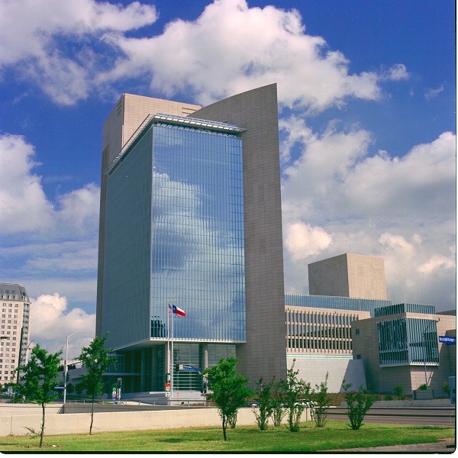
Notes:
The Federal Reserve continues its work today. Bringing the views and the voice of the residents of the 11th District to the decisionmaking table in monetary policy, providing financial services to the banks and to the U.S. government, and supervising the banks and financial institutions to make sure that they are safe and sound.

