Slide 2

Standard 14:
Entrepreneurship

Slide 3
If you were asked to name an entrepreneur, who would come to mind?

Slide 4




Innovative Entrepreneurs vs. Replicative Entrepreneurs

Slide 5
What resources are used to produce a meal in your favorite restaurant?

Slide 6
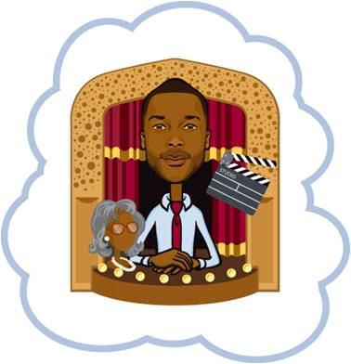
What resources did their business require?
What risks did they take?
Notes:
Putting their own resources on the line

Slide 7


How can entrepreneurs acquire the financial capital to buy the resources needed for their businesses?
What would happen to an entrepreneur who does not have access to credit?

Slide 8
Grand Opening
Going Out of Business!
Everything Must Go!
Entrepreneurs in the Marketplace

Slide 9
An Entrepreneurial Society
Tax policies
Government services and public goods
Regulation
Property rights

Slide 10
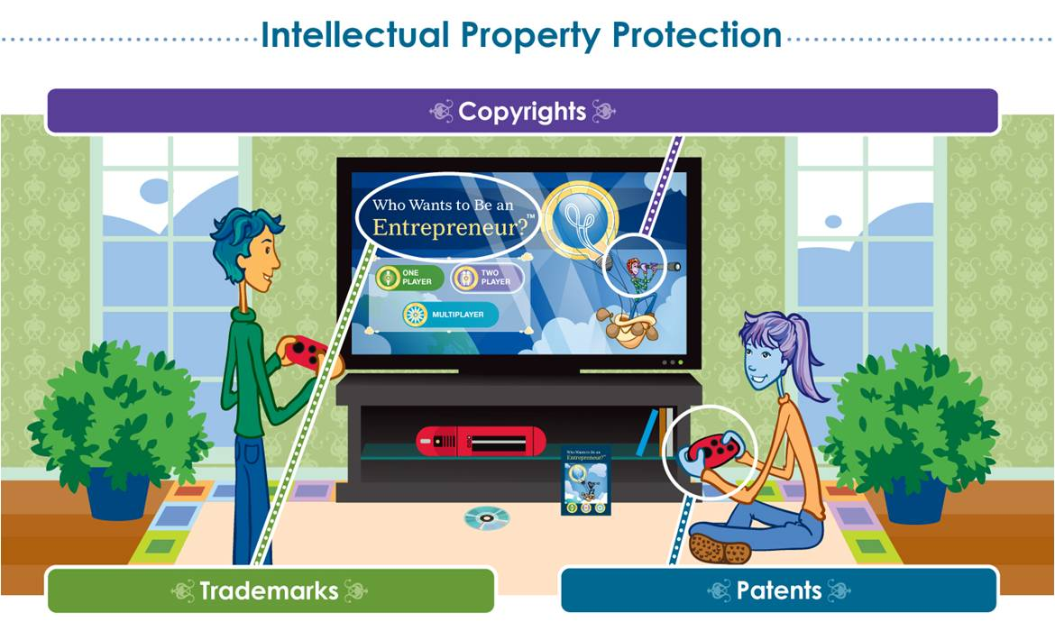

Slide 11
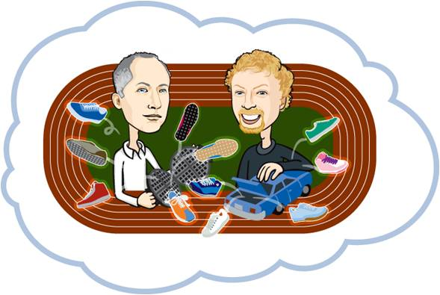


Slide 12
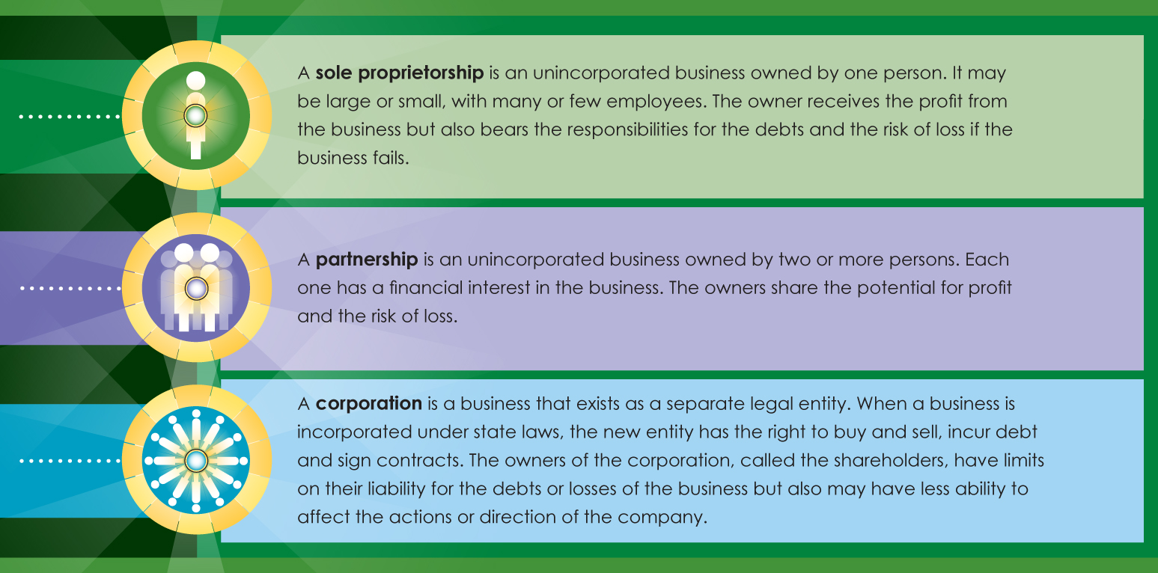

Slide 13
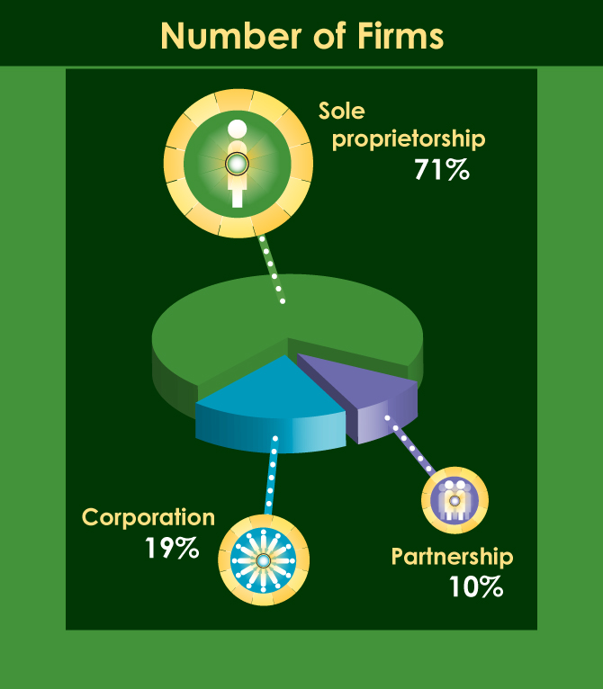
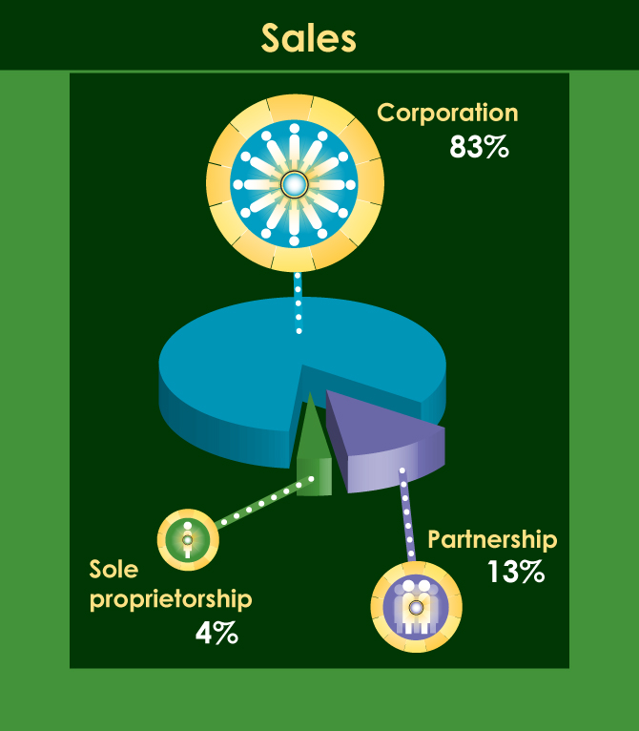

Slide 14
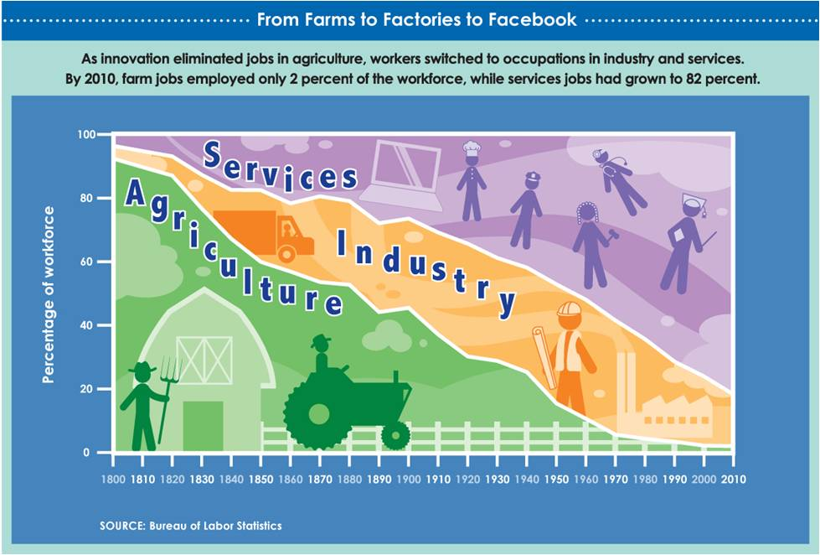
Explore the Concept…
Innovation, Productivity and Economic Growth

Slide 15
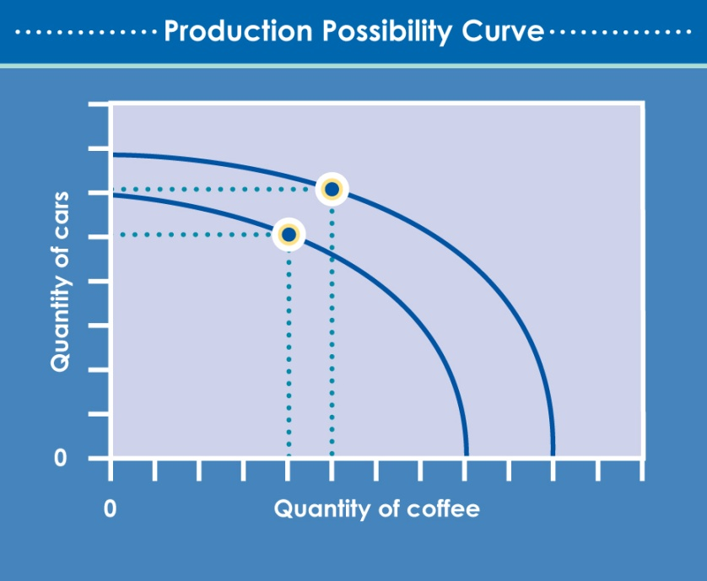
Modeling Economic Growth
Productivity rises as a nation
Builds its capital stock
Upgrades workers’ skills
Innovates and introduces new technology

Slide 16

Questions?
The views expressed are solely those of the presenter and do not reflect those of the Federal Reserve System or the Federal Reserve Bank of Dallas.

