Slide 1
Session 12 Money and Financial Markets

Slide 2
TEKS
(12) Economics. The student understands the role of money in an economy. The student is expected to:
(A) describe the functions of money;
(B) describe the characteristics of money, including commodity money, fiat money, and representative money; and
(C) examine the positive and negative aspects of barter, currency, credit cards, and debit cards.

Slide 3
TEKS
(17) Personal financial literacy. The student understands the role of financial markets/institutions in saving, borrowing, and capital formation. The student is expected to:
(A) explain the functions of financial institutions and how they affect households and businesses;
(B) explain how the amount of savings in an economy is the basis of capital formation;
(C) analyze the role of interest and risk in allocating savings to its most productive use; and

Slide 4
Teaching the Terms
Commodity money
Fiat money
Representative money
Liquidity
Default

Slide 5
Problems with barter
Inefficient
Time consuming
Difficult to satisfy wants and needs consistently

Slide 6
Functions of Money
Unit of account
Store of value
Medium of exchange

Slide 7
Sources of Money’s Value
Commodity Money – medium of exchange has intrinsic value
Representative money – medium of exchange represents a claim on an item of value
Fiat Money – medium of exchange has value by government decree

Slide 8
Characteristics of Money
Portable
Durable
Divisible
Uniform
Limited
Acceptable

Slide 9
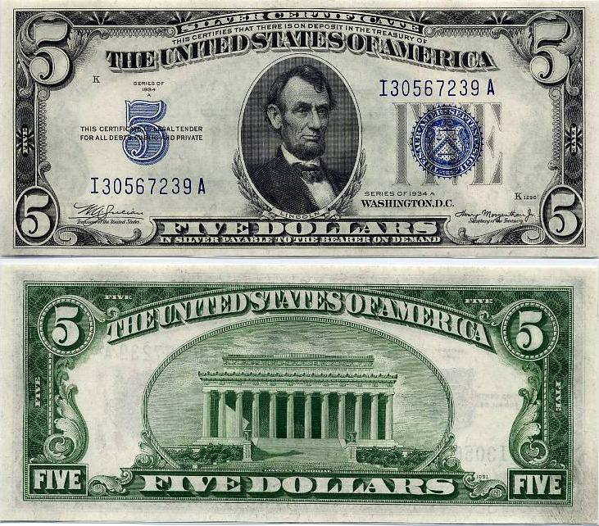
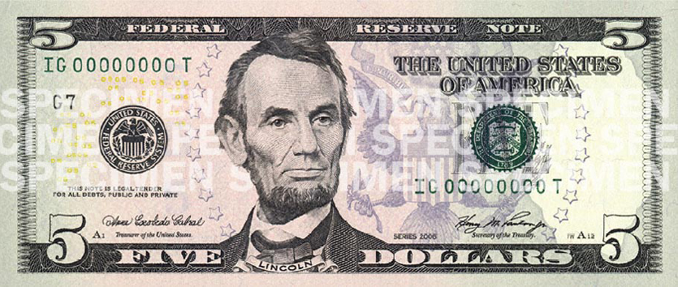
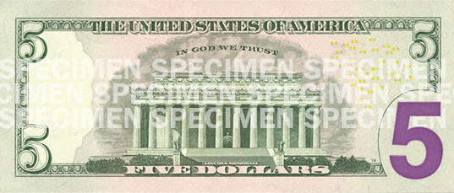
What is the difference?
Notes:
Silver certificate image: http://en.wikipedia.org/wiki/File:Silvercertificate.jpg
5 dollar bill image: http://en.wikipedia.org/wiki/United_States_five-dollar_bill

Slide 10
Monetary Aggregates
Currency and coins
Checkable deposits
Traveler’s checks
M1

Slide 11
Monetary Aggregates
M1
Savings accounts
Time deposits <$100K
M2
Money Market Mutual Funds

Slide 12
Liquidity
Ability to convert an asset to a medium of exchange without loss of value
Factors that affect liquidity include
Time constraints
Withdrawal restrictions
Minimum deposits
Market conditions
When liquidity decreases, savers demand compensation (interest)

Slide 13
Money
Credit Cards
Credit cards represent a loan. The card (or the number) is simply a way to access a line of credit.
On the other hand, a debit card is a way to spend checkable deposits, just like a paper check.

Slide 14
Financial Markets
Savers
Financial Intermediaries
Indirect Finance
Borrowers
Financial Markets
Direct Finance

Slide 15
Types of Financial Intermediaries
Banks, savings and loans, credit unions
Mutual funds
Life insurance companies
Pension funds

Slide 16
Benefits of Financial Intermediaries
Reduce transaction costs by gathering and providing information
Reduce risk by allowing diversification
Increase liquidity

Slide 17
Risks of Saving or Lending
Default
The saver might not be repaid (either the original amount or the promised interest)
Liquidity
How quickly can the saver access the money?
Inflation
The interest rate might be less than the rate of inflation

Slide 18
Trade-offs
Default risk
Return

Slide 19
Trade-offs
Liquidity
Return

Slide 20
Inflation Risk
A student has saved $100 to buy an iPod, but she faces a choice
Buy it today
Loan the money to a friend for one year and buy her iPod when the loan is repaid
Why would she wait? She wants an interest payment that will allow her to buy six $1 song downloads.

Slide 21
Inflation Risk
Loan details
Loan amount = $100
Nominal interest rate = 6%
$100 iPod → $6 interest = 6 downloads
$104 iPod → $6 interest = 2 downloads
Nominal interest rate = 6%
Real interest rate = 2%

Slide 22
Questions?

