Slide 1
Everyday Economics:
Three Faces of Globalization
Disclaimer: The views expressed are those of the presenter and do not necessarily reflect those of the Federal Reserve Bank of Dallas or the Federal Reserve System.

Slide 2
Globalization
Globalization is a complex process that allows national resources to become more and more internationally mobile while national economies become increasingly interdependent and integrated.
Notes:
Three parts
Look at resources – that become mobile (they are traded) – leading to interdependent and integrated national economies.

Slide 3

Notes:
Resources – labor, land, capital and entrepreneurial ability

Slide 4
Is it globalization?
Kevin H. O’Rourke and Jeffrey G. Williamson
Historians look at:
  Shipping technologies
  Port histories
  Evolution of trading monopolies
  Rise and fall of trade routes
  Trade volumes
But rarely prices
Notes:
Economists looking for evidence of globalization must go beyond “how much” and look for evidence of integration and interdependence

Slide 5
Imagine two islands…
Both islands produce fish and coconuts
  Fishing requires boats (capital) and labor
  Coconut production requires trees (land) and labor
Different amounts of resources
  One island has many trees and few boats
  Other island has many boats, but few trees

Slide 6
Before trade…
Island with few trees and many boats
  Expensive coconuts and cheap fish
Island with many trees and few boats
  Expensive fish and cheap coconuts
Notes:
Autarky (before trade) pricing that results from the relative scarcity of productive resources

Slide 7
Trade begins…
A new navigational device allows trade between the islands
  Which island will import fish?
  Which island will import coconuts?
Notes:
Fish will be exported from the island with cheap fish and imported by the island with expensive fish
Coconuts will be exported from the island with cheap coconuts and imported by the island with expensive coconuts

Slide 8
Few trees → expensive domestic coconuts before trade
Imported foreign coconuts are cheap
Domestic price of coconuts ↓ with trade
Many boats → cheap domestic fish before trade
New export markets for fish increases demand
Domestic price of fish ↑ with trade
Notes:
Think about the island that has few trees but many boats – (cheap fish and expensive coconuts in autarky). The other island is the opposite.
Expensive coconuts no longer look very attractive. Faced with competition from producers from the other island, coconut production declines. Tree climbers might eventually learn to sail, but not right away. The value of owning local coconut trees is diminished.
Cheap fish are exported. This is great for the boat owners, the boats are at sea 7 days a week etc. Good for sailors and fishers, lots of work. New markets cause the price of fish to rise.

Slide 9
Who cares about the price of coconuts?
  People who own trees (land)
  People who climb trees (labor)
Who cares about the price of fish?
  People who own boats (capital)
  People who sail and fish (labor)
Notes:
As price of coconuts falls, land owners and labor in that industry are harmed.
As the price of fish rises, boat owners and crew benefit.

Slide 10
Is it globalization?
Was some barrier to trade removed? Did transport costs decline?
Was there a change in domestic prices?
Did prices in resource markets change?
Notes:
Are our islands globalizing? It seems that they are.

Slide 11
Before the 19th Century
Transport costs were flat on Atlantic and Asian trade routes
Trade consisted of non-competing goods
  Expensive luxuries that could bear the high costs of transportation
  No impact on domestic production
No price convergence on key commodities – cloves, coffee, pepper and cloth
Notes:
Historical picture…before 19th century, little evidence of globalization
Transport costs were flat on Atlantic and Asian trade routes
Evidence from sugar, rice and wine
Tobacco was the only trading industry with falling transport costs
Expensive luxuries that could bear the high costs of transportation
Europe imported spices, silk, sugar and gold
Asia imported silver, linens and woolens

Slide 12
19th Century Political Developments
Britain repealed the Corn Laws
Gunboat diplomacy forced Japan to open its markets
British victory in the Opium Wars caused China to open port cities to trade
Notes:
American military forces led by Commodore Matthew C. Perry forced Japan to open its markets – in 15 years following 1858, Japan’s foreign trade grew from zero to 7% of national income.

Slide 13
19th Century Innovation
Railroads
Steamships
Suez Canal and Erie Canal
Telegraph lines
Refrigeration

Slide 14
Commodity Price Gaps Decline
Notes:
Measures of price gaps on traded goods decline between 1870-1912, largely based on falling transportation costs. (e.g. bacon and refrigerated shipping)
These are the percentage difference in prices between U.S. and U.K.

Slide 15
Two Ratios
Land
Labor
Wage
Land rents
Compares the quantity of available resources
Compares the price of those resources

Slide 16
Wage-Rent Ratios in Europe

Slide 17
Wage-Rent Ratios in New World

Slide 18
Wage-Rent Ratios in Developing World

Slide 19
Second Era of Globalization
Political changes resulted from the idea that economic interdependence would help maintain peace between nations
Multinational negotiations on trade
  1947 – General Agreement on Tariffs and Trade (GATT) and subsequent trade rounds
  1995 – World Trade Organization (WTO)
Notes:
Allowed multinational corporations to manage production, delivery and sales worldwide. Services once available only from local providers were now delivered from international producers to buyers throughout the world.

Slide 20
Global Integration
Trade agreements
  World Trade Organization
  Free trade areas
    North American Free Trade Agreement (NAFTA)
    Association of Southeast Asian Nations (ASEAN)
Broader integration
  EU and Euro-zone

Slide 21
Second Era of Globalization
Innovations in transportation
  Modern container ships
  Airplanes
Innovations in communication
  Computers, cell phones, and the Internet
  Fiber optic networks
Allowed new global markets to emerge
Notes:
Allowed multinational corporations to manage production, delivery and sales worldwide. Services once available only from local providers were now delivered from international producers to buyers throughout the world.

Slide 22
Three Faces of Globalization
Trade of goods and services
Flow of financial capital
Movement of people

Slide 23
Trade of Goods and Services
Between 1960 and 2000, the share of the world’s production that was exported increased from 12% to 25%
Two types of trade
  Trade of goods
  Trade of services
Notes:
Look at the first of the three faces of globalization
Steel used in factories around the world is produced in Europe, North America and Asia. Capital equipment used by businesses is bought and sold in a global market. Cranes and bulldozers move to construction sites far from the place of manufacture. Clothing, textiles and a host of other consumer goods travel internationally to their final destination.
Wide range of services, from call center operations to sophisticated financial, engineering, legal, medical and entertainment services. Interestingly, foreign audiences often account for more than half of Hollywood’s box-office revenues from movies, and American programmers design video games that are played all over the world. McDonald’s and KFC might appear to be on every corner in the U.S., but they have more restaurants in other countries. American architects design office towers, airports and stadiums in China, Dubai, Canada and other foreign locales. International students enroll at American universities and create jobs for faculty and staff at the schools. American forensic experts investigate accidents and crimes around the globe. Foreign tourists visit the United States and create job opportunities at hotels, airlines and tourist attractions.

Slide 24
Why trade?
Arbitrage
Absolute advantage
Comparative advantage

Slide 25
Sources of Comparative Advantage
Investments in technology
Relative supply of key inputs
  Land (natural resources)
  Labor (both skilled and unskilled)
  Capital
Government services and regulations

Slide 26
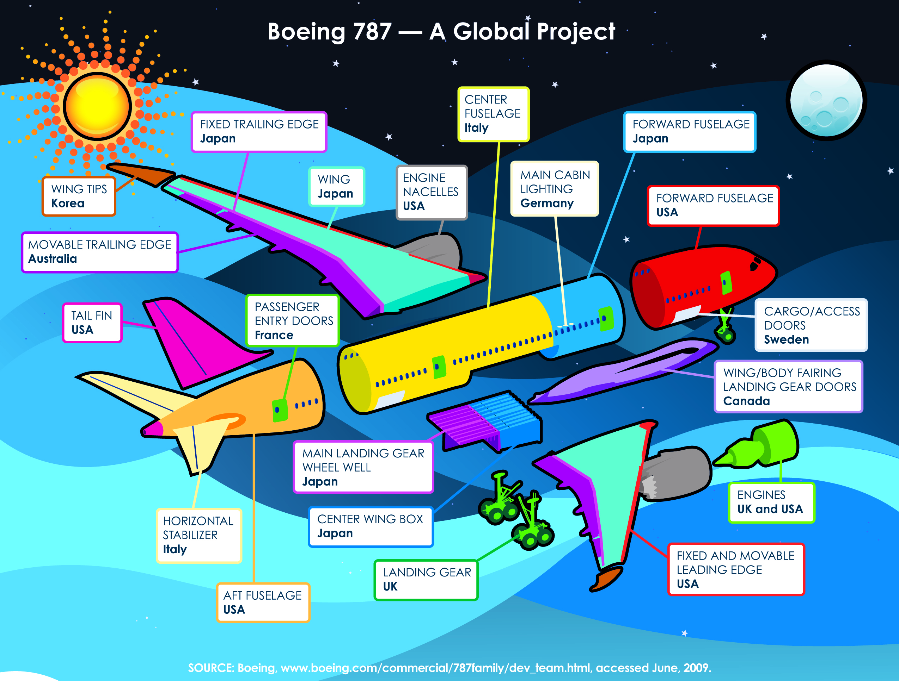
Notes:
Boeing 787 – assembled outside of Seattle, Washington, but individual sections are built across the globe
Segmented production process requires communication, standards, etc.
Parts of the plane arrive in Washington from China, South Korea, Australia, Japan, Canada, England, France, Sweden and Italy, as well as multiple states in the U.S.
Other examples include Mini and iPod.

Slide 27
Movement of People
Emigration vs. Immigration
Late 20th century was dramatically different from late 19th and early 20th
Notes:
Emigration the departure of both skilled and unskilled workers from their country of origin
Immigration, new residents compete for jobs in a variety of fields and change the dynamics of the labor market in the destination country

Slide 28
Immigration to the Americas
Thousands
Notes:
Note: Migrations of the 1920s never recovered to the levels of the 1880s, let alone those of the 1895-1914 period. Most of the collapse in mass migration was due to a sharp decline in emigration from “new source” countries in southern & eastern Europe (Austro-Hungarian empire, Russian empire, Iberia, Italy & the Balkans); emigration from “old source” countries in northwestern Europe (British Isles, Scandinavia, Low Countries, Germany, France, Switzerland) hardly declined at all. Note also that the US saw the biggest decline in immigration
Four pieces of legislation were enacted in eth US between 1917 and 1927 with the intent of limiting immigration: 1917 Literacy Act; 1921 Quota Act (restricting immigration from Eastern Hemisphere countries); 1924 Johnson-Reid Act (lowered immigrant quotas from 356,000 to 165,000); 1927 National Origins Act (set the overall immigration quota at about 150,000 based on national origins of the US population in 1920).
Note economic conditions also played an important role in dampening migration – from the early 1930s to the mid 1940s none of the US country quotas was binding
Sources: Based on Figure 9.2, p.182 of Timothy J. Hatton & Jeffrey G. Williamson, Global Migration and the World Economy: Two Centuries of Policy and Performance, Cambridge MA: MIT Press. Original data from Table 2, p. 280 of Dudley Kirk, 1946, Europe’s Population in the Interwar Years, Princeton: Princeton University Press (for the League of Nations) and various tables in Imre Ferenczi and Walter F. Willcox, 1929, International Migrations: Volume 1 - Statistics, New York: National Bureau of Economic Research.

Slide 29
Flow of Financial Capital
Foreign Direct Investment
  the purchase of physical capital such as buildings, tools and machinery in other parts of the world
Foreign Portfolio Investment
  the purchase of financial assets that originate outside of the buyer’s country of residence and are valued in a foreign currency
Notes:
Some companies import intermediate products from foreign firms, as is the case with the Boeing plane. Other firms decide to locate their own plants or production facilities in other countries. Rather than producing all its soft drinks in one plant and exporting them from there, Coca Cola builds regional bottling plants across the world to serve its growing international customer base. Japanese and European car manufacturers have built enormous new plants in the United States as U.S. automobile companies build facilities in other countries. These firms are seeking both lowest cost resources as inputs to production and freer access to global markets that comes from owning a plant in a given region.
FDI rose from less than $100 billion annually in 1980 to $1.4 trillion in 2000.
Multinational corporations own facilities and employ workers throughout the world
Investors might be banks, pension funds or private individuals seeking the highest return for their investments in both domestic and international financial markets.
FPI is somewhat different from FDI because the ownership of these financial assets does not imply a controlling interest or a majority stake in a foreign business.
Some fear that foreign portfolio investment can be volatile and lead to financial panics.

Slide 30
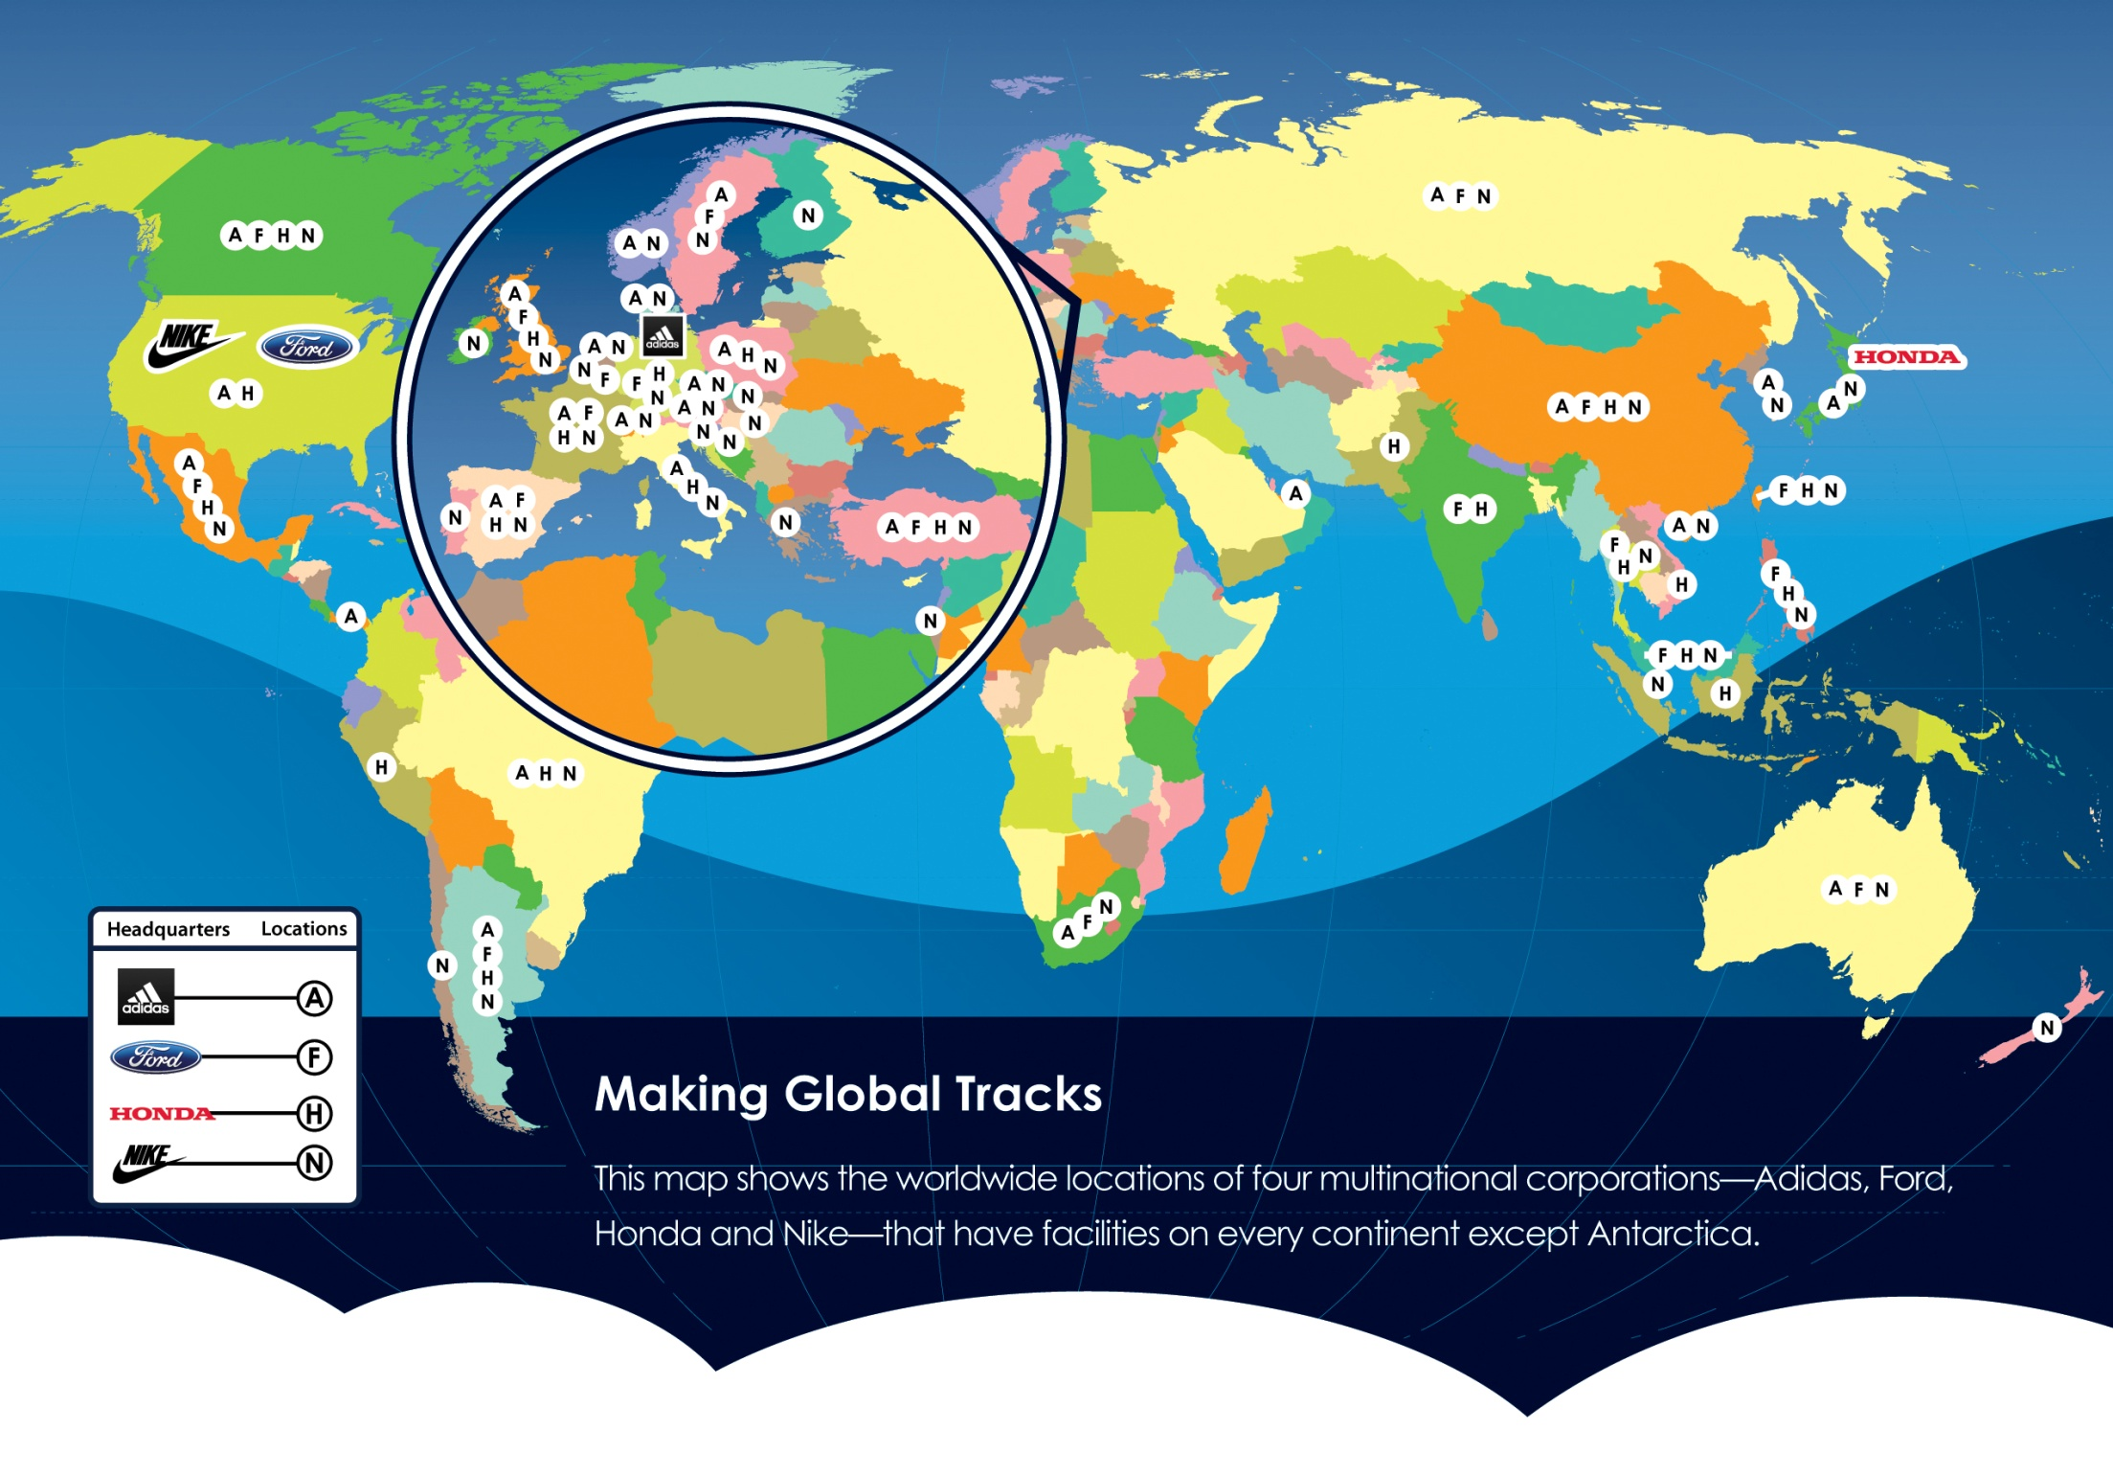

Slide 31
Foreign Exchange Markets
Market where currencies from around the world are bought and sold
Largest financial market in the world
Operates 24 hours a day
Global market
Notes:
If Americans want to buy Japanese products, they must pay the Japanese firm with yen, the Japanese currency. The foreign exchange market allows Americans to buy the necessary yen using U.S. dollars. In other words, Americans are selling U.S. dollars in order to buy yen.
Japanese who wish to buy stock in an American company must first buy U.S. dollars. To do so, they must sell yen.
The number of U.S. dollars required to buy yen (or the number of yen required to buy a U.S. dollar) is called the exchange rate.

Slide 32
Exchange Rates
One exchange rate is the reciprocal of another exchange rate
  If €1 = $2.00, then $1 = €0.50
As the exchange rate fluctuates, the value (or strength) of each currency is affected
When one currency strengthens, the other weakens

Slide 33
Weakening Dollar / Strengthening Euro
Value of
$1 = €1.00 (or €1 = $1.00)
U.S. dollar
$1 = €0.67 (or €1 = $1.50)
Falling
$1 = €0.50 (or €1 = $2.00)

Slide 34
Weakening Euro / Strengthening Dollar
Value of
Euro
Falling
€1 = $2.00 ($1 = €0.50)
€1 = $1.50 ($1 = €0.67)
€1 = $1.00 ($1 = €1.00)

Slide 35
A stronger U.S. dollar means …
U.S. can buy foreign goods more cheaply and U.S. imports will increase
Foreigners find U.S. goods more expensive and U.S. exports fall

Slide 36
A weaker U.S. dollar means …
Foreigners can buy American goods more cheaply and U.S. exports will increase
Foreigner goods become more expensive for U.S. residents and U.S. imports fall

Slide 37
Questions?
To order Globalization, visit http://www.dallasfed.org/educate/pubs/index.html

Slide 38
Sources
O’Rourke, Kevin H., and Jeffrey G. Williamson (1999), “The Heckscher-Ohlin Model Between 1400 and 2000: When It Explained Factor Price Convergence, When It Did Not, and Why,” NBER Working Paper Series, no. 7411 (Cambridge, Mass., National Bureau of Economic Research, November).
O’Rourke, Kevin H., and Jeffrey G. Williamson (2000), “When Did Globalization Begin?” NBER Working Paper Series, no. 7632 (Cambridge, Mass., National Bureau of Economic Research, April).

