Slide 1
Globalization
Disclaimer: The views expressed are those of the presenters and do not necessarily reflect those of the Federal Reserve Bank of Dallas or the Federal Reserve System.

Slide 2
Imagine two islands…
Both produce fish and coconuts
  Fishing requires boats (capital) and labor
  Coconut harvest requires trees (land) and labor
Different amounts of resources
  One island has many trees and few boats
  Other island has many boats, but few trees

Slide 3
The Impact of Trade
Who cares about the price of coconuts?
  People who eat coconuts
  People who own trees (land)
  People who climb trees (labor)
Who cares about the price of fish?
  People who eat fish
  People who own boats (capital)
  People who sail and fish (labor)

Slide 4
Who Could Object?
Domestic Price > World Price
Country imports → domestic price falls
Domestic consumers benefit.
Domestic producers are harmed.

Slide 5
Who Could Object?
Domestic Price < World Price
Country exports → domestic price rises
Domestic producers benefit.
Domestic consumers are harmed.

Slide 6
1870’s to 1920
Imperialism
Globalization

Slide 7
Globalization
Increased integration of the world’s economies
  Trade in goods and services
  Flows of capital
  Movements of people
Driven by political changes and technological innovation

Slide 8
Globalization
Historical
Technologies
Port Histories
Economic
Prices
Trading Monopolies
Volumes
Prices
Prices
Prices

Slide 9
It is globalization if…
Trade-creating forces change domestic commodity prices
  Decline in transportation costs
  Removal of barriers to trade
Changes in domestic commodity prices induce a reshuffling of resources between economic activities

Slide 10
Before the 19th Century
Transport costs were flat on Atlantic and Asian trade routes
Trade consisted of non-competing goods
  Expensive luxuries that could bear the high costs of transportation
  No impact on domestic production
No price convergence on key commodities – cloves, coffee, pepper and cloth

Slide 11
19th Century Political Developments
Britain repealed the Corn Laws
Gunboat diplomacy forced Japan to open its markets
British victory in the Opium Wars caused China to open port cities to trade
Open Door Policy
Dollar Diplomacy
Spanish-American War

Slide 12
19th Century Innovations
Transportation
  Railroads
  Steamships
  Refrigeration
  Suez Canal and Erie Canal
Communication
  Telegraph lines

Slide 13
Mind the (Price) Gap

Slide 14
Mind the (Price) Gap

Slide 15
Comparing Resource Prices
Ratio compares the price of labor and the price of using land
Falls when wages fall or rents rise
Rises when wages rise or rents fall
Wage
Rent

Slide 16
Wage-Rent Ratios

Slide 17
Three Faces of Globalization
Trade of goods and services
Movement of people
Flow of financial capital

Slide 18
Globalization and history
Globalization not new
Keynes
  “Internationalization” of economic life in 1913 “…normal, certain and permanent, except in the direction of further improvement…”
Notes:
“What an extraordinary episode in the economic progress of man that age was which came to an end in August 1914! The greater part of the population, it is true, worked hard and lived at a low standard of comfort, yet were, to all appearances, reasonably contented with this lot. But escape was possible, for any man of capacity or character at all exceeding the average, into the middle and upper classes, for whom life offered, at a low cost and with the least trouble, conveniences, comforts, and amenities beyond the compass of the richest and most powerful monarchs of
other ages. The inhabitant of London could order by telephone, sipping his morning tea in bed, the various products of the whole earth, in such quantity as he might see fit, and reasonably expect their early delivery upon his doorstep; he could at the same moment and by the same means adventure his wealth in the natural resources and new enterprises of any quarter of the world, and share, without exertion or even trouble, in their prospective fruits and advantages; or he could decide to couple the security of his fortunes with the good faith of the townspeople of any substantial municipality in any continent that fancy or information might recommend. He could secure forthwith, if he wished it, cheap and comfortable means of transit to any country or climate without passport or other formality, could despatch his servant to the neighbouring office of a bank for such supply of the precious metals as might seem convenient, and could then proceed abroad to foreign quarters, without knowledge
of their religion, language, or customs, bearing coined wealth upon his person, and would consider himself greatly aggrieved and much surprised at the least interference. But, most important of all, he regarded this state of affairs as normal, certain, and permanent, except in the direction of further improvement, and any deviation from it as aberrant, scandalous, and avoidable. The projects and politics of militarism and imperialism, of racial and cultural rivalries, of monopolies, restrictions, and exclusion, which were to play the serpent to this paradise, were little more than the amusements of his daily newspaper, and appeared to exercise almost no influence at all on the ordinary course of social and economic life, the internationalisation of which was nearly complete in practice.”
John Maynard Keynes The Economic Consequences of the Peace (online at http://socserv.mcmaster.ca/econ/ugcm/3ll3/keynes/peace.htm)

Slide 19
Immigration to the U.S.
Thousands

Slide 20
19th Century Movement
Thousands

Slide 21
After WWI
1917 Literacy Act
1921 Quota Act (restricting immigration from Eastern Hemisphere countries)
1924 Johnson-Reid Act (lowered immigrant quotas from 356,000 to 165,000)
1927 National Origins Act (set the overall immigration quota at about 150,000 based on national origins of the US population in 1920)

Slide 22
Second Era of Globalization
Political changes resulted from the idea that economic interdependence would help maintain peace between nations
Multinational negotiations on trade
  1947 – General Agreement on Tariffs and Trade (GATT) and subsequent trade rounds
  1995 – World Trade Organization (WTO)

Slide 23
GATT
“Provisional” agreement (1948 – 1994)
Dramatic tariff reductions were negotiated in a series of trade rounds
Grew from 23 to 123 countries

Slide 24
WTO
WTO created in the Uruguay trade round
Established in Geneva in 1995
153 member countries
GATT was updated and still forms the legal framework for WTO negotiations on the goods trade

Slide 25
WTO
WTO provides a negotiating forum and a place to settle trade disputes
Governed by a set of international agreements
  GATT
  GATS (General Agreement on Trade in Services)
  TRIPS (Agreement on Trade-Related Aspects of Intellectual Property Rights)

Slide 26
Regional Trade Agreements
Examples include
  North American Free Trade Agreement
  Association of Southeast Asian Nations
  Common Market of the South (MERCOSUR)
  European Union
Regional agreements have been praised and criticized

Slide 27
Second Era of Globalization
Innovations in transportation
  Modern container ships
  Airplanes
Innovations in communication
  Computers, cell phones, and the Internet
  Fiber optic networks
Allowed new global markets to emerge

Slide 28
20th Century Trade
Between 1960 and 2000, the share of the world’s production that was exported increased from 12% to 25%
New types of trade

Slide 29
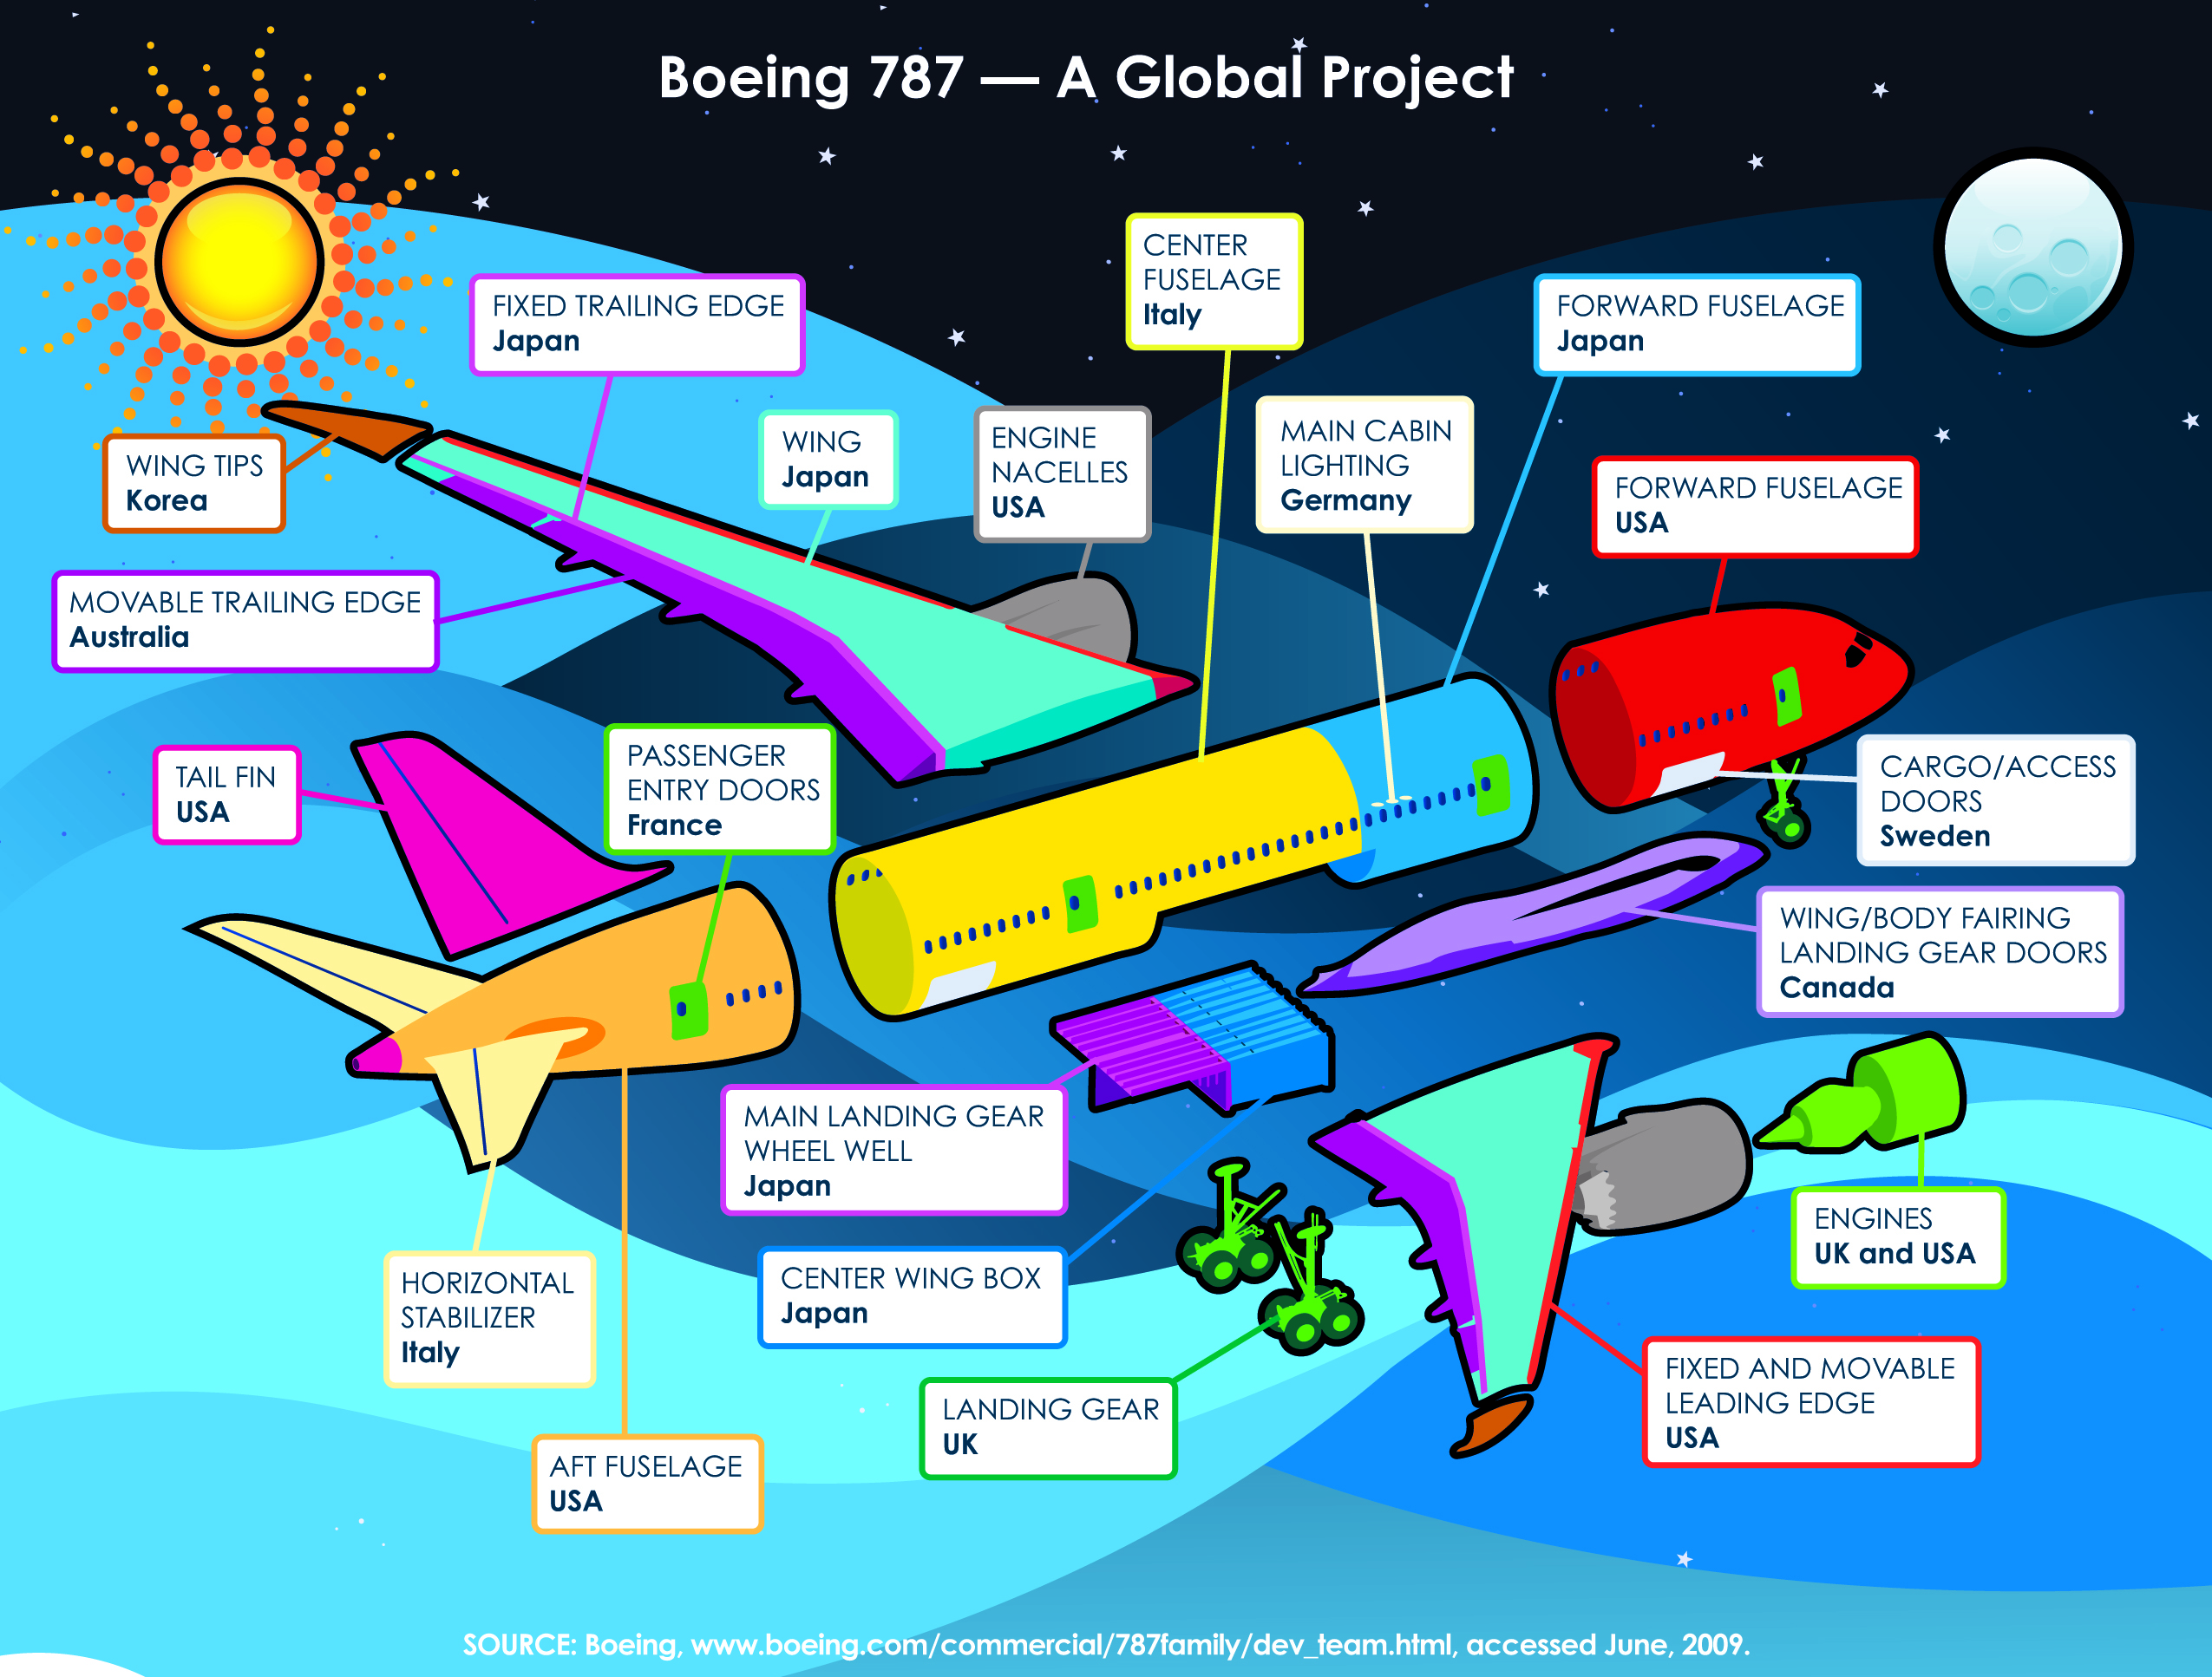

Slide 30
20th Century Capital
Foreign Direct Investment
  the purchase of physical capital such as buildings, tools and machinery in other parts of the world
Foreign Portfolio Investment
  the purchase of financial assets that originate outside of the buyer’s country of residence and are valued in a foreign currency

Slide 31
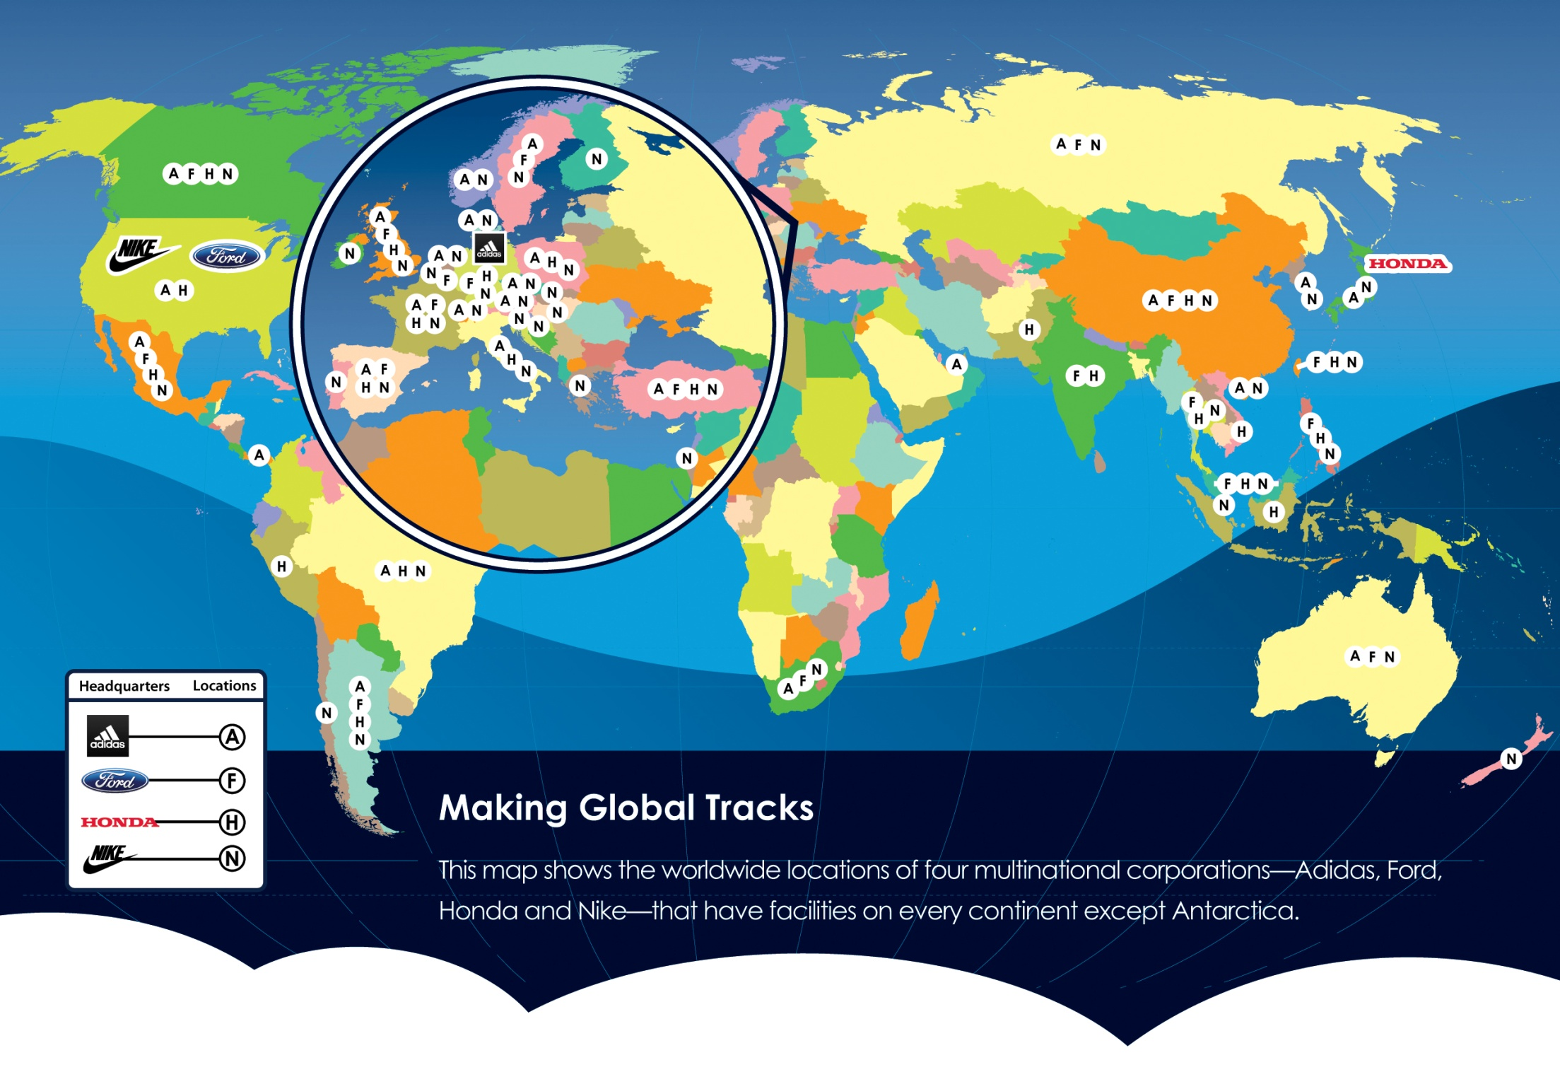

Slide 32
20th Century Movement
Emigration vs. Immigration
Late 20th century was dramatically different from late 19th and early 20th

Slide 33
Questions?

Slide 34
Sources
O’Rourke, Kevin H., and Jeffrey G. Williamson (1999), “The Heckscher-Ohlin Model Between 1400 and 2000: When It Explained Factor Price Convergence, When It Did Not, and Why,” NBER Working Paper Series, no. 7411 (Cambridge, Mass., National Bureau of Economic Research, November).
O’Rourke, Kevin H., and Jeffrey G. Williamson (2000), “When Did Globalization Begin?” NBER Working Paper Series, no. 7632 (Cambridge, Mass., National Bureau of Economic Research, April).

