Slide 1
The Role of Government
The opinions expressed are solely those of the presenters and do not reflect the opinions of the Federal Reserve Bank of Dallas or the Federal Reserve System.

Slide 2
Role of Government in a Market Economy
Maintain legal and social framework
Maintain competition
Provide public goods and services
Redistribute income
Correct for externalities
Stabilize the economy

Slide 3
Two Types of Policies
Fiscal Policy
Monetary Policy
The use of spending and taxation by the federal government (Congress and the President) to affect economic activity
The actions of a central bank to affect the availability and cost of money and credit in order to achieve national economic goals

Slide 4
Roles of Government
Correct for externalities
Provide public goods and services
Redistribute income
Stabilize the economy

Slide 5
Externalities
Benefits or costs from a transaction extend beyond the buyer or seller
Positive externalities
Education
Technology spillovers or patent protection
Negative externalities
Pollution

Slide 6
Fiscal Policy Tasks
Correct for externalities
Provide public goods and services
Redistribute income
Stabilize the economy

Slide 7
Potential Market Failures
 |  | Rival in Consumption?
 |  | Yes | No
Excludable? | Yes | Private Goods | Natural Monopolies
 | No | Common Resources | Public Goods

Slide 8
 |  | Rival in Consumption?
 |  | Yes | No
Excludable? | Yes | Private Goods Clothing Congested toll roads Ice cream | Natural Monopolies Fire protection Cable TV Uncongested toll roads
 | No | Common Resources Fish in the ocean Environment Congested non-toll roads | Public Goods Tornado siren National defense Uncongested non-toll roads

Slide 9
Potential for Market Failure
Public goods are subject to a free-rider problem
Lighthouse, basic research
Common resources can lead to the tragedy of the commons
Clean air and water, congested cities

Slide 10
Natural Monopolies
Some industries are characterized by conditions that create barriers to entry
Location
Economies of scale
Utilities are the classic example
Water
Cable television
Electricity

Slide 11
Protected Monopolies
Barriers to entry in some industries are the result of specific protections granted by government
Licenses
Patents
Examples
Concessions in national park
Pharmaceuticals

Slide 12
Fiscal Policy Tasks
Correct for externalities
Provide public goods and services
Redistribute income
Stabilize the economy

Slide 13
Federal Government: Receipts
Individual income taxes
Social insurance taxes
Corporate income taxes
Other

Slide 14
Structure of Taxes
Regressive
Progressive
Proportional
% of income paid in taxes ↓ as income ↑
% of income paid in taxes ↑ as income ↑
% of income paid in taxes is fixed as income changes

Slide 15
Structure of Taxes
Regressive
Progressive
Proportional
Sales tax, Social Security taxes
U.S. federal income tax, estate taxes
Flat tax, Medicare tax

Slide 16
Federal Government: Spending
Social Security
National defense
Income security
Medicare
Health
Net interest
Other

Slide 17
Fiscal Policy Tasks
Correct for externalities
Provide public goods and services
Redistribute income
Stabilize the economy

Slide 18
Business Cycle
Real GDP
Long Run Growth Trend
Expansion
Recession
Time

Slide 19
Expansionary Fiscal Policy
Response to a recession (economy is operating below full employment)
Seeks to stimulate production (and consumption)
Directly (expenditures ↑)
Indirectly (taxes ↓ to encourage household spending or investment spending)

Slide 20
Contractionary fiscal policy
Response to inflation (economy is operating above full employment and prices are rising)
Seeks to reduce production (and consumption)
Directly (expenditures ↓)
Indirectly (taxes ↑ to discourage household or investment spending)
Politically difficult

Slide 21
Fiscal Response to Economic Contractions
New Deal
Great Society
2008 Financial Crisis

Slide 22
Sinking into Depression

Slide 23
New Deal
“We have two problems: First, to meet the immediate distress; second, to build up a basis of permanent employment. As to immediate relief, the first principle is that this nation, this national government if you like, owes a positive duty that no citizen shall be permitted to starve. In addition to providing emergency relief, the federal government should and must provide temporary work wherever that is possible.”
Franklin D. Roosevelt
October 1932

Slide 25
Goals of the New Deal
Relief programs to help immediately
Recovery programs to rebuild
Reform programs to prevent the disaster from reoccurring

Slide 26
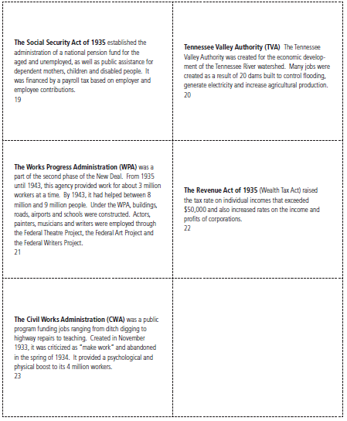
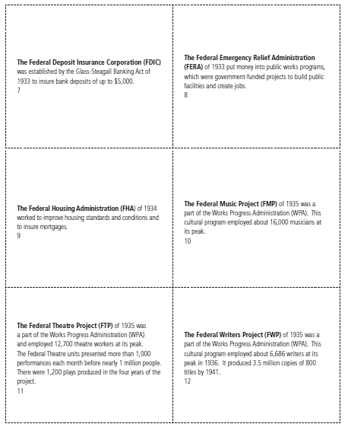
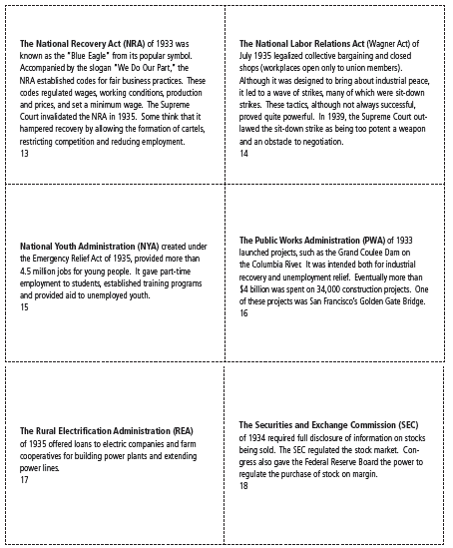
Alphabet Soup

Slide 27
Alphabet Soup
New Deal
Relief
Reform
Recovery
Combination

Slide 28
Lasting Recovery?

Slide 29
Assessment – A New Deal Box
Front of box:
Name and abbreviation of the program
Art relating to the program
Purpose of the New Deal program
Top of box:
Dates of program
Purpose of program (relief, reform, recovery)
Side panel one:
Following the “Nutrition Facts” format, create a “Program Effects on the Economy”
Biographical information about Franklin D. Roosevelt
Side panel two:
Description of the program in paragraph form
Description of end of program or its current-day status
Back panel:
Game, word search, puzzle or cartoon

Slide 31
Employment Act of 1946
It is the policy and responsibility of the federal government to use all practical means to promote maximum employment, production and purchasing power.
Three goals
Full employment
Price stability
Economic growth

Slide 32
Great Society
Aid to education
Funded students (instead of schools)
Medicaid and Medicare (1965)
Created a new entitlement in perpetuity
Immigration and Nationality Act of 1965
Abolished the national-origin quota system
Created family reunification policy

Slide 33
Full Employment and Balanced Growth Act The Humphrey-Hawkins Act (1978)
An Act to translate into practical reality the right of all Americans who are able, willing, and seeking to work to full opportunity for useful paid employment at fair rates of compensation;
to assert the responsibility of the Federal Government to use all practicable programs and policies to promote full employment, production, and real income, balanced growth, adequate productivity growth, proper attention to national priorities, and reasonable price stability;
to require the President each year to set forth explicit short-term and medium-term economic goals;
to achieve a better integration of general and structural economic policies;
and to improve the coordination of economic policymaking within the Federal Government.

Slide 34
Fiscal Responses to 2008 Recession
Emergency Economic Stabilization Act of 2008
American Recovery and Reinvestment Act of 2009
Established the Troubled Assets Relief Program (TARP)
Renewable energy and weatherize buildings
New infrastructure (roads, bridges, and mass transit)
Making Work Pay tax credit and Child Tax Credit
Fund Pell Grants

Slide 35
Two Types of Policies
Fiscal Policy
Monetary Policy
The use of spending and taxation by the federal government (Congress and the President) to affect economic activity
The actions of a central bank to affect the availability and cost of money and credit in order to achieve national economic goals

Slide 36
Questions?

