Slide 1
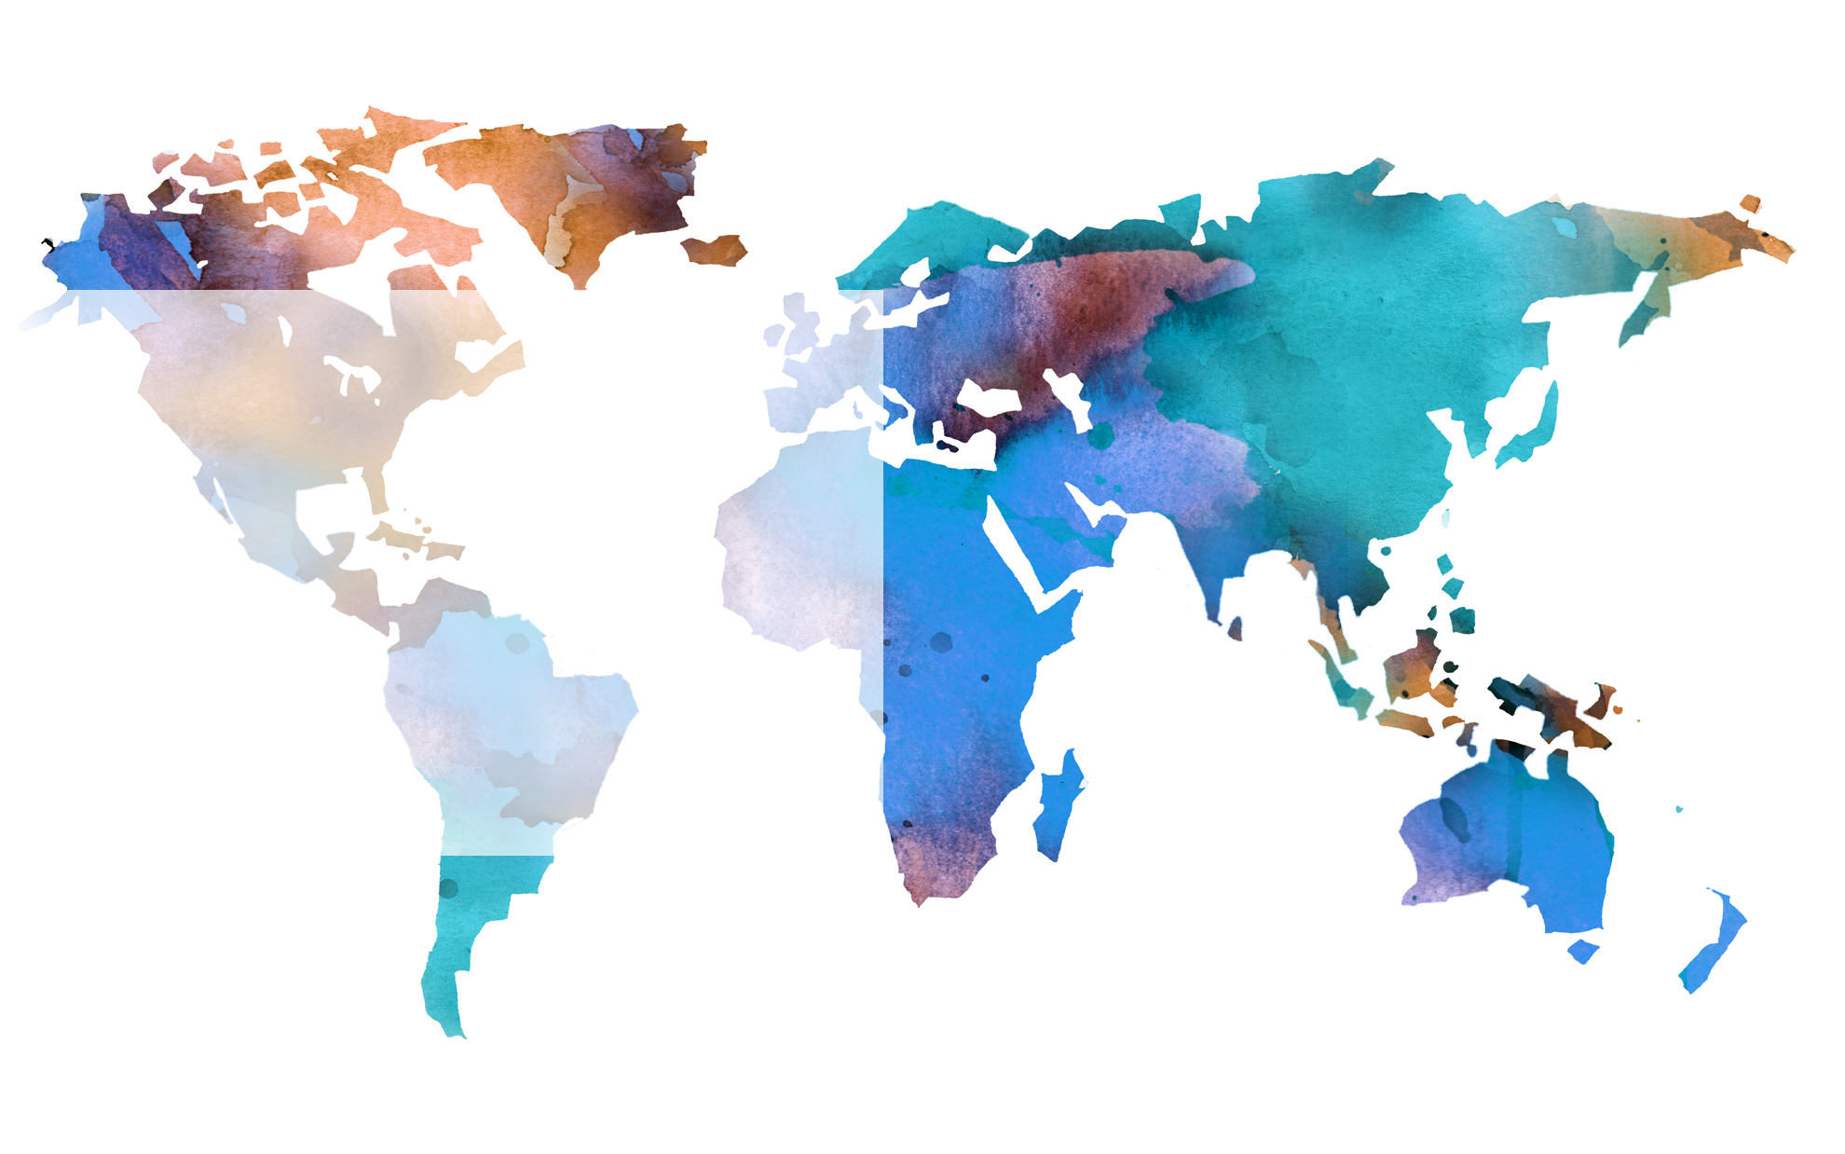
Poor, Poorer, Poorest
The opinions expressed are solely those of the presenters and do not reflect the opinions of the Federal Reserve Bank of Dallas or the Federal Reserve System.

Slide 2
Defining Poverty
Condition of having little or no money, goods or means of support
U.S. poverty threshold $18,106¹
2497.4 hours of work at minimum wage
312 full-time work days
1.Threshold from the Census Bureau 2011 Poverty Thresholds by Size of Family and Number of Children. Household has 2 adults, one under 18 dependent and a head of household under 65 years of age. http://www.census.gov/hhes/www/poverty/data/threshld/index.html

Slide 3
Poor: U.S. Poverty Statistics¹
In 2010
46.2 million people
15.1 percent of the population lived in poverty
16.4 million are under the age of 18
20.5 million lived at less than half their poverty level.
1.United States. Dept. of Commerce. Income, Poverty, and Health Insurance Coverage in the United States: 2010. Washington: GPO, 2011.

Slide 6
Near Poverty
In 2010,
Over 60 million Americans lived below 1.25 times their poverty threshold.
Over 75 million lived below 1.5 times their poverty threshold.

Slide 7
Living in Poverty (U.S.)
Spring of 2011,
21.8 million households, or 69.2 million adults lived in doubled-up households.
A family of four, living at the 2012 poverty line ($23,050) qualifies for a maximum home price of $61,327.
In San Antonio, that will gain you access to 15% of the housing stock.

Slide 8
Poor, but not impoverished
The current poverty thresholds do not adjust for rising levels and standards of living that have occurred since 1965¹.
Thresholds do not account for variation in cost of living.
1.Short, Kathleen. The Research Supplemental Poverty Measure:2010. Washington: GPO, 2011.

Slide 9
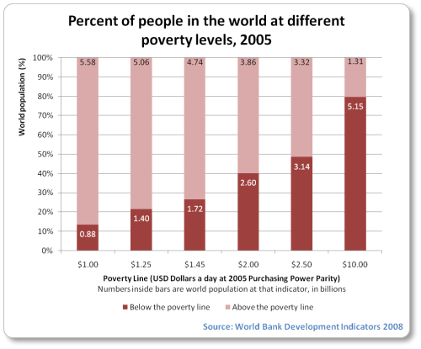
U.S. Minimum Wage is Not Globally Poor
5.15 billion people live on less than $10 per day.

Slide 10
Poorer: Two Dollars a Day
Median poverty line in the developing world.
Adjusted for purchasing power parity.
2.6 billion people

Slide 11
What is Purchasing Power Parity?
Is an implicit exchange rate.
How much money is necessary to purchase the same goods and services in different countries.
A person living on “Two dollars a day” in different countries will be able to purchase the same amount of goods and services.

Slide 12
Access to Basic Needs
More than two-thirds of people without clean water live on less than $2 dollars a day.
2.4 billion people worldwide do not have access to adequate sanitation.

Slide 13
Living on Two Dollars a Day
What would you eat on two dollars a day in the U.S.?
Two double cheeseburgers a day (880 calories).
3.4 lbs. of rice(5,598 calories)¹
After food, what would you have left?
1. Based on advertised price at Wal-Mart of $11.86 for 20 lbs.

Slide 14
A Developing World Problem?
1.46 million Americans live on less than two dollars a day.¹
Even accounting for food assistance programs 795 thousand Americans live on less than two dollars a day
1. Shaefer, H. Luke and Kathryn Edin. Extreme Poverty in the United States, 1996 to 2011,National Poverty Center Policy Brief #28

Slide 15
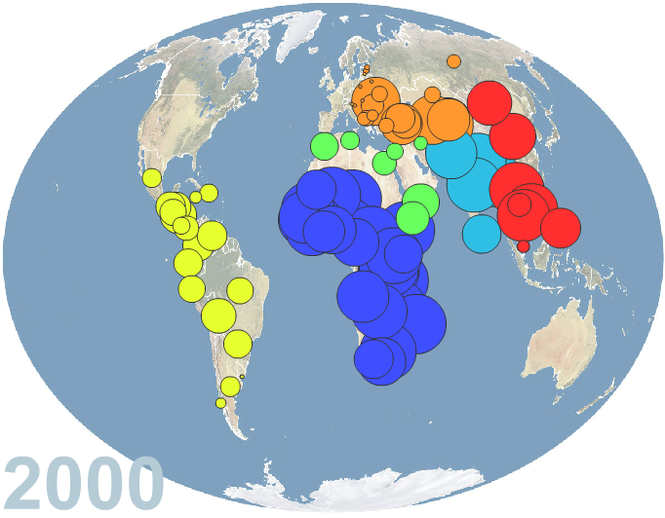
Geographic Breakdown¹
1. Map created at www.gapminder.com. Circles represent the percent of a country’s population living on less than $2 a day.

Slide 16
Poorest: Less than $1.25 a day
1.29 billion people
Roughly 22 percent of the developing world
Adjusted for purchasing power parity.

Slide 17
Access to Basic Needs
One third of all people who do not have access to clean water live on less than $1.25 a day.

Slide 18
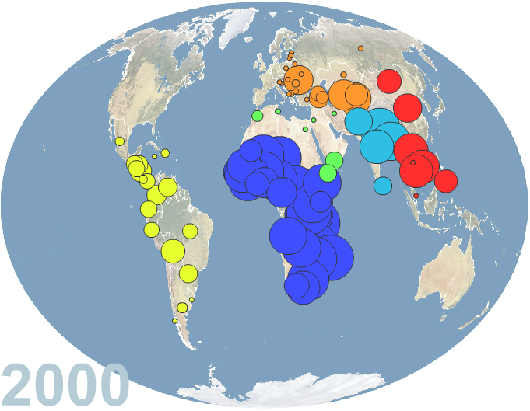
Geographic Breakdown¹
1. Map created at www.gapminder.com. Circles represent the percent of a country’s population living on less than $2 a day.

Slide 19
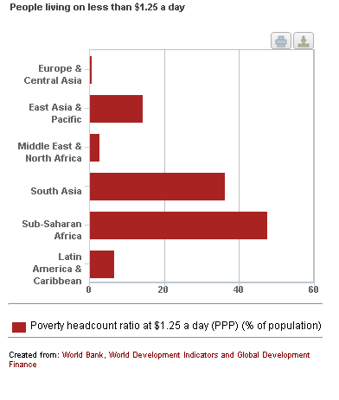
Regional Percentages of Extreme Poverty
Notes:
East Asia and the Pacific: About 14 percent of its population lived below US$1.25 a day in 2008, down from 77 percent in 1981, when it was the region with the highest poverty rate in the world. In China, 13 percent, or 173 million people, lived below $1.25 a day in 2008. East Asia achieved MDG1 about 10 years ago.
In the developing world outside China, the extreme-poverty rate was 25 percent in 2008, down from 41 percent in 1981. The number of people living in extreme poverty, however, was about the same in 2008 as 1981 at around 1.1 billion, after rising in the 1980s and 1990s and falling since 1999.
South Asia: The $1.25 a day poverty rate fell from 61 percent to 39 percent between 1981 and 2005 and fell a further 3 percentage points between 2005 and 2008. The proportion of the population living in extreme poverty is now the lowest since 1981.
Latin America and the Caribbean: From a peak of 14 percent living below $1.25 a day in 1984, the poverty rate reached its lowest value so far of 6.5 percent in 2008. The number of the poor rose until 2002 and has been falling sharply since.
Middle East and North Africa: The region had 8.6 million people—or 2.7 percent of the population—living on less than $1.25 a day in 2008, down from 10.5 million in 2005 and 16.5 million in 1981.
Eastern Europe and Central Asia: The proportion living on less than $1.25 is now under 0.5 percent, having peaked at 3.8 percent in 1999. 2.2 percent lived on less than $2 a day in 2008, down from a peak of 12 percent in 1999.
Sub-Saharan Africa: For the first time since 1981, less than half of its population (47 percent) lived below $1.25 a day. The rate was 51 percent in 1981. The $1.25-a-day poverty rate in SSA has fallen 10 percentage points since 1999. 9 million fewer people living below $1.25 a day in 2008 than 2005.

Slide 20
Progress in Asia
East Asia and the Pacific
1981- 77 percent below $1.25 a day
2008 – 14 percent below $1.25 a day
South Asia
1981 – 61 percent below $1.25 a day
2008 – 36 percent below $1.25 a day

Slide 21
Little Progress in Sub-Saharan Africa
1981 – 51 percent under $1.25 per day
2008 – 47 percent under $1.25 per day

Slide 22
Should the U.S. Give Aid?
Is it helping?
Is it hurting?
In what form should aid be given?

Slide 23
Some Aid Terminology
Official Development Assistance (ODA): Public Sector Aid
Private Development Assistance: Private Sector Aid
Public-Private Partnerships (PPPs): ODA and Private and Philanthropic Leadership

Slide 24
More Aid Terminology
Unilateral Aid: Given by one country to another.
Multilateral Aid: Aid delivered by an international organization.

Slide 25
Should the U.S. Aid? Yes
Many economists believe there is a framework of aid that may be valuable to the developing world.
They differ on the structure, planners and recipients.

Slide 26
Sachs on Aid: We must do more
The West has committed hundreds of billions of dollars to aid and has not delivered.
This aid is necessary to help the poorest countries even begin the ascent out of poverty.
One such undelivered promise is the Millennium Development Goals.

Slide 27
Sachs on Aid, cont.
Does not believe that corruption and mismanagement is to blame for lingering poverty.
Does admit that corruption and lawlessness will destroy an economy.
Has addressed both top-down and bottom-up approaches, in both cases, believes significant coordination of large scale aid is required.

Slide 28
Easterly on Aid: Fund Individuals
Aid has failed because of corruption and paternalistic delusion.
Top-down goals, like the Millennium Development Goals are doomed.
We should fund non-profits, shift to smaller, incremental projects, and hold the providers responsible.

Slide 29
Easterly on Aid, cont.
Badly governed countries are poor.
Top 15 aid recipients in 2002 all have governments ranked in the bottom quartile.
Aid has tried and failed to change the quality of government.
More aid has tried and failed more.

Slide 30
Common critique of Sachs and Easterly
Both acknowledge the role of well defined and protected private property, but both undersell the impact.
Neither are looking at the incentives of recipient governments or individuals as the driving force behind outcomes.

Slide 31
Support of the Critics
China, the strongest success story in recent history, focused on bolstering entrepreneurship and fostering business investment.

Slide 32
Banerjee and Duflo
Aid should not seek to change the condition of the poor through large scale projects.
Small projects should seek to marginally, but efficiently, improve the lives of the poor.
Small projects should be evaluated quantitatively.

Slide 33
Familiar Methodology, Novel Application
Random Control Trials (RCTs) are familiar to the pharmaceutical industry.
Some people receive the drug, some the placebo, observe outcomes for trends.
This methodology was used to answer small questions about aid projects.

Slide 34
Using the Trials to Direct Action
Based on the results of RCTs, small policy decisions can be made to maximize the impact per dollar spent.
The goal is to allow impartial data, not preconceived notions to dictate action.

Slide 35
An Example of RCTs
If the goal is to increase school attainment we could offer
Extra Teachers
Free Meals
Deworming
Information of Returns

Slide 36
The Results of the RCT
Extra years of schooling per $100
Extra Teachers 1.7 years
Free Meals 2.8 years
Deworming 28.6 years
Information of Returns 40.0 years

Slide 37
Critiques of Banerjee and Duflo
Can’t answer big questions.
Only improve life of poor at the margin.
Ethical Concerns?

Slide 38
Should the U.S. Aid? No
George B.N. Ayittey
Africa has the resources to become self-sustaining.
The problem is reliance on Western Aid.
Corruption has squandered, in some cases all of the aid given to African countries

Slide 39
Should the U.S. Aid? No
Countries who have seen significant progress against extreme poverty have not been the large aid recipients.
Free markets and private property protection are the most important aspects of ascent from poverty.

Slide 40
Summary
Many economists believe there is economic value to recipients of aid.
There is substantial disagreement to the type and structure of aid.
There are some who say the condition of certain nations make aid useless.
The most successful stories of poverty reduction are about countries that have focused on entrepreneurship and private property protection.

