Slide 1
The Federal Reserve and You
The opinions expressed are solely those of the presenters and do not reflect the opinions of the Federal Reserve Bank of Dallas or the Federal Reserve System.

Slide 2
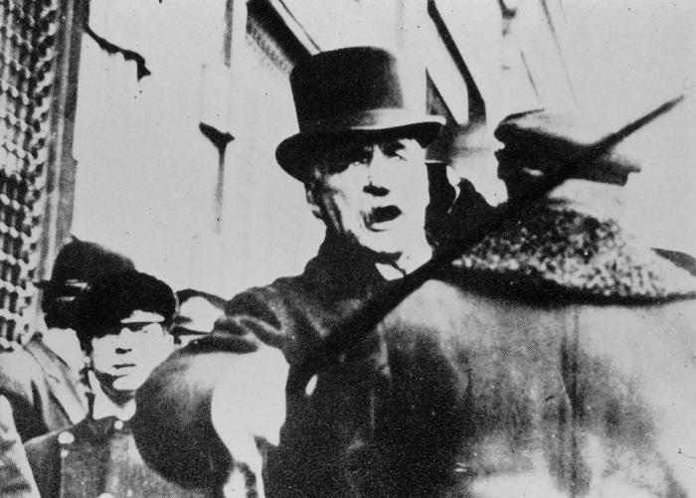
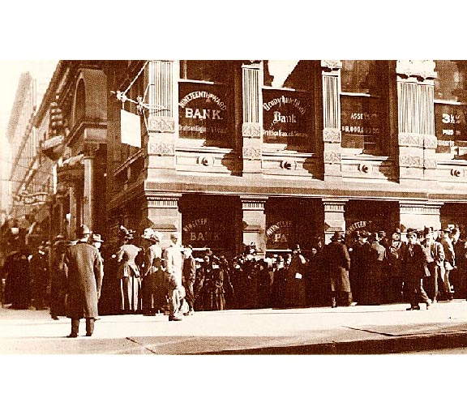
A History of Financial Panics
Financial panics are a part of United States history
The Panic of 1907
  Jolted Wall Street
  Highlighted need for financial reform

Slide 3

The Federal Reserve Act
An act to provide for the establishment of Federal Reserve Banks, to furnish an elastic currency, to afford means of rediscounting commercial paper, to establish a more effective supervision of banking in the United States, and for other purposes.
Preamble
Federal Reserve Act of 1913

Slide 4
The Critical Balance
Public versus Private
National versus Regional

Slide 5
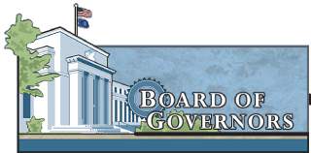

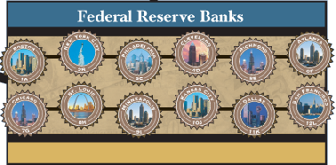
The Structure of the Fed

Slide 6
Structure of the Fed: The Board of Governors

Slide 7
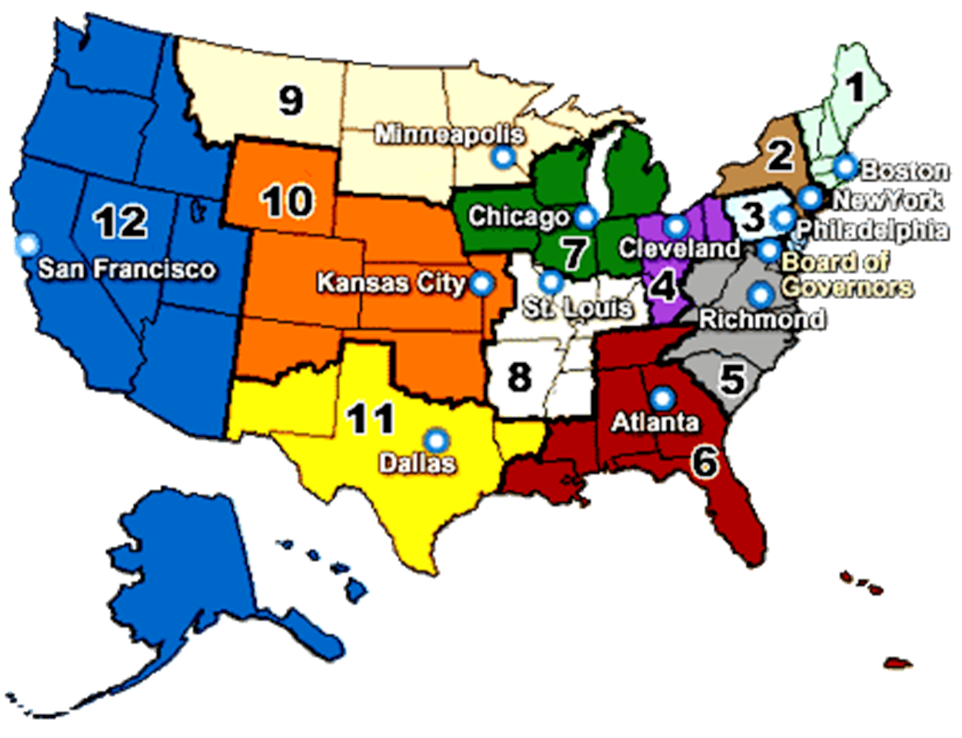
The Structure of the Fed: 12 Regional Banks

Slide 8
The Structure of the Fed: The FOMC

Slide 9

The FOMC and Monetary Policy
Set target fed funds rate
Take into account input from the Board and Reserve Banks to determine economic conditions
Conduct open market operations

Slide 10
Dual Mandate of Monetary Policy
Stable Prices
Maximum Employment

Slide 11
Inflation
General rise in prices over time
Spending
Inflationary pressure
Prices
Fed Funds Target

Slide 12
Employment
Employment
Fed Funds Target
Employment
Spending

Slide 13
Other Tools of Monetary Policy
Reserve requirements
Discount rate

Slide 14
Monetary vs. Fiscal Policy
Monetary Policy
  Conducted by the Fed
  Three main tools
Fiscal Policy
  Congress
  Taxation and spending

Slide 15
Purpose of the Fed
Conducting Monetary Policy
Supervision and Regulation

Slide 16
Regulations
Written rules
Written in response to legislation under the direction of Congress
Notes:
.

Slide 17
Supervision
The enforcement of regulations

Slide 18
Existing Regulation of Banks and Their Holding Companies
Federal
Comptroller
Federal
State
Securities
Department
Reserve
of the
Deposit
Bank
and
of
Board
Currency
Insurance
Departments
Exchange
Justice
Corporation
Commission
State
State
National
Holding
Member
Holding
Non-
Holding
Bank
Company
Bank
Company
Member
Company
Bank

Slide 19
Purpose of the Fed
Conducting Monetary Policy
Supervision and Regulation
Provide Financial Services

Slide 20
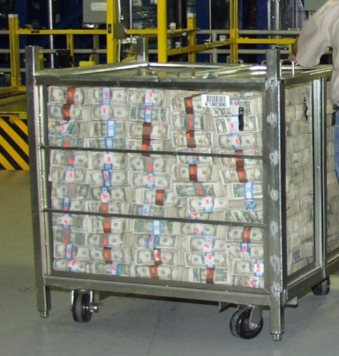
Providing Financial Services
Bankers’ Bank
  Cash Services
  Check Processing
  Electronic Payments

Slide 21
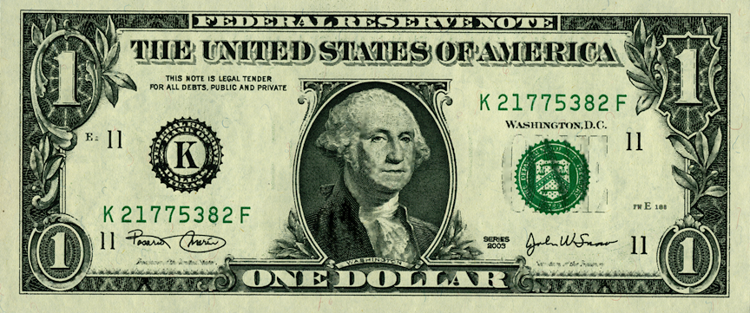
Eleventh District Note

Slide 22
Eleventh District Note

Slide 23
Printed in Fort Worth (BEP)

Slide 24
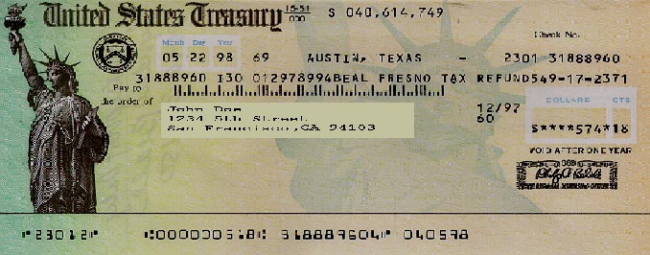
Providing Financial Services
United States Government’s Bank

Slide 25
Summary
The Federal Reserve System is a three-part system.
  The Board of Governors
  The Reserve Banks
  The Federal Open Market Committee
The Federal Reserve System has three main purposes.
  Monetary policy
  Supervision and regulation
  Financial services

