Slide 1
Why Trade?
Disclaimer: The views expressed are those of the presenters and do not necessarily reflect those of the Federal Reserve Bank of Dallas or the Federal Reserve System.

Slide 2
Gains from Trade
Distribute bags and rate satisfaction
Divide into groups of three, trade and rate satisfaction after trade
Trade with everyone in the room and rate satisfaction after trade

Slide 3
Two Concepts
Trade
  Occurs when parties expect to gain
  Trade among individuals or organizations within a nation or in different nations
Specialization
  Producers specialize in what they can produce at the lowest cost
  Necessitates trade
  Production and (total) consumption increase
Notes:
Related concepts: Barriers to Trade, Barter, Exports, Imports, Voluntary Exchange, Exchange, Exchange Rate

Slide 4
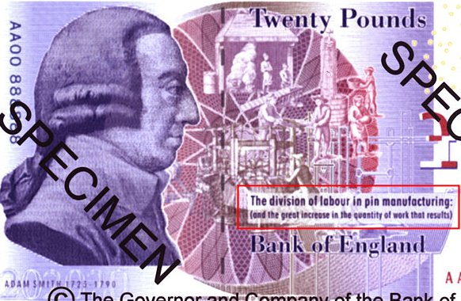
Specialization and Trade
Notes:
New-style £20 issued on 13 March 2007

Slide 5
Absolute Advantage
“The natural advantages which one country has over another in producing particular commodities are sometimes so great that it is acknowledged by all the world to be in vain to struggle with them.”
Adam Smith in Wealth of Nations
Book IV, Chapter 2

Slide 6
Comparative Advantage
David Ricardo showed that nations could benefit from trade even without an absolute advantage.
Comparative advantage refers to a country’s ability to produce a good at a lower opportunity cost than another country.

Slide 7
Opportunity Costs
An economic way of thinking…
  Costs are not monetary
  The cost of getting something is really the value of the next best alternative that is not chosen
Think about the choices you make
  Nap or workout on Sunday afternoon
  Beach or mountains or city for vacation

Slide 8
Differing Opportunity Costs
Investments in technology
Relative supply of key inputs
  Land (natural resources)
  Labor (both skilled and unskilled)
  Capital
Government services and regulations

Slide 9
Imagine two islands…
Both produce fish and coconuts
  Fishing requires boats (capital) and labor
  Coconut harvest requires trees (land) and labor
Different amounts of resources
  One island has many trees and few boats
  Other island has many boats, but few trees

Slide 10
Coconut Island
Resources – lots of coconut trees and only a few boats
Coconut Industry – thriving coconut harvests with lots of competition
Fishing Industry – very little fishing and almost no competition
Food supply – abundant coconuts and scarce fish
Consumers – cheap coconuts and expensive fish

Slide 11
Fish Island
Resources – lots of boat and only a few trees
Coconut Industry – small harvests and no competition
Fishing Industry – abundant catches and intense competition
Food supply – abundant fish and scarce coconuts
Consumers – cheap fish and expensive coconuts

Slide 12
New connections
Innovation
Trade
Prices equalize

Slide 13
The Impact of Trade
Who cares about the price of coconuts?
  People who eat coconuts
  People who own trees (land)
  People who climb trees (labor)
Who cares about the price of fish?
  People who eat fish
  People who own boats (capital)
  People who sail and fish (labor)
Notes:
As price of coconuts falls, land owners and labor in that industry are harmed.
As the price of fish rises, boat owners and crew benefit.

Slide 14
Who Could Object?
Domestic Price > World Price
Country imports → domestic price falls
Domestic consumers benefit.
Domestic producers are harmed.

Slide 15
Who Could Object?
Domestic Price < World Price
Country exports → domestic price rises
Domestic producers benefit.
Domestic consumers are harmed.

Slide 16
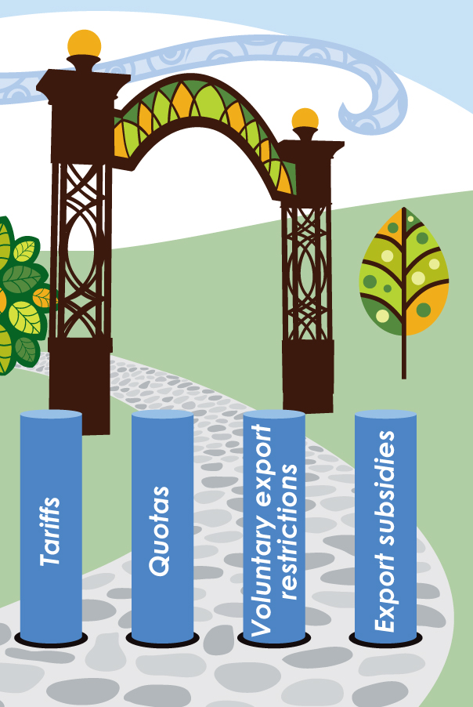
Barriers to Trade
Notes:
Tariffs – taxes on imports
Quotas – limits on the quantity of imports
Voluntary Export Restrictions – a self-imposed limit on the quantity of exports
Export Subsidies – government payments to producers of goods for export

Slide 17
Tariff
Tax on imported goods or services
Reasons for tariffs
  Raise tax revenues
  Reduce consumption of the imported good or service
Effect – Price of import rises, “cheaper” domestic goods become more attractive

Slide 18
Percent of Federal Budget from Tariffs

Slide 19
Percent of Federal Budget from Tariffs

Slide 20
Types of Federal Revenue as a percentage of total receipts

Slide 21
Alexander Hamilton
Proposed extensive tariffs to provide revenue and protect American manufacturers (rooted in mercantilism)
Three tariff acts
  1789
  1790
  1792

Slide 22
Andrew Jackson
Tariff Act of 1828 (Tariff of Abominations)
Nullification Crisis

Slide 23
Progressive Ideal
Replace tariffs with income tax
1913 – watershed year
  Underwood Tariff Act lowered tariffs
  Federal income tax created

Slide 24
Ongoing
Fordney—McUmber Tariff (1922)
Smoot—Hawley (1933)

Slide 25
Quota
Limits the amount of an imported good allowed into the country
Supply is decreased and price increases
Voluntary Export Restrictions (VER’s) are similar

Slide 26
Export Subsidy
Government financial assistance to a firm that allows a firm to sell its product at a reduced price
Benefits and harms
  Consumers (both at home and abroad) benefit from lower prices
  Foreign producers are harmed because of lower world prices
  Taxpayers in the producing country pay the subsidy

Slide 27
Product Standards
A type of “hidden” trade barrier
Types of standards
  Product safety
  Content
  Packaging

Slide 28
Questions?

